Slide 1
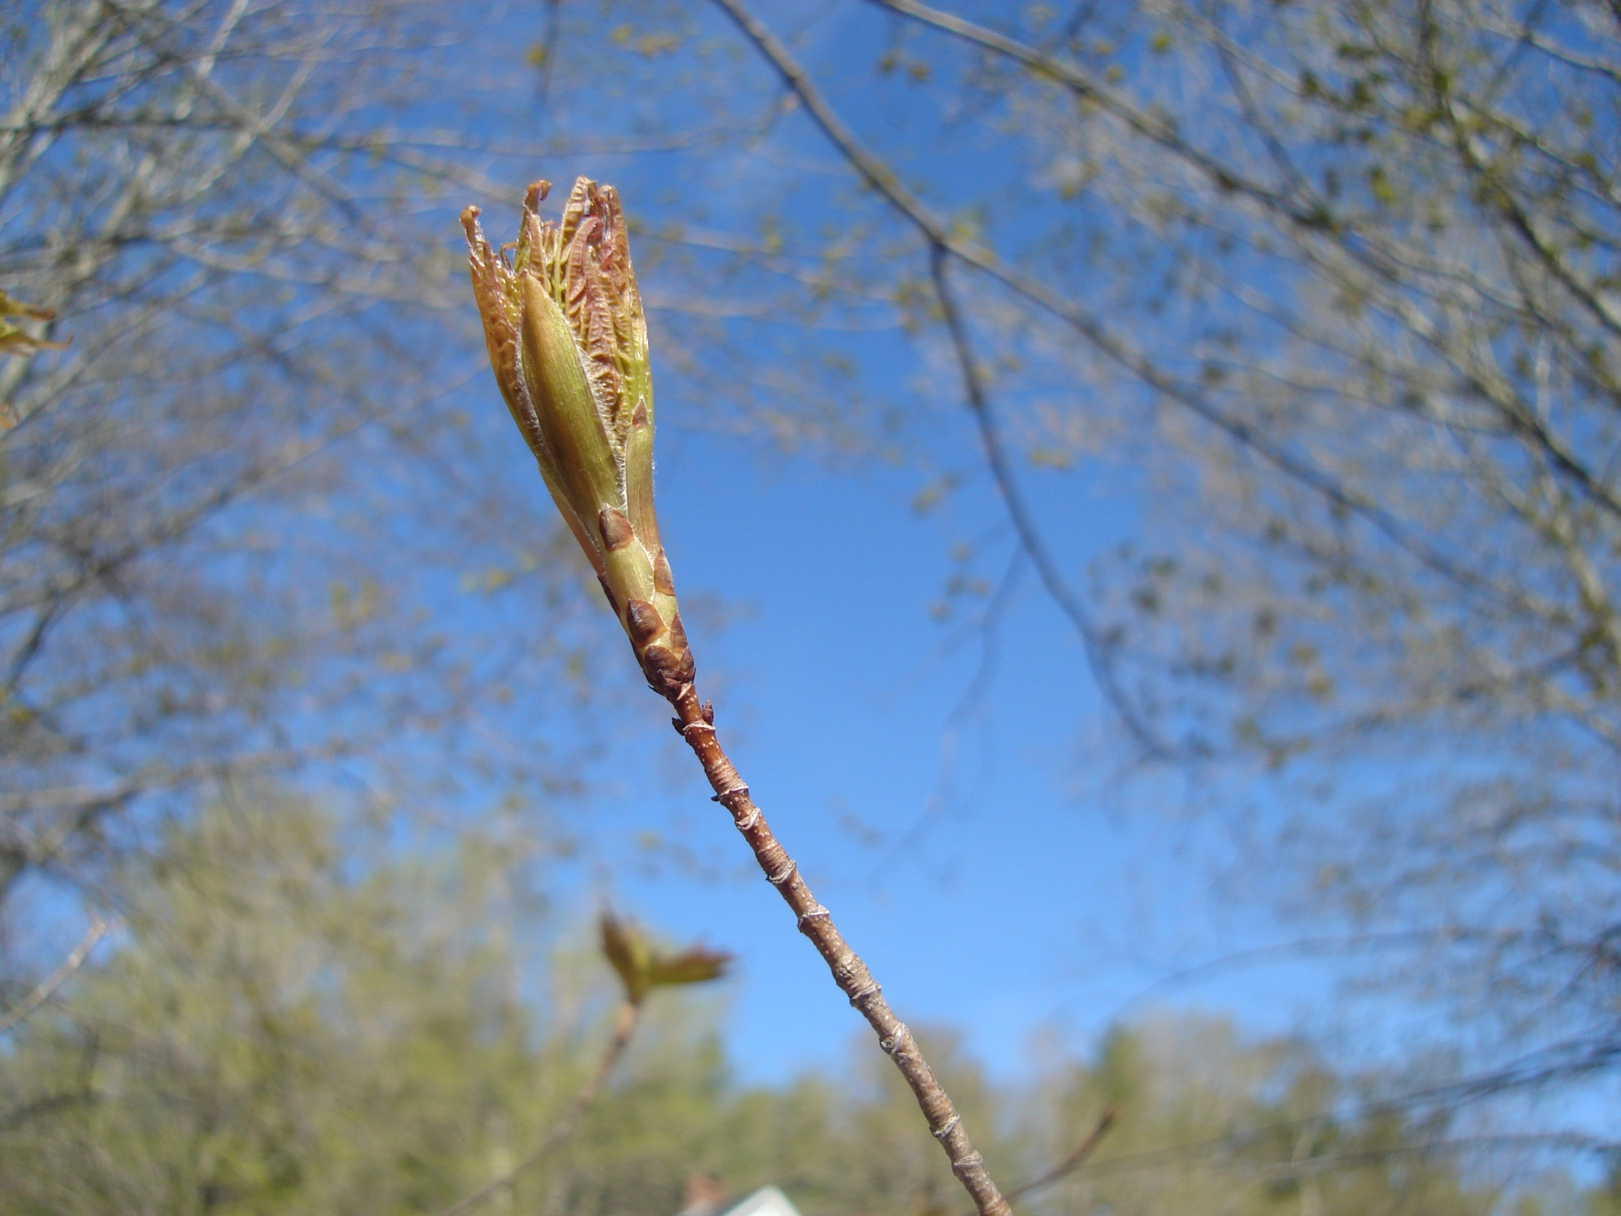
What’s in A Bud?
Monitoring Forest Health 782-882
By Martha Carlson
PhD student, UNH
2011

Slide 2
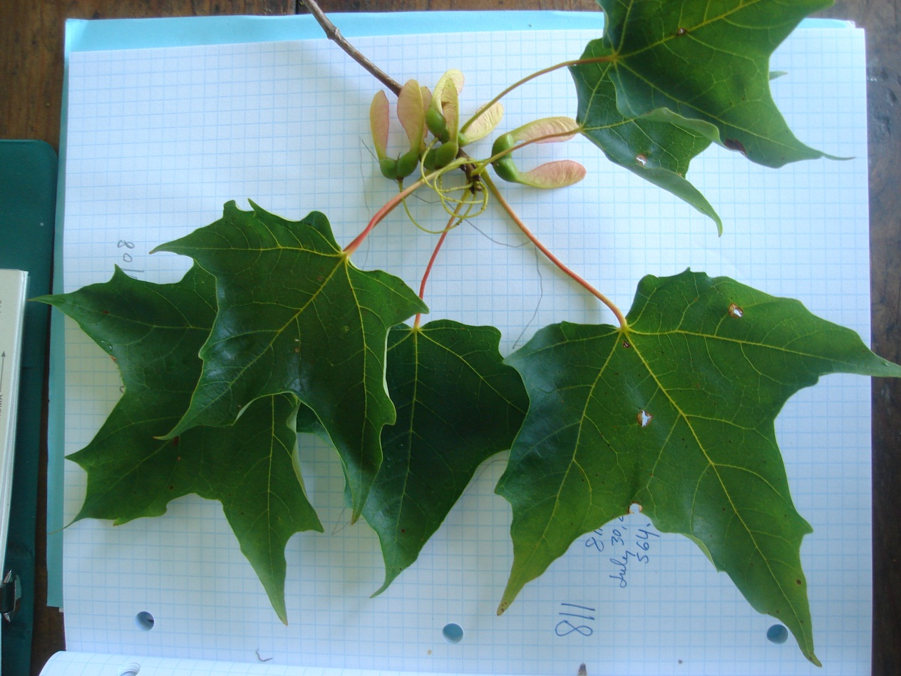
Six Leaves Came from One Bud!
Sugar maple trees produce six leaves from every bud. Each bud is formed in the prior growing season—beginning in May! In early spring it is only 6 to 10 mm long.

Slide 3
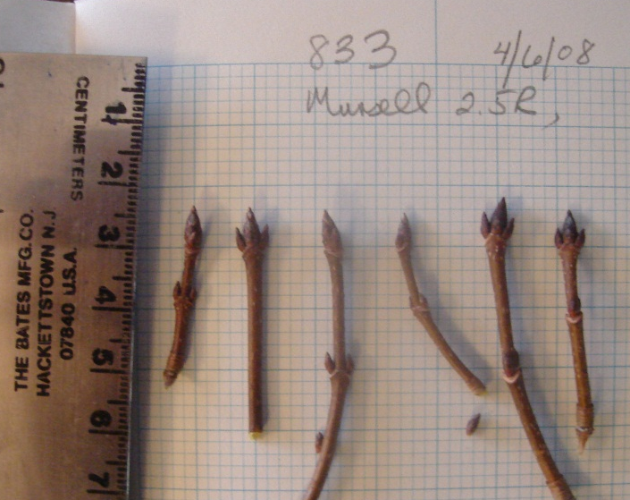
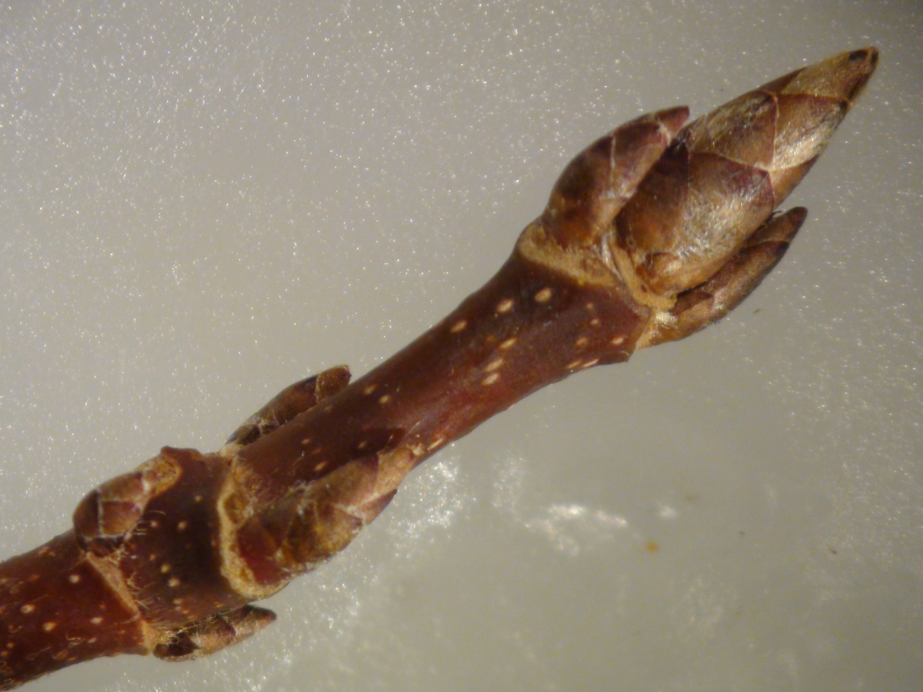
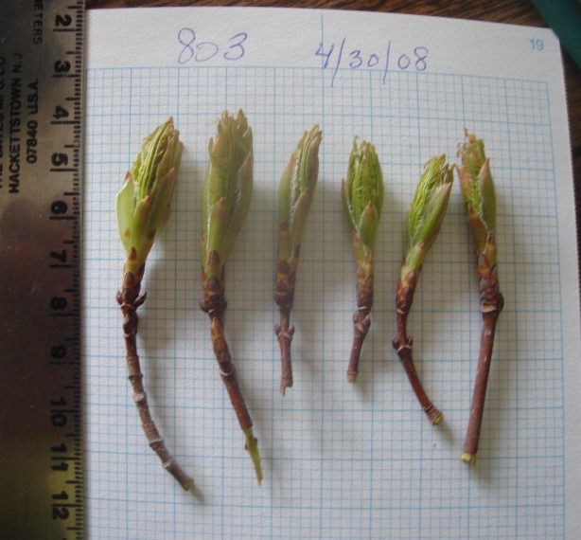
Buds Swell after Sap Season
Only when sap stops flowing in March or April do the buds begin to swell.
Let’s examine what’s in a 6 mm bud. The UNH scanning electron microscope allows us to magnify the bud 20 to 570 times what we see with our eyes.
One bud forms at the base of each leaf petiole. A 7th bud forms at the twig apex between the two distal leaves. 6 leaves 7 buds and
7 buds 42 leaves.

Slide 4
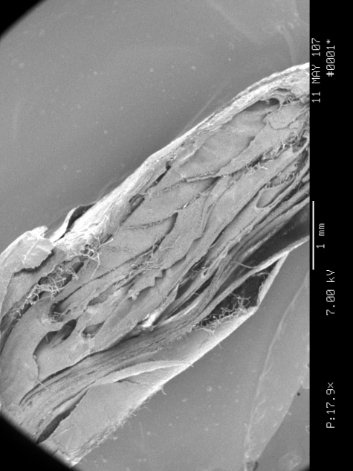
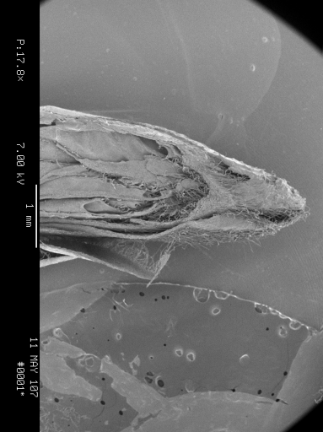
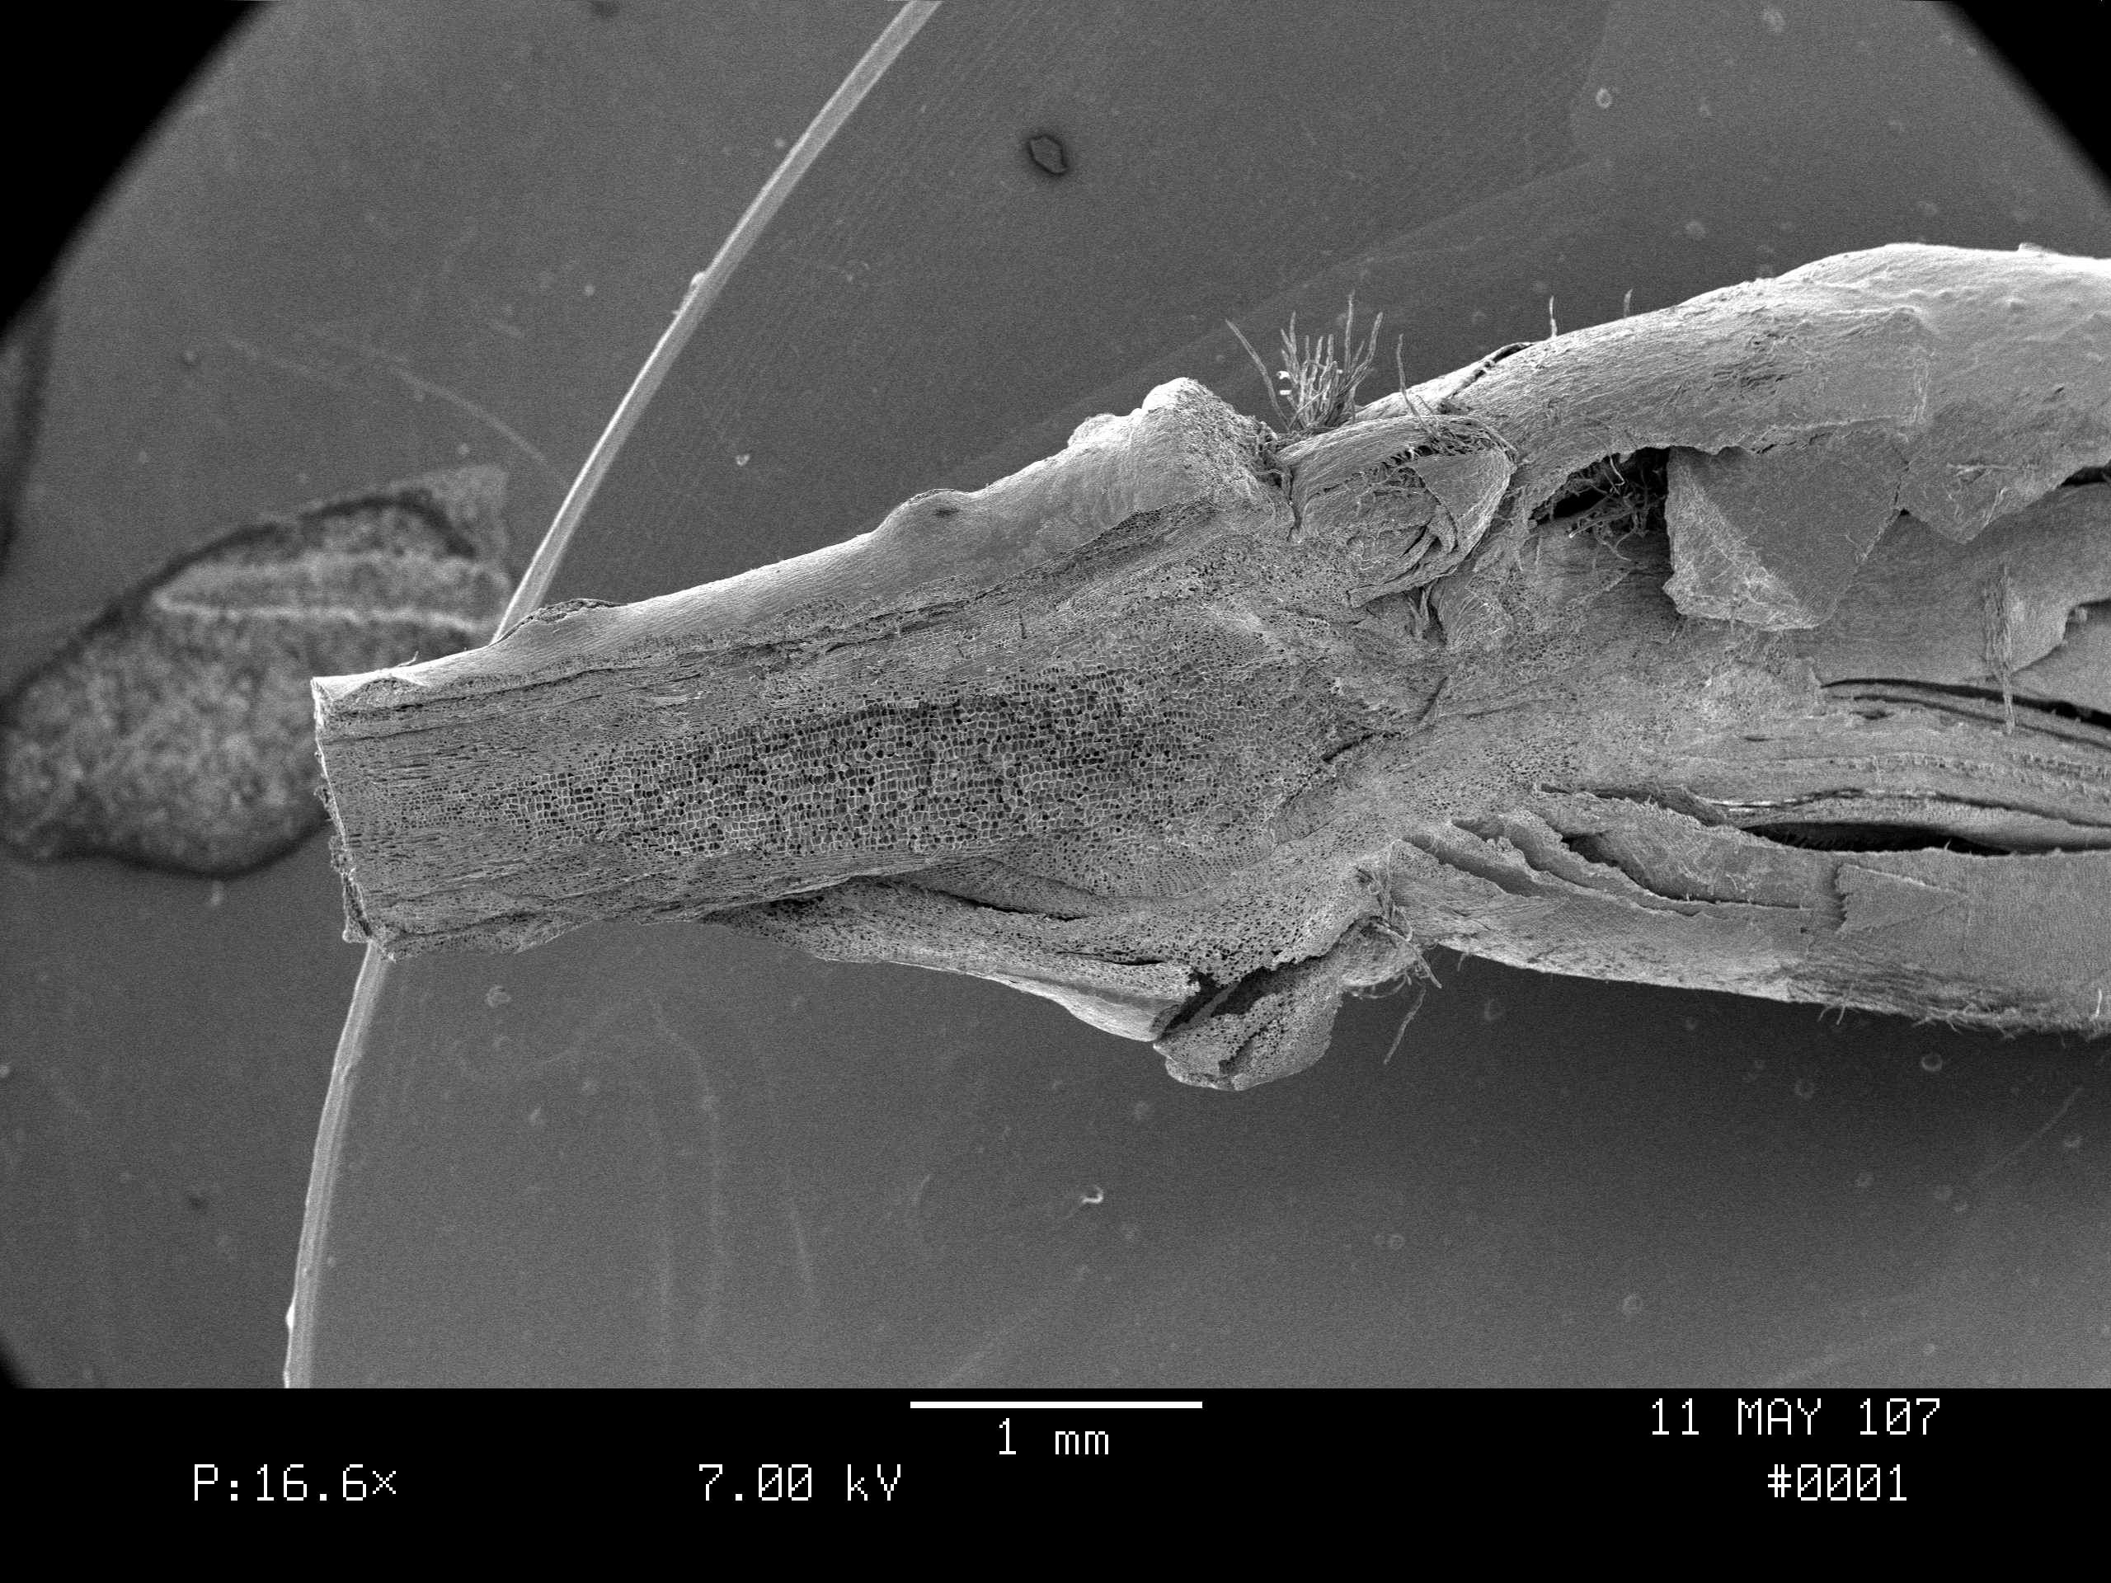
These three photographs show the entire bud. The parts of this bud will be identified with a numbering system that will follow various parts into higher magnifications.
3 Photos Show the
Whole Bud Sliced
Longitudinally
4
3
2
6
Here, one can see the following parts:
1 Ground meristem
2 Lateral bud or Bud primordium
3 Apical meristem
4 Leaf primordium or Plumule
5 Procambium
6 Bud scale or Protoderm
5
1

Slide 5
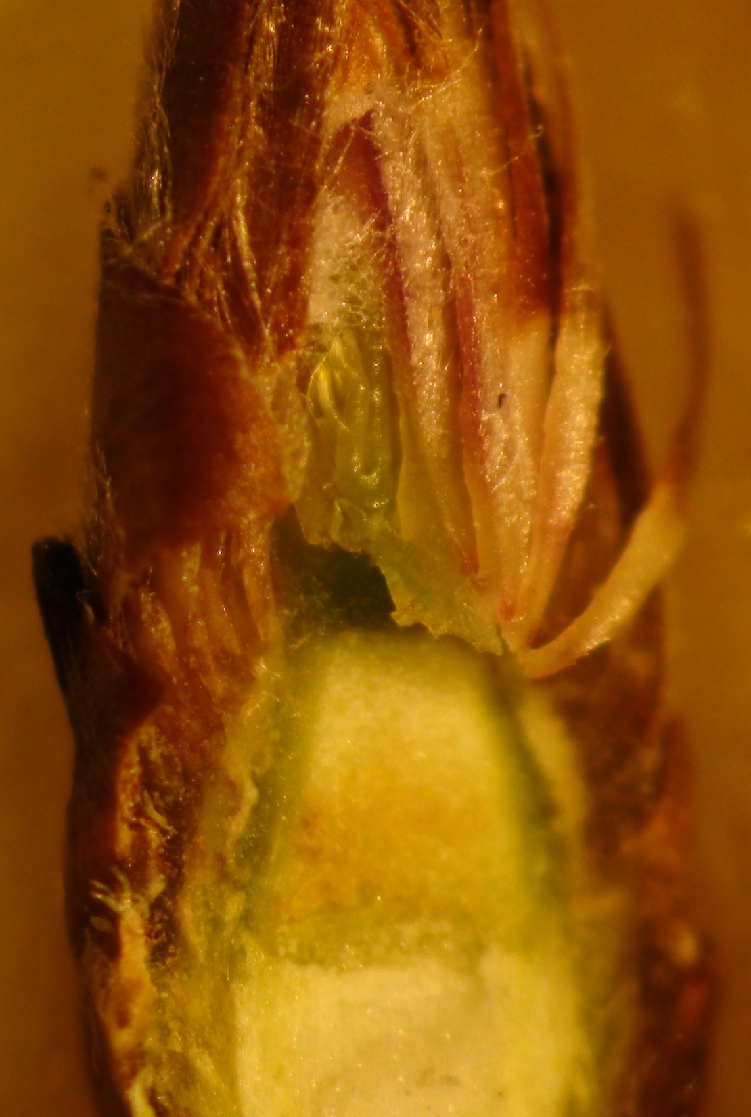
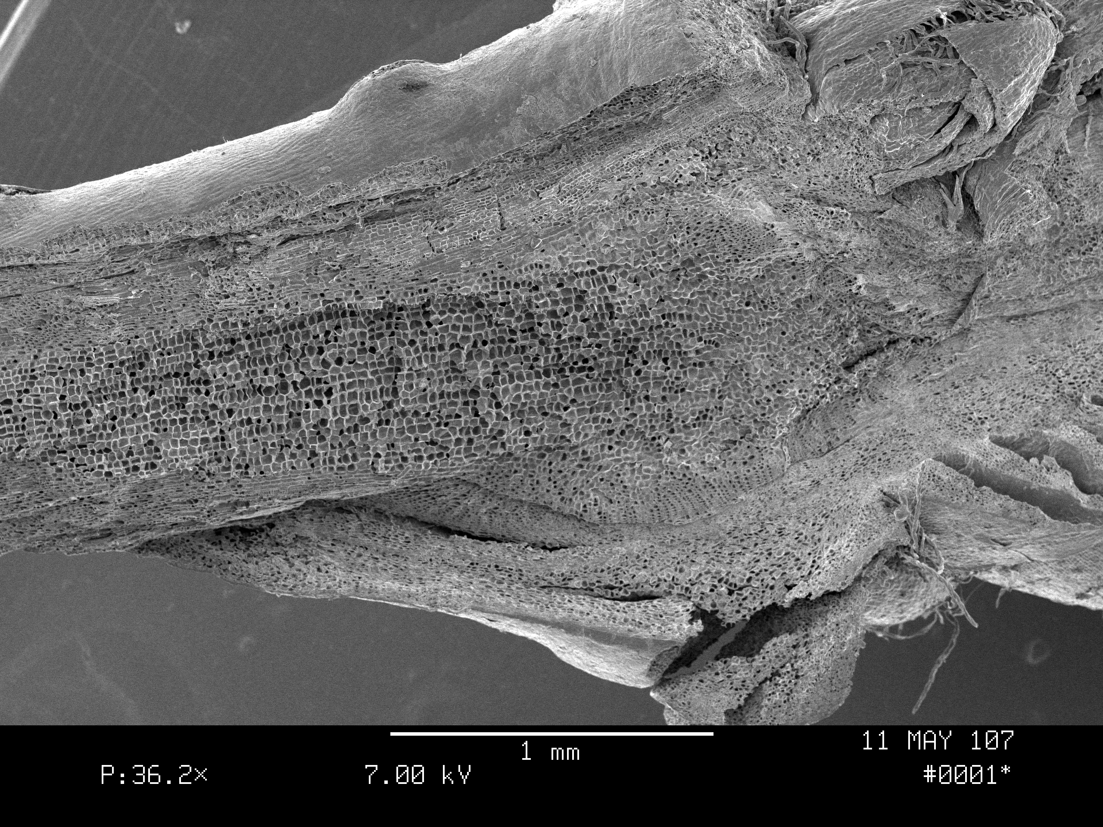
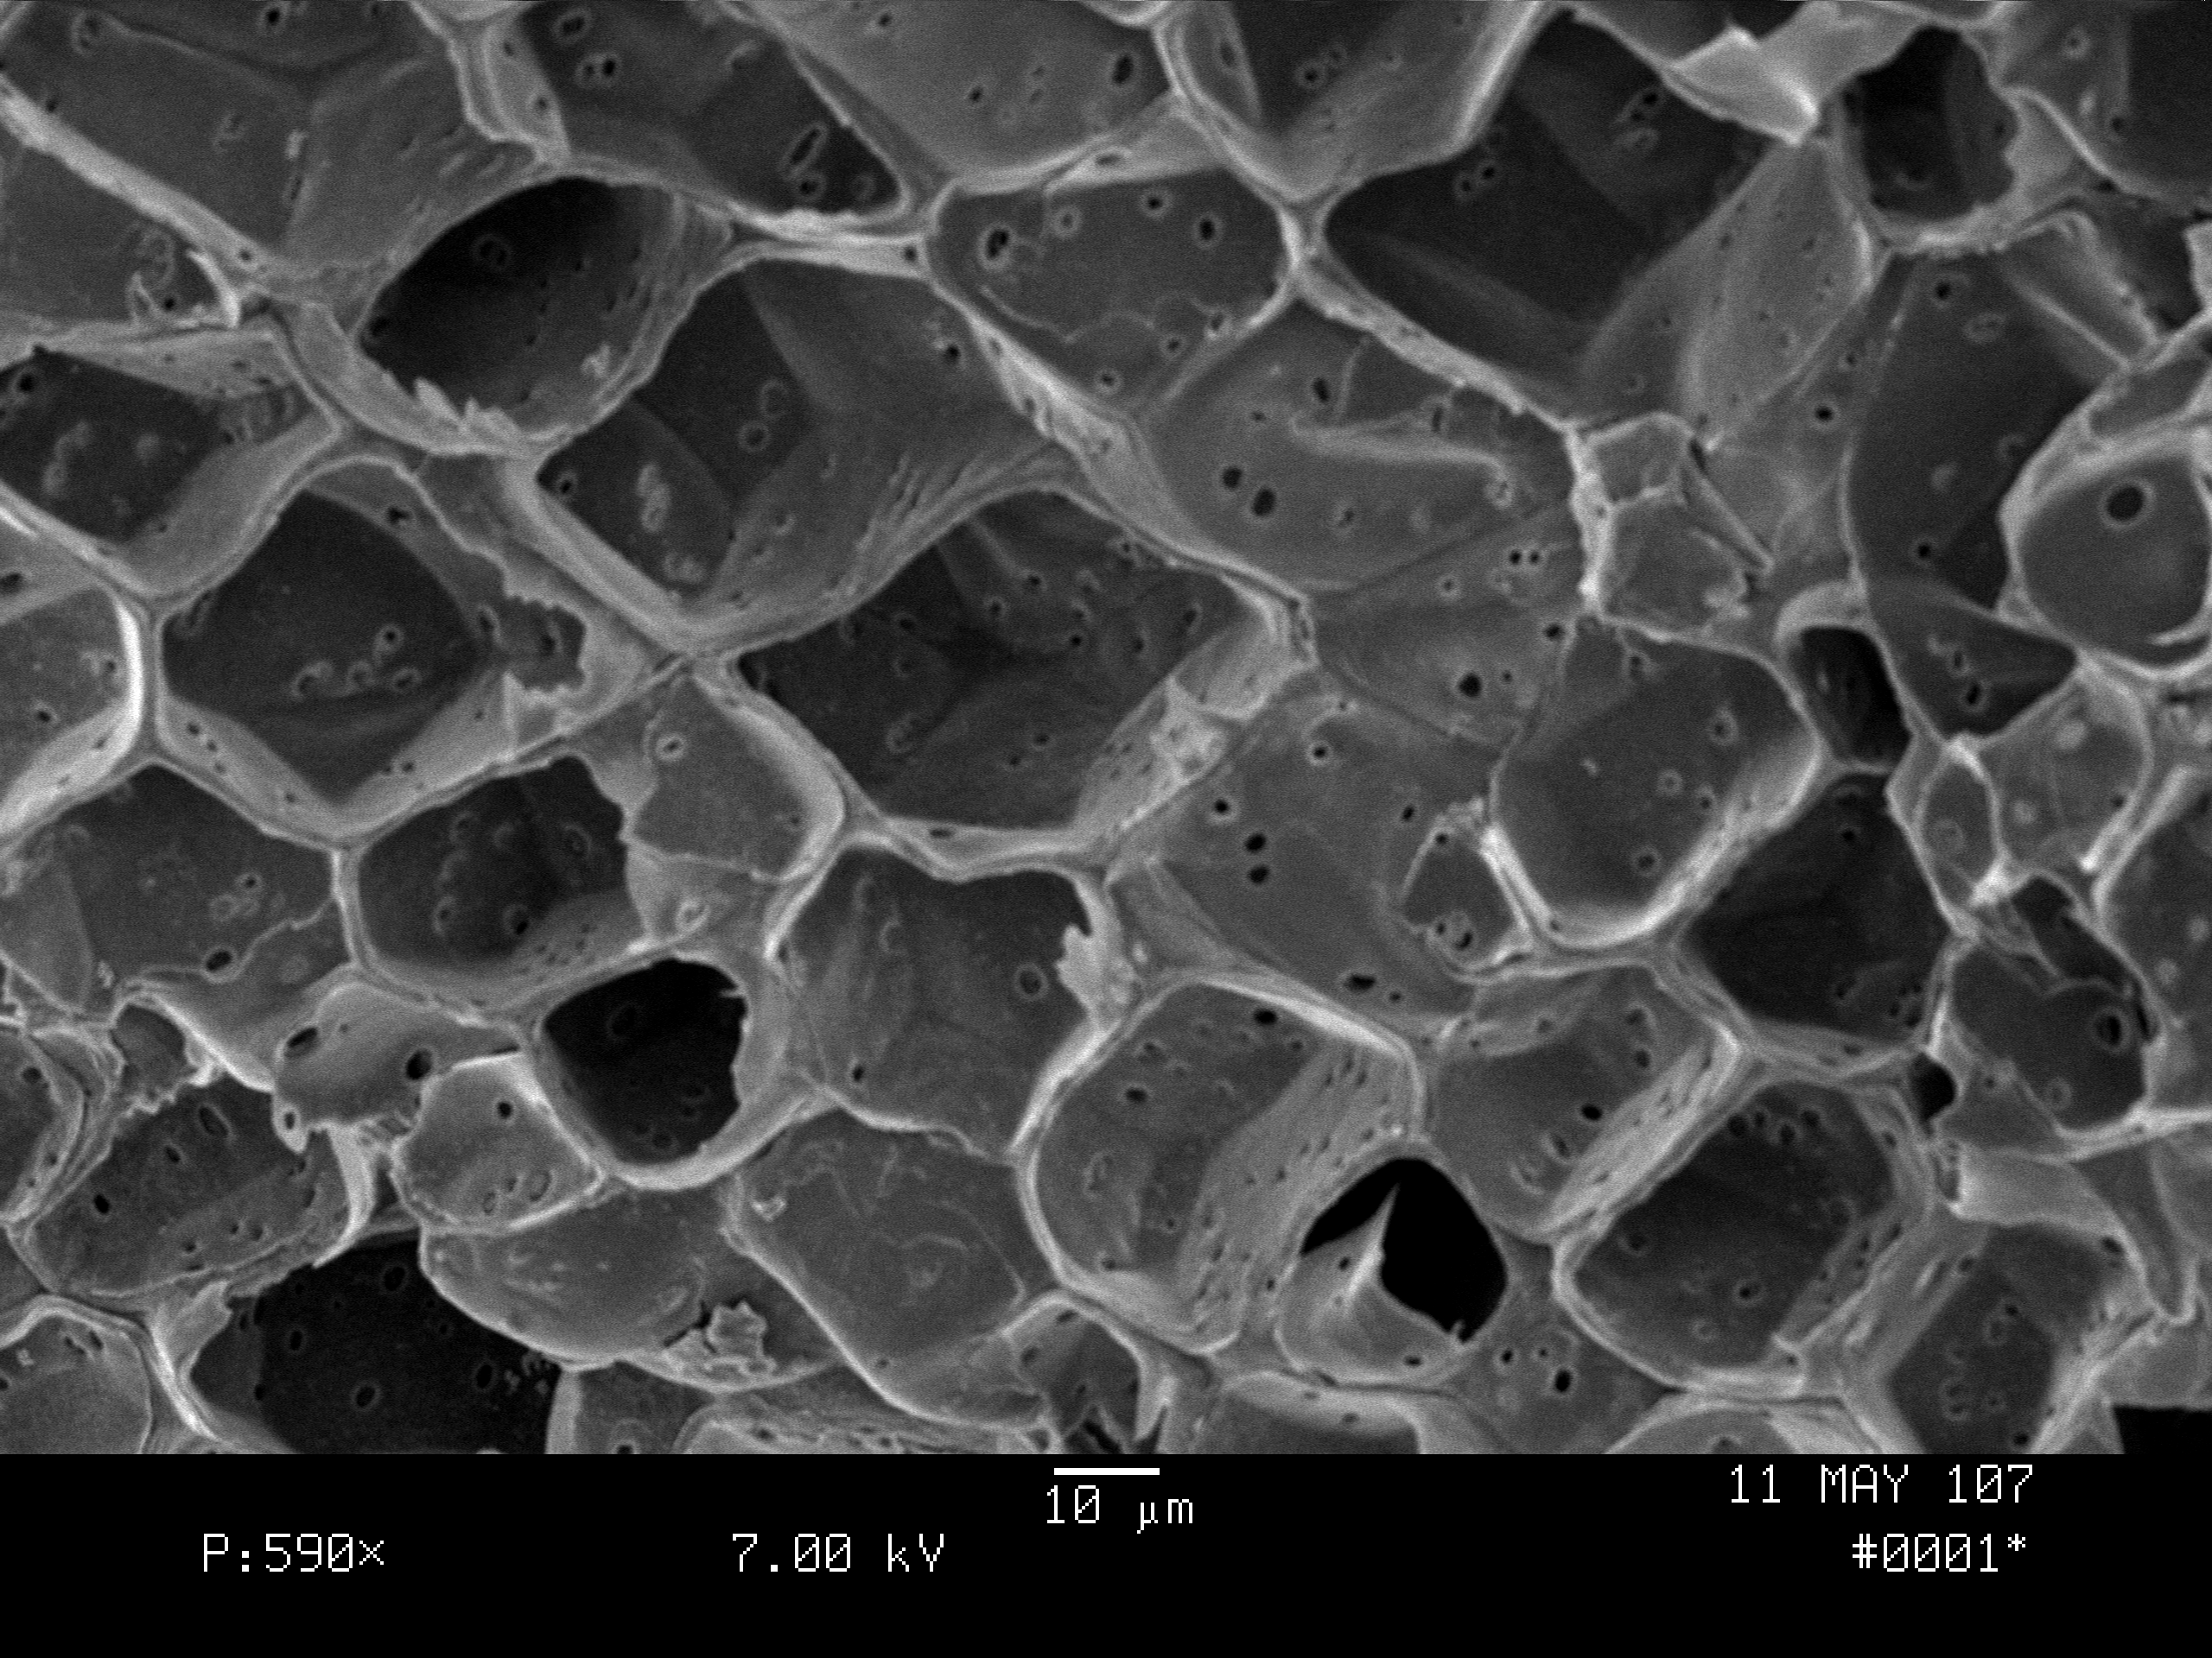
#1, Ground Meristem
Undifferentiated cells at the base of the bud will rapidly grow into supportive fibers, vascular cells and protective epidermis on the bud’s extending stem.
Notice the cells at right. These are parenchyma cells.

Slide 6
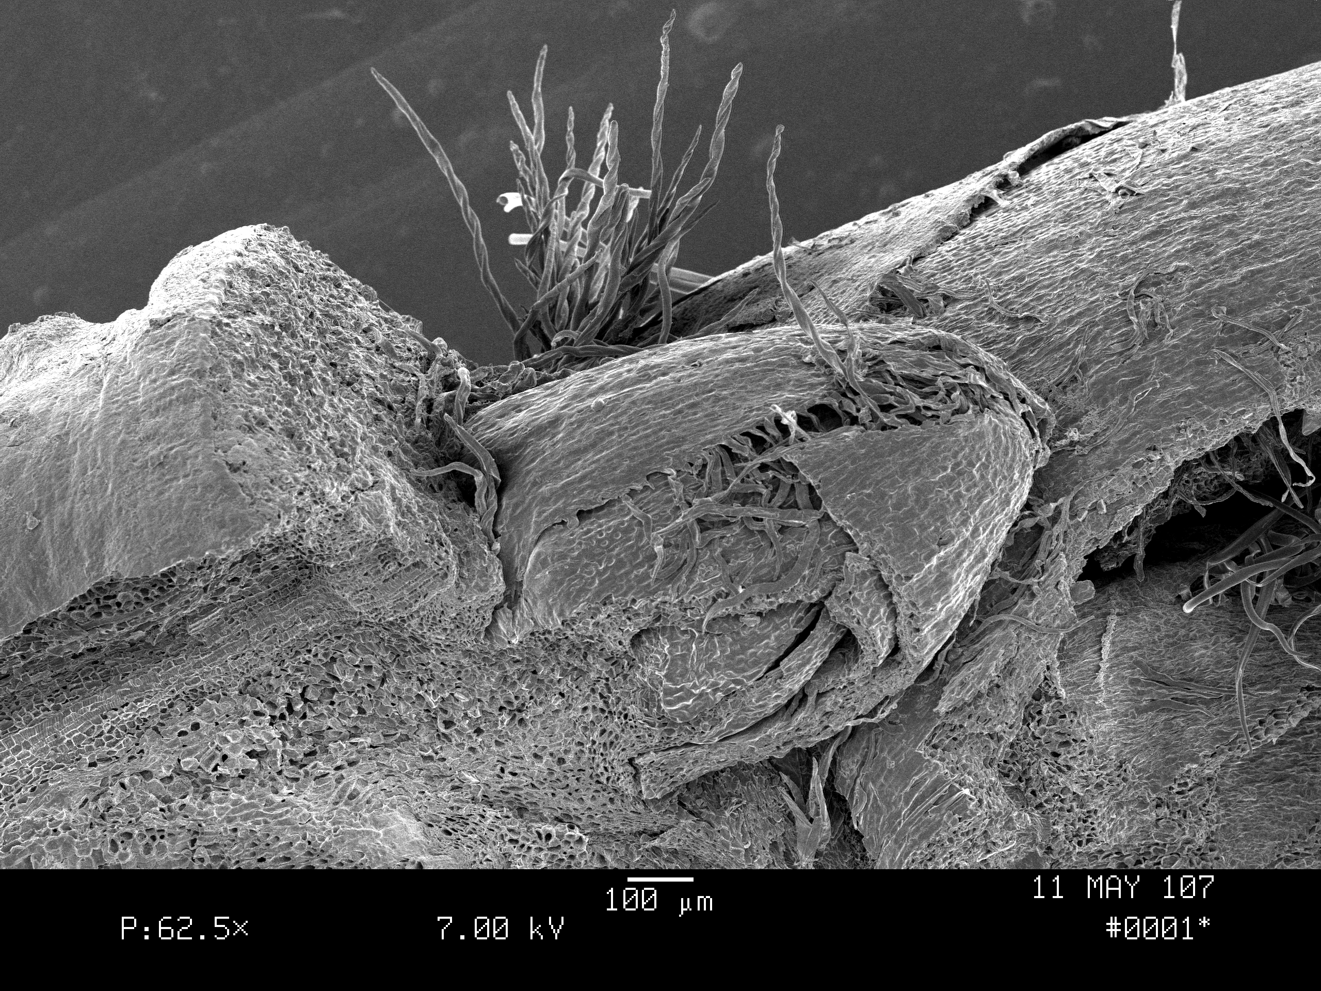
#2, Lateral Bud with Hairs
Each apical or central bud is flanked by two lateral buds.
If the apical bud is a flower, laterals develop as leaves. The laterals may not develop if the apical develops as leaves.
Bud hairs were observed to contain crystals of sap sugar on a March day.

Slide 7
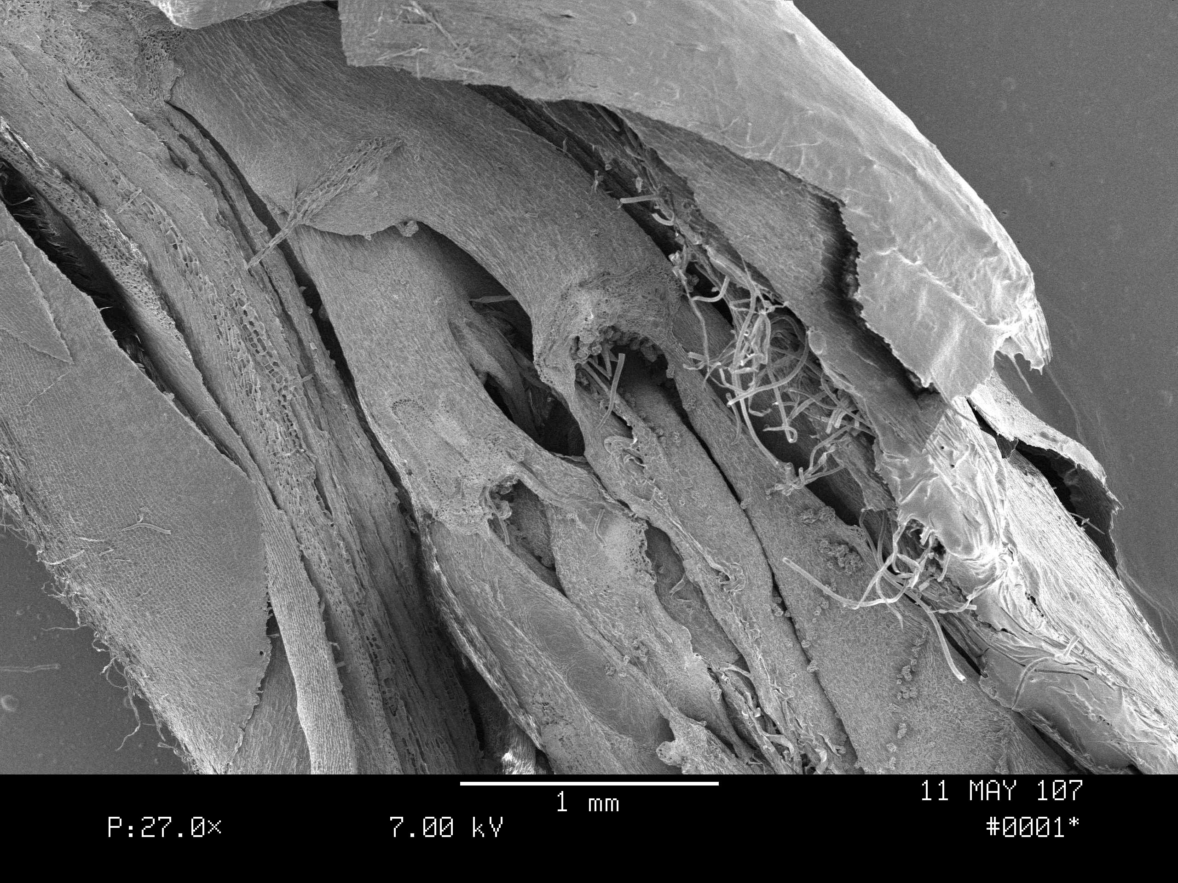
#3, Apical Meristem
Apical Meristem cells are the mother cells. Every cell in a leaf, stem, even an entire tree, comes from the apical meristem cells.
In the bud, these cells are forming primordial leaves.

Slide 8
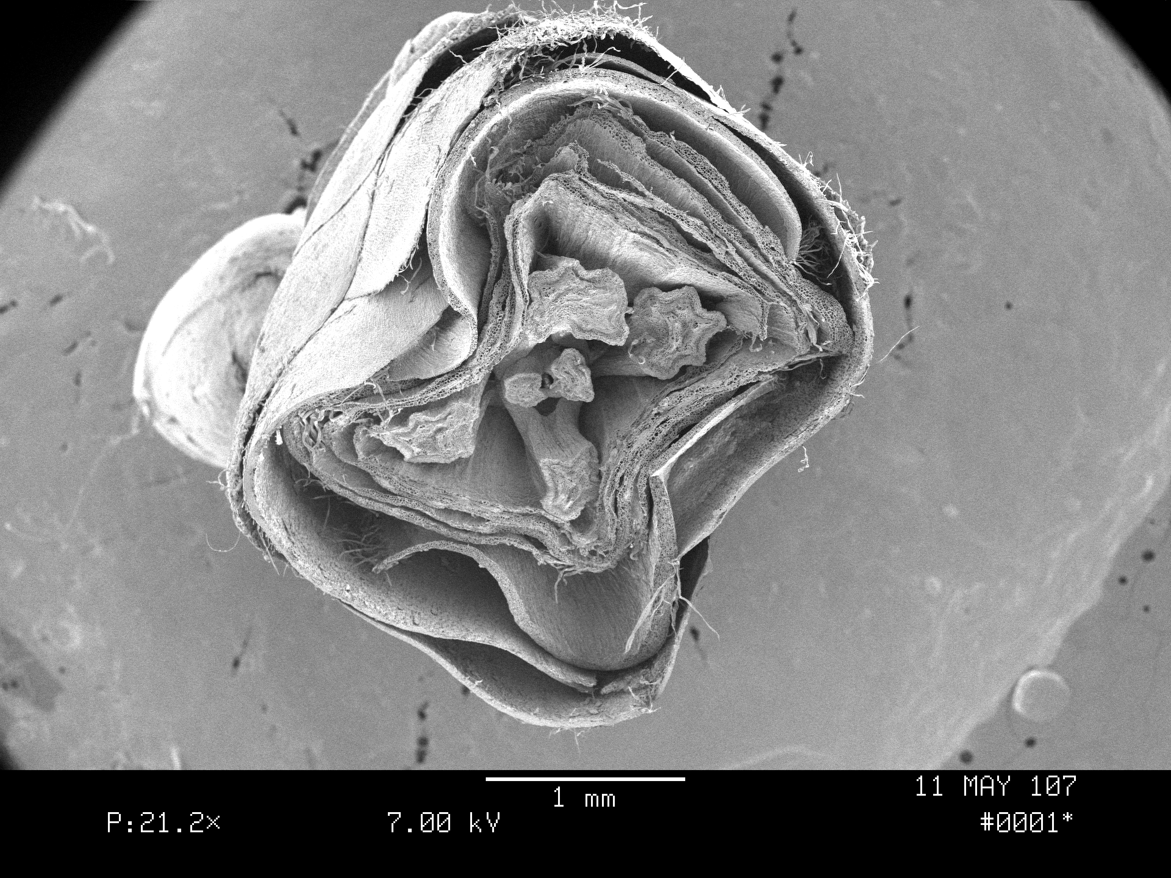
#3, Mother Cells
How many primordial leaves are the forming?
How are they arranged?
Why does one have a star-like projection?
Notice how the bud scales cup and protect the delicate leaves.

Slide 9
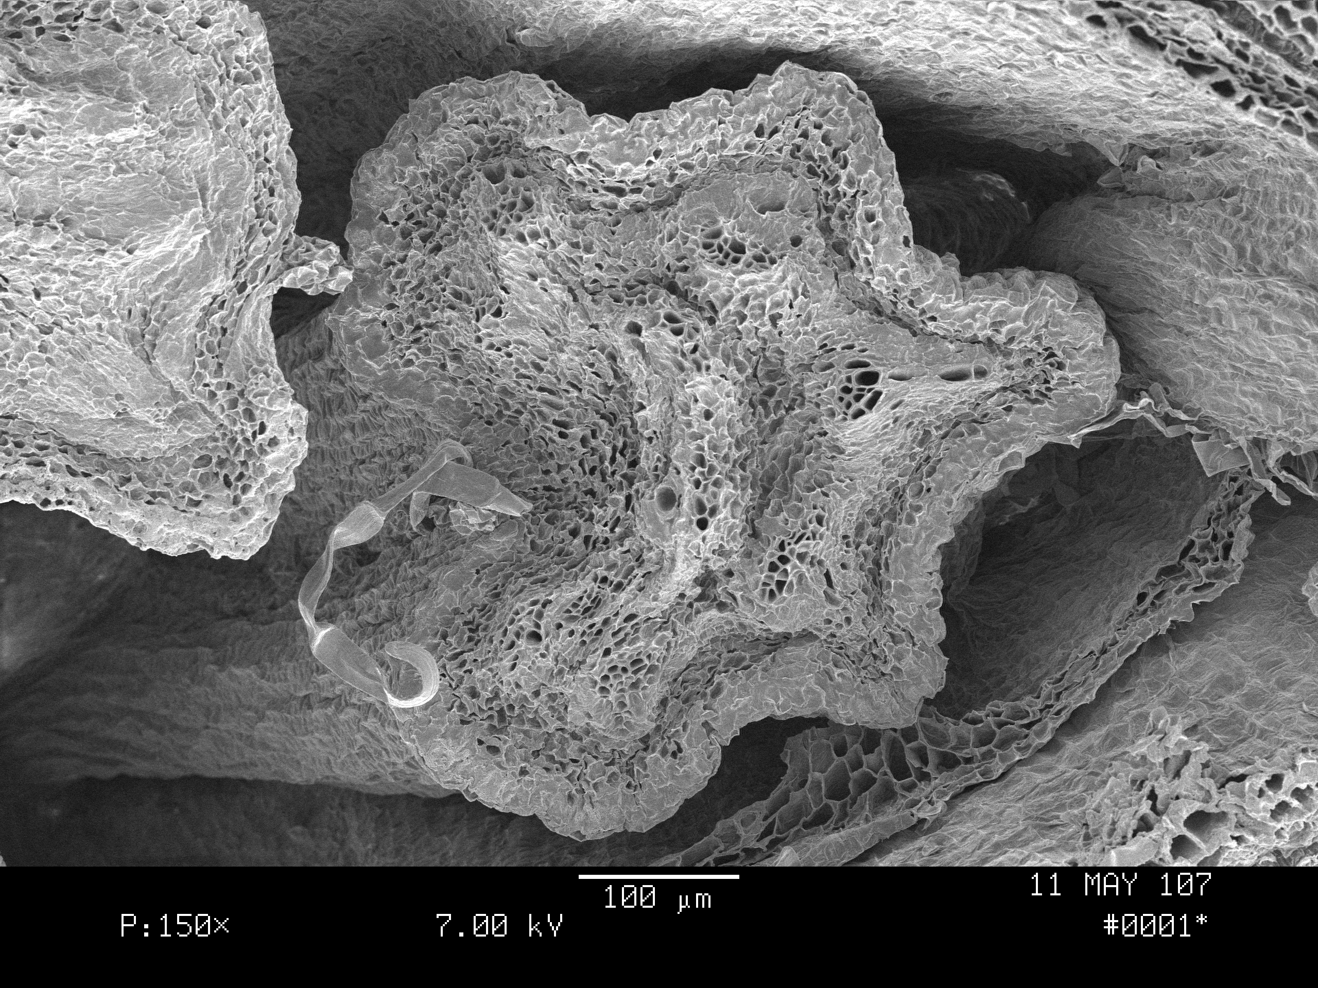
Close-up on One Leaf
What has 5 points?
A Maple Leaf!
Veins are forming even in the infant leaf.
What tissues seem to be forming on the outer edge of the leaf?
What are those little holes just below each point?

Slide 10
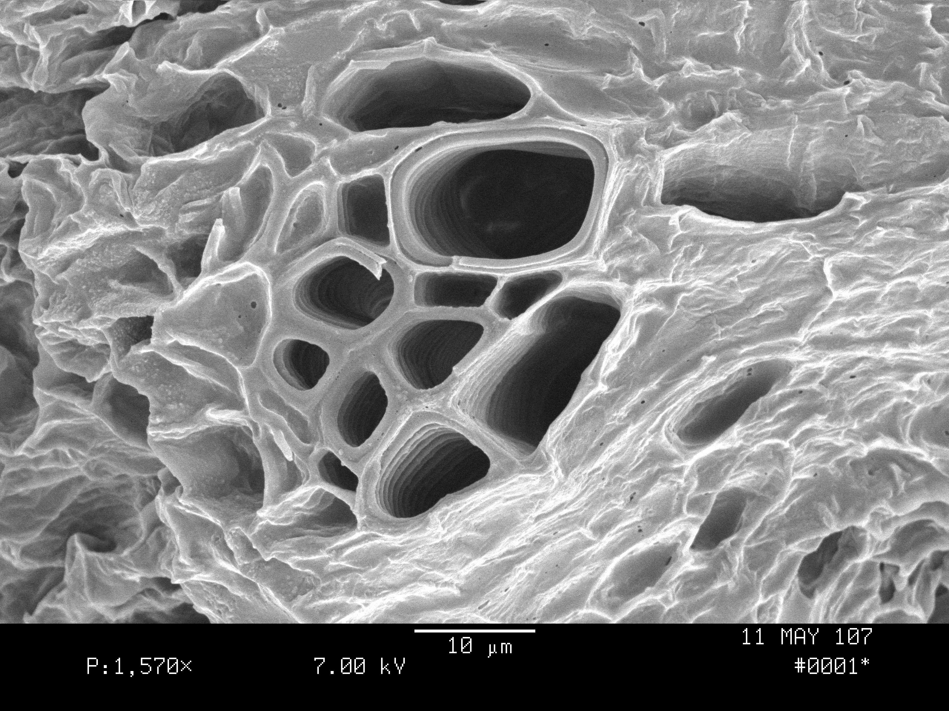
Closer Still on Leaf Vein
Cells at right are vessel elements, xylem cells that can pump water to the developing leaf. These are formed by pro-cambium cells.
Shallow cells are parenchyma cells which are forming palisade and mesophyll cells, chloroplasts and other leaf organelles.

Slide 11
Returning to Apical Meristem
Two leaves form at the base of the apical meristem. They will be the largest, proximal (close to the stem) leaves.
At 90 degrees, two medial leaves form.
At 90 degrees, in the center,are two distal leaves (farthest from the stem).

Slide 12
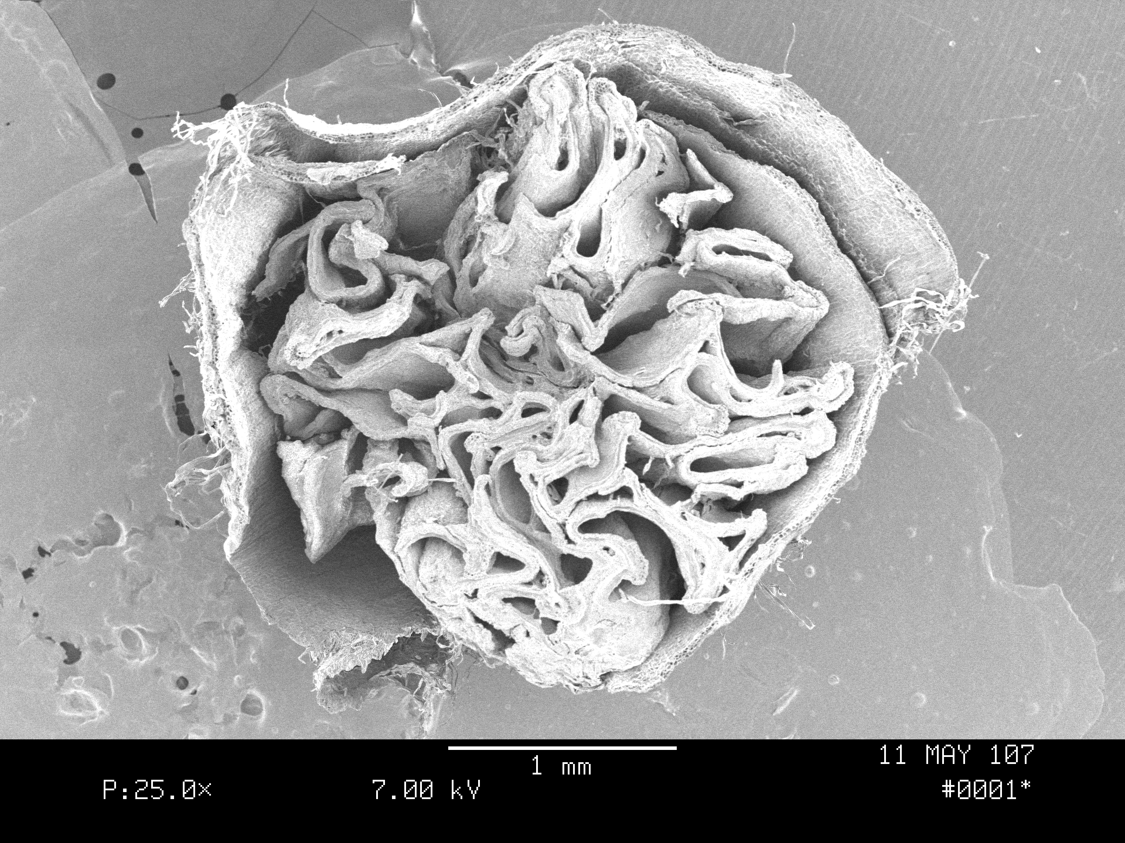
#4, Leaf Primordia
The longitudinal view shows the leaf plumule like a scroll of leaf cells. In cross-section, these scrolls are hard to see. Can you see one?
Can you find all six?

Slide 13
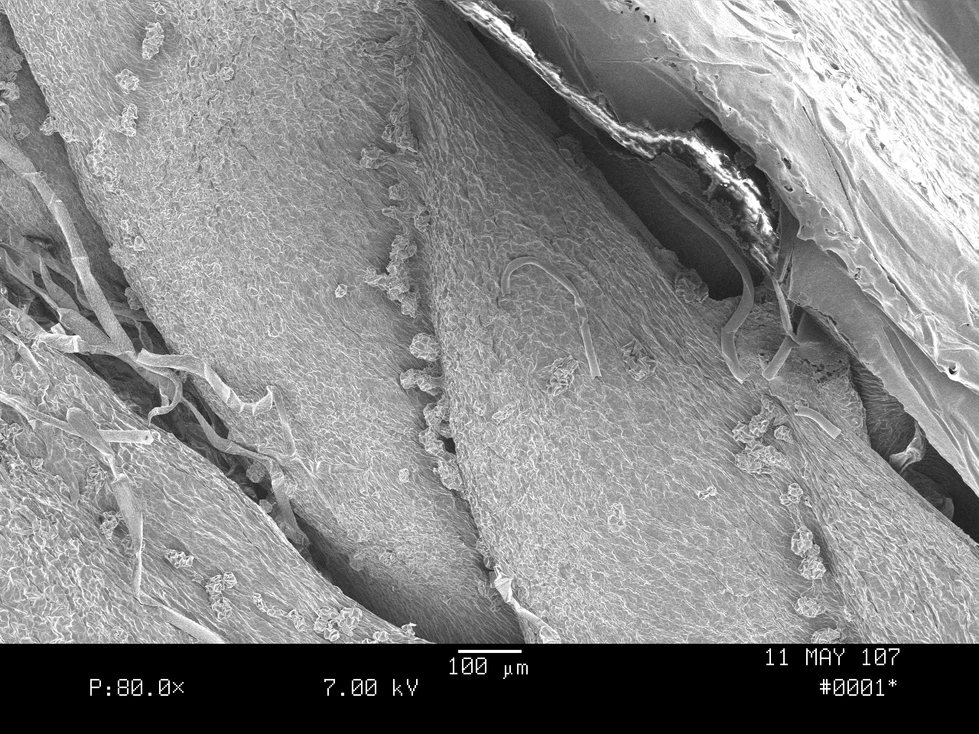
Leaf Cells Growing
Each leaf plumule has tiny bubbles along creases. What could they be?

Slide 14
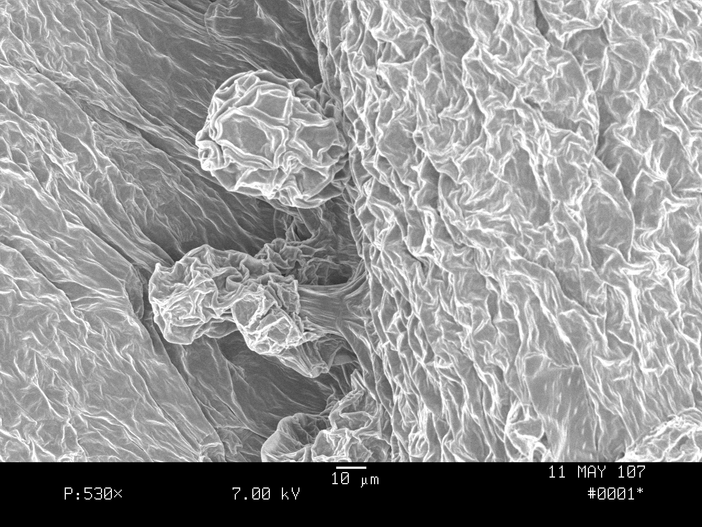
Closer Yet on Leaf Plumule
Cells emerge from the leaf tissues like a silk scarf pulling out of a sea of silk!

Slide 15
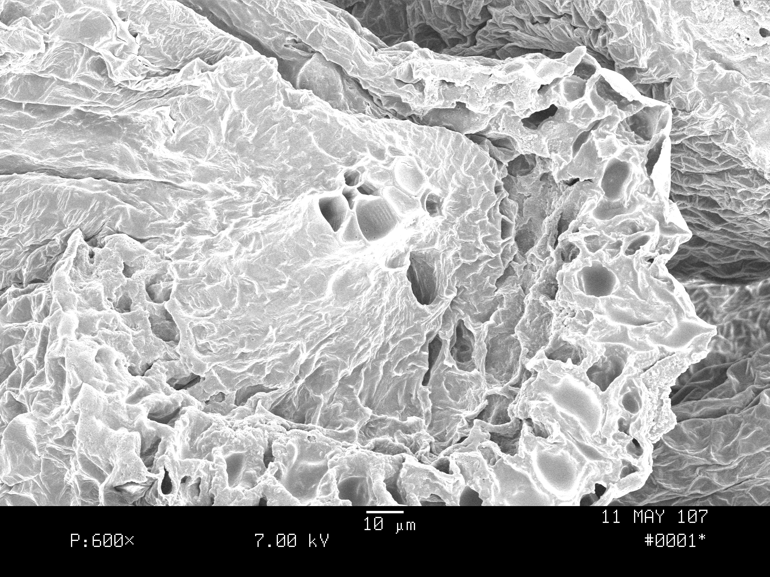
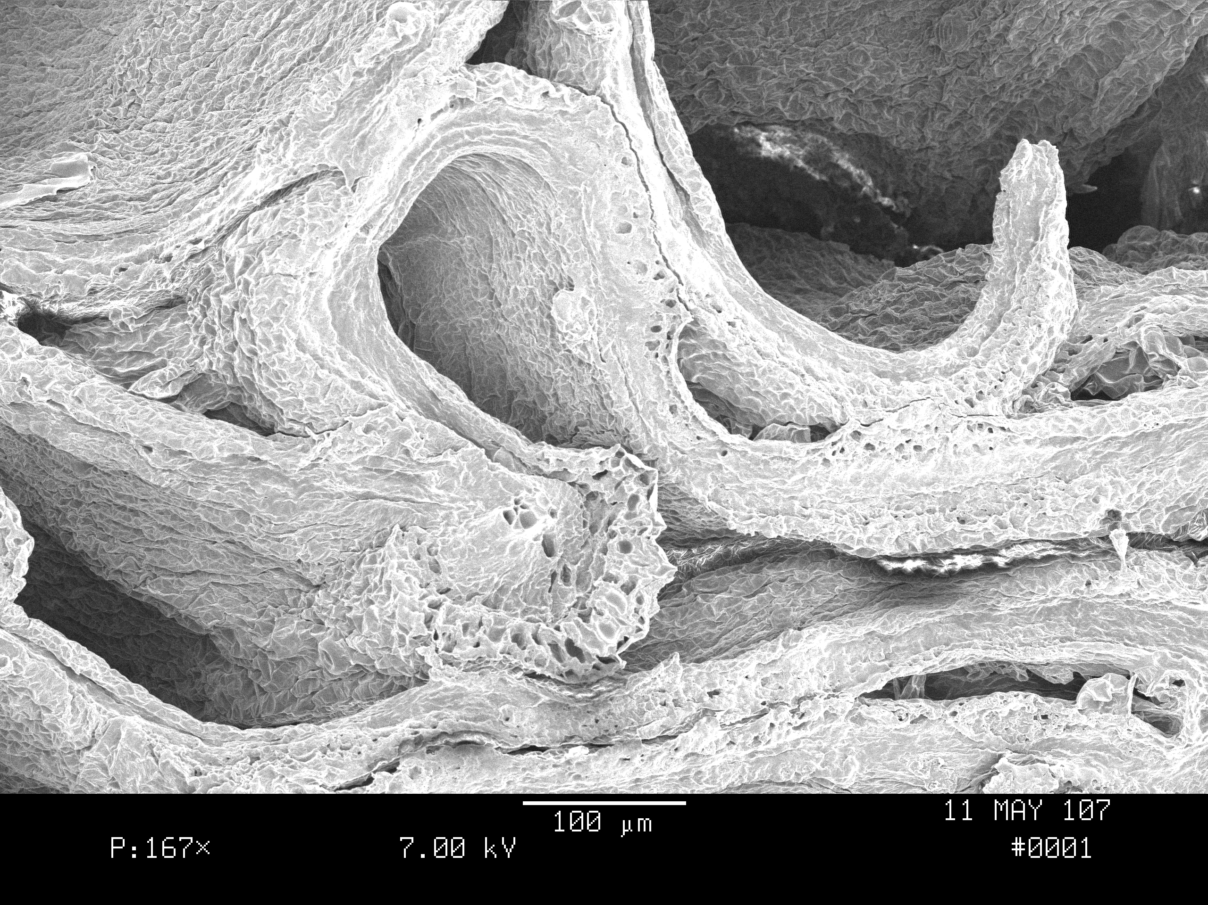
#5, Procambial Cells Produce Vascular Tissues
Layers of differentiating cells, a tip of a leaf and a vein with developing xylem and phloem arise from procambium cells.

Slide 16
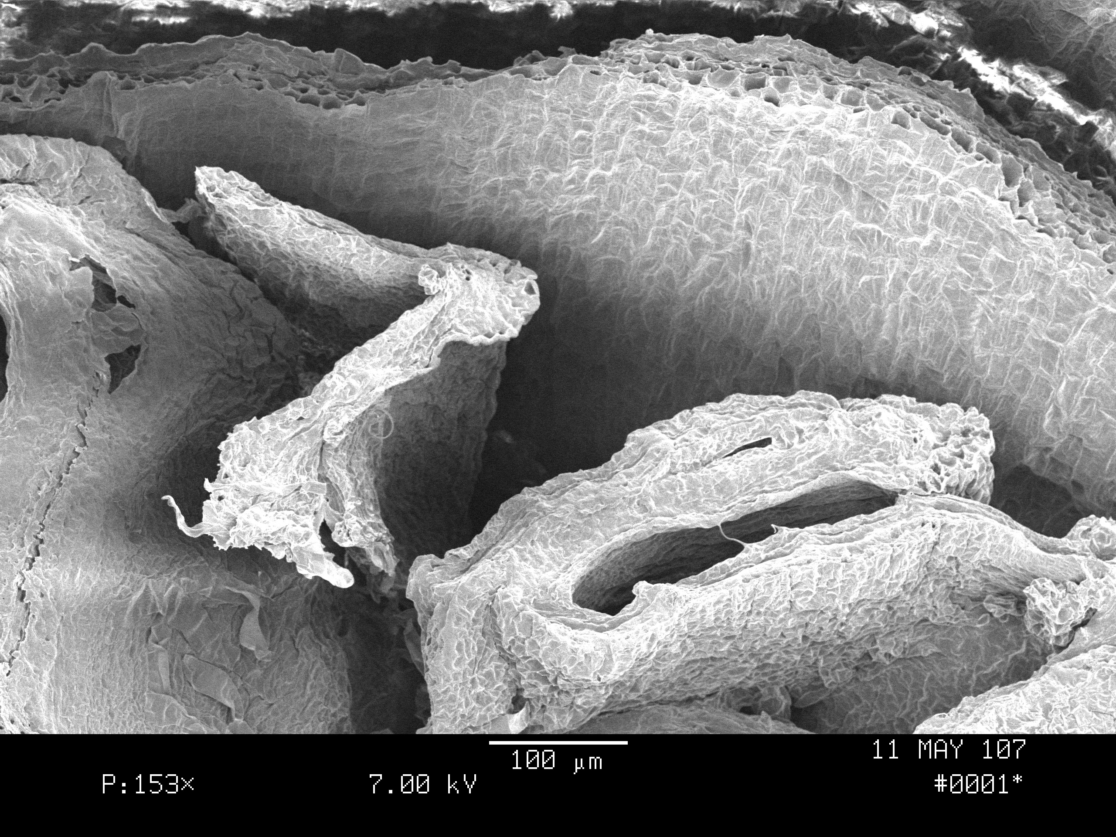
#4 and #6, Leaf & Bud Scale
Even as primordial structures, leaf and bud scale have layers of different cells.

Slide 17
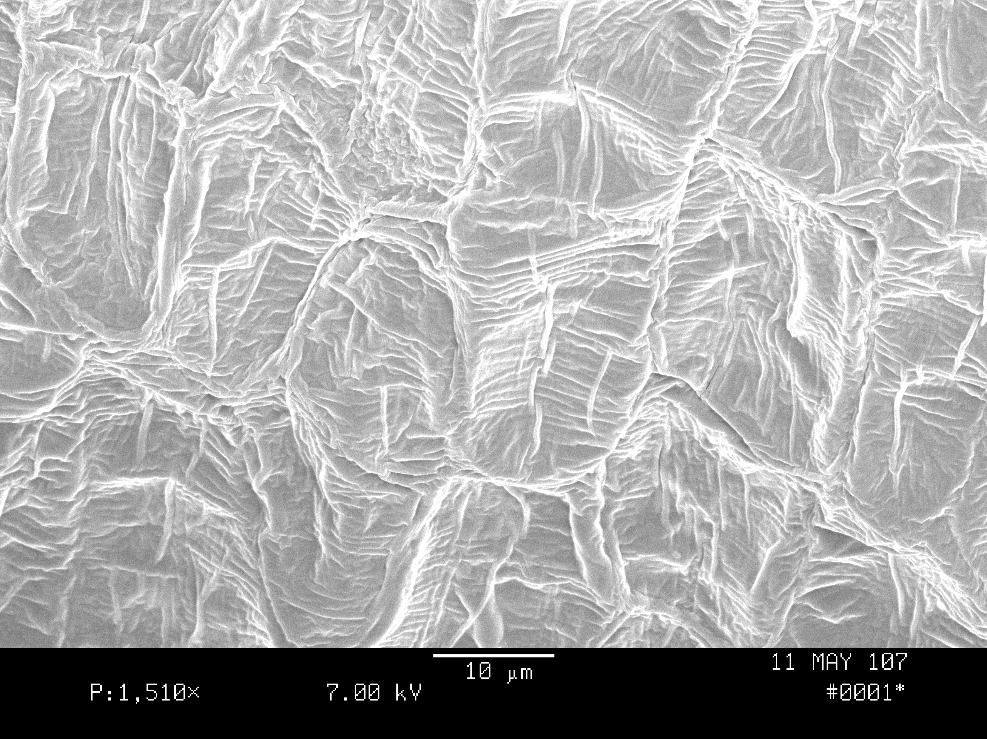
Closeup on #6, Bud Scale
Like sheets, bud scale cells are waxy.
They protect the tender inner leaf tissues from ultraviolet light, freezing temperatures, insect predators. What color are bud scales in early spring?

Slide 18
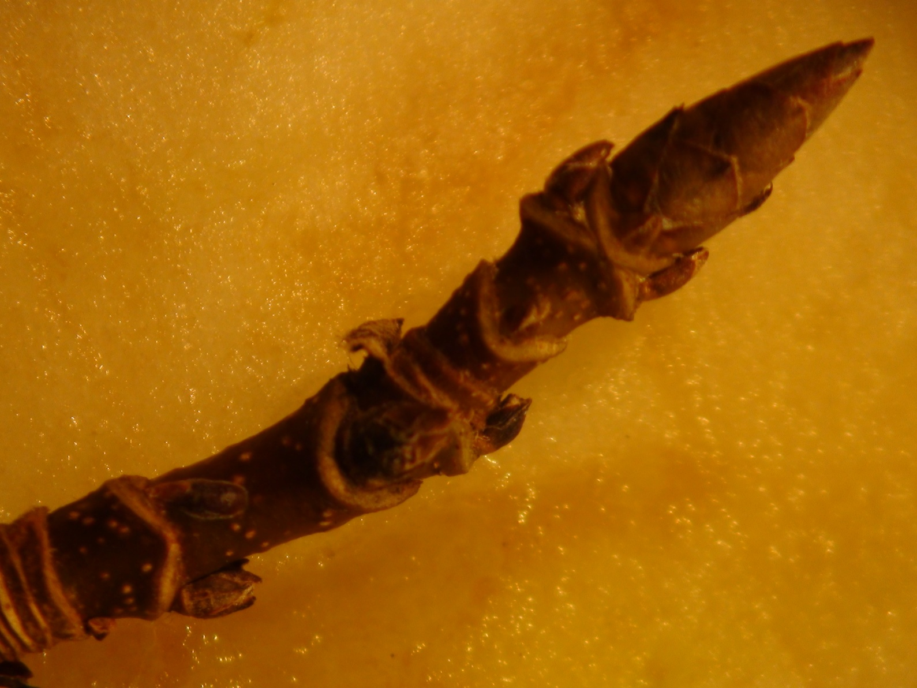
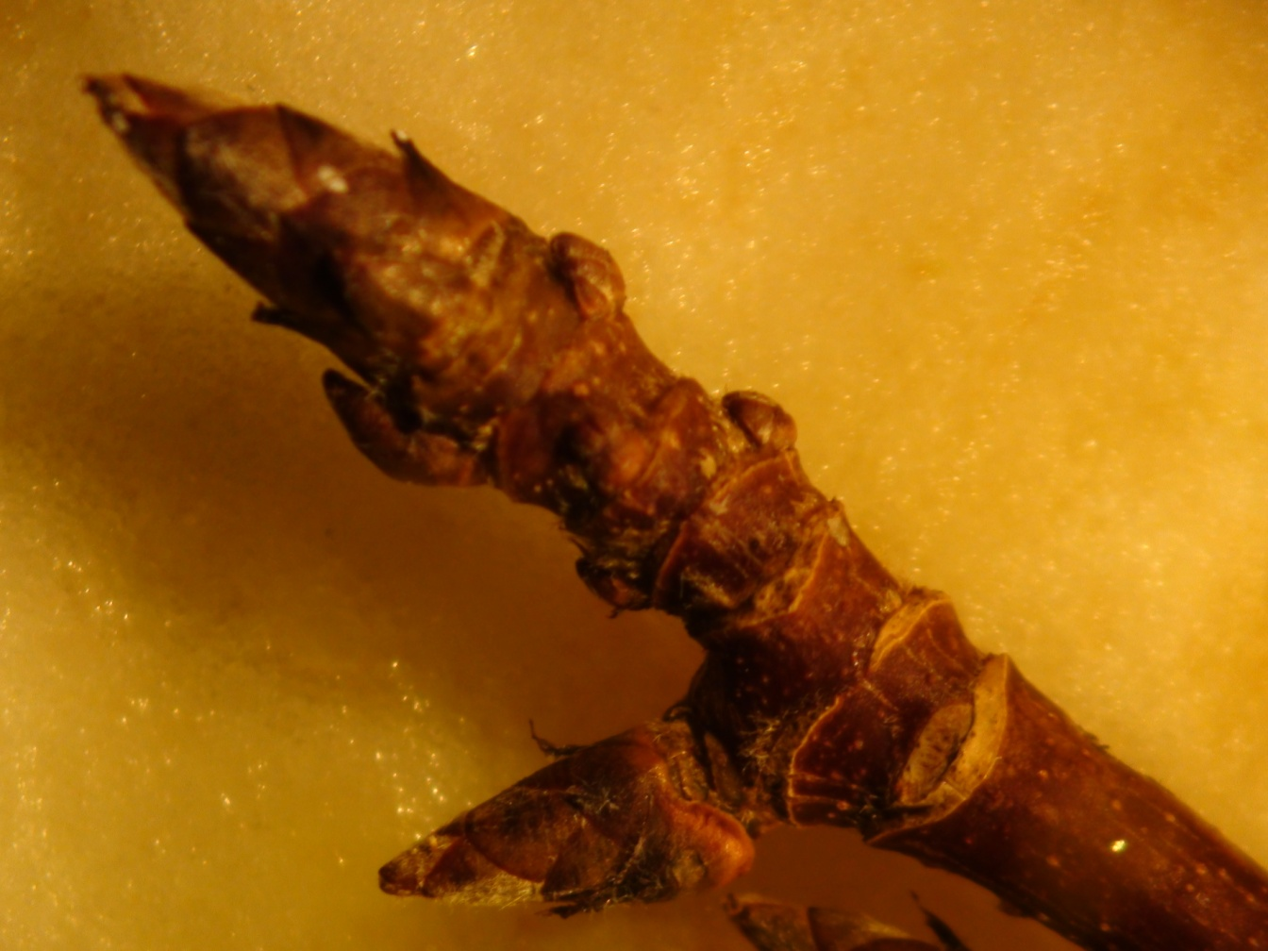
Bald Mt. Trees Produce Adventitious Buds
22 Buds on one twig demonstrate the tree’s protective response to the PAN event defoliation in 2010. This tree is making sure buds will be available for good leaf production in 2011.

Slide 19
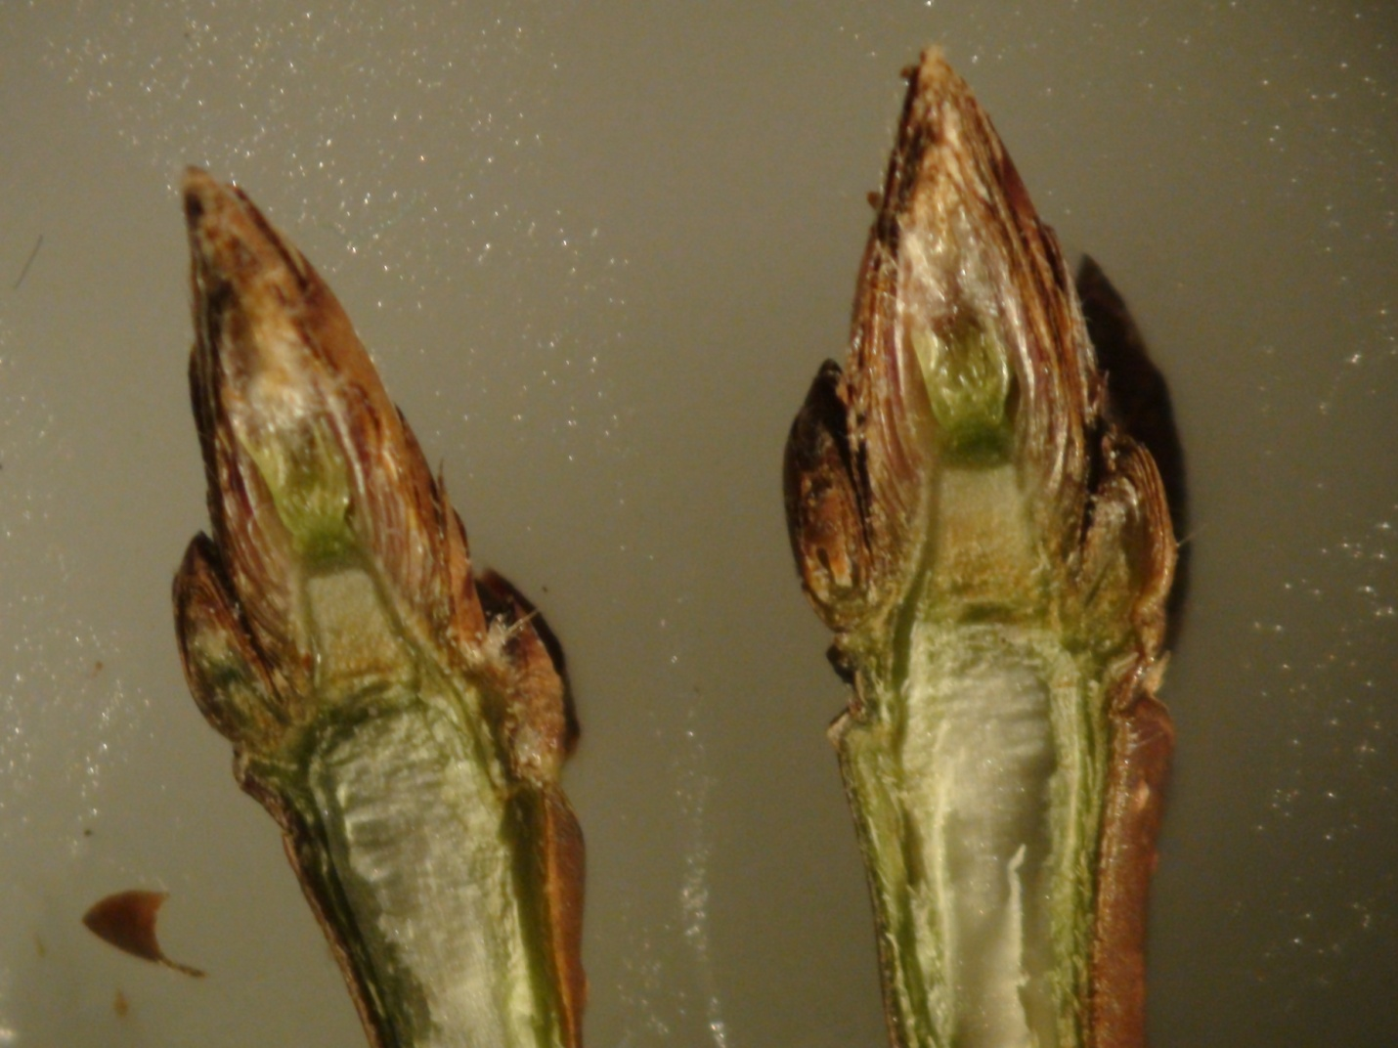
Even small buds appear viable
Lots of chlorophyll and red anthocyanins in late autumn protects delicate leaf embryos from UV light and winter cold.

Slide 20
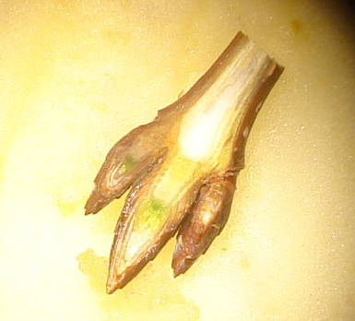
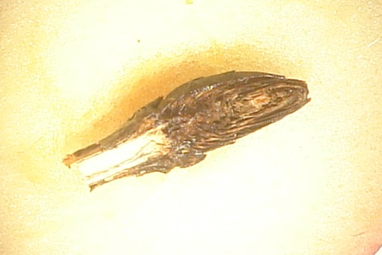
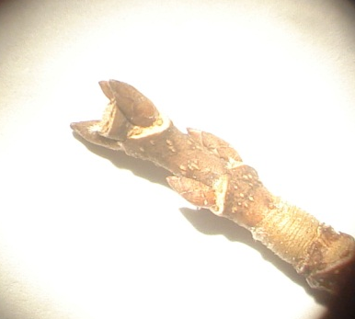
Buds, Lots of Them, Easy to Rate
Scale | Plot | Tree | Excellent | Good | Dead/Dying | Missing | %Excellent | %Good | %D/D | %Missing
1 | 1 | 801 | 37 | 0 | 0 | 8 | 82 | 0 | 0 | 18
1 | 1 | 803 | 25 | 0 | 1 | 7 | 76 | 0 | 3 | 21
1 | 1 | 804 | 30 | 2 | 0 | 3 | 86 | 5 | 0 | 9
1 | 2 | 808 | 35 | 0 | 1 | 0 | 97 | 0 | 0 | 3
1 | 2 | 811 | 36 | 0 | 0 | 5 | 88 | 0 | 0 | 12
3 | 2 | 812 | 24 | 0 | 25 | 0 | 49 | 0 | 0 | 51
3 | 3 | 813 | 0 | 6 | 0 | 36 | 0 | 14 | 0 | 86
3 | 3 | 814 | 7 | 14 | 4 | 36 | 11 | 23 | 7 | 59
3 | 3 | 815 | 0 | 0 | 18 | 36 | 0 | 0 | 33 | 66
3 | 4 | 816 | 24 | 10 | 1 | 32 | 36 | 15 | 1 | 48
2 | 4 | 817 | 16 | 17 | 1 | 13 | 34 | 36 | 2 | 28
2 | 4 | 818 | 30 | 21 | 7 | 11 | 43 | 30 | 10 | 16
2 | 5 | 820 | 15 | 1 | 8 | 1 | 60 | 4 | 32 | 4
1 | 5 | 821 | 37 | 0 | 1 | 0 | 97 | 0 | 3 | 0
1 | 5 | 822 | 46 | 0 | 1 | 6 | 87 | 0 | 2 | 11
1 | 6 | 823 | 29 | 0 | 3 | 5 | 78 | 0 | 8 | 14
1 | 6 | 824 | 28 | 0 | 1 | 4 | 85 | 0 | 3 | 12
3 | 6 | 825 | 13 | 0 | 18 | 5 | 36 | 0 | 50 | 14
2 | 7 | 826 | 21 | 19 | 4 | 3 | 45 | 40 | 9 | 6
3 | 7 | 827 | 24 | 33 | 20 | 54 | 18 | 25 | 15 | 41
2 | 7 | 828 | 18 | 52 | 8 | 18 | 19 | 54 | 8 | 19
2 | 8 | 829 | 18 | 21 | 5 | 8 | 35 | 40 | 10 | 15
3 | 8 | 830 | 19 | 16 | 4 | 20 | 32 | 27 | 7 | 34
2 | 8 | 831 | 0 | 32 | 3 | 11 | 0 | 70 | 6 | 24
2 | 9 | 832 | 34 | 15 | 3 | 4 | 61 | 27 | 5 | 7
2 | 9 | 833 | 32 | 16 | 12 | 15 | 43 | 21 | 16 | 20
2 | 9 | 834 | 27 | 21 | 1 | 4 | 51 | 40 | 2 | 7
1 | 10 | 835 | 44 | 0 | 1 | 7 | 85 | 0 | 2 | 13
1 | 10 | 836 | 37 | 0 | 1 | 2 | 93 | 0 | 3 | 5
1 | 10 | 837 | 31 | 0 | 1 | 0 | 97 | 0 | 3 | 0
Table 4.4: Fall Bud Quality. Buds collected after leaf drop in late October were assessed as described in Table 4.1 and counted. An overall rating was awarded each tree: Scale 1 = 75% or more, excellent buds; Scale 2 = 60% or more of buds are excellent and/or good; Scale 3 = 40% or more are dead, deformed or missing.

Slide 21
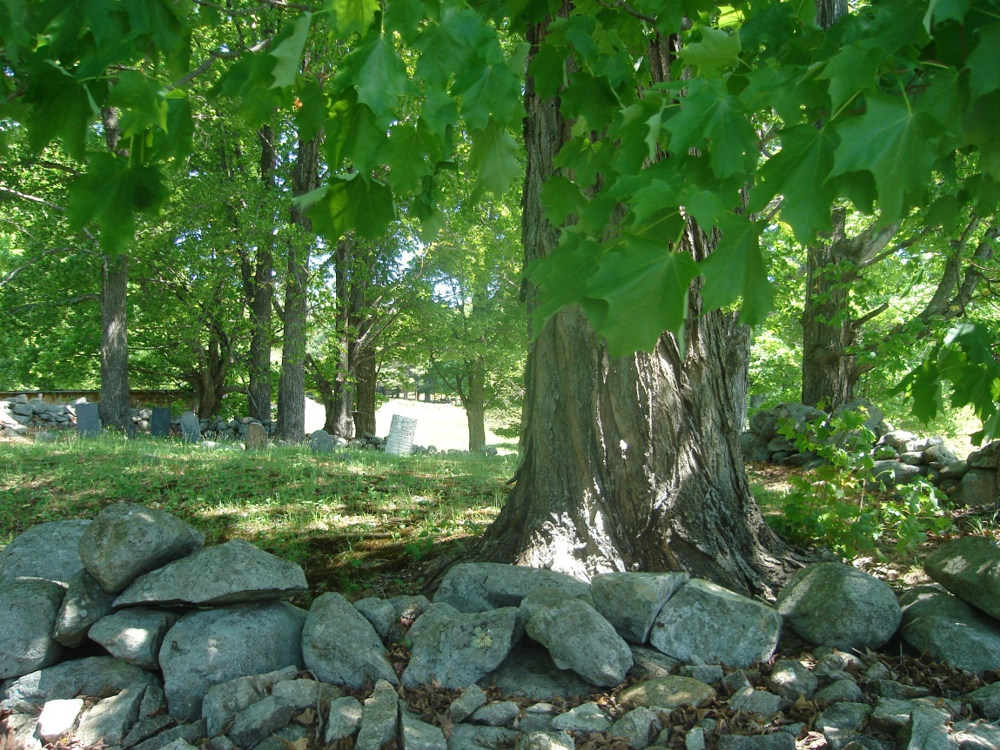
Buds Clearly Mirror Site Health
Fall Buds
During the fall, the percent of viable buds ranked excellent or good was compared with non-viable buds, dead, deformed and missing (Table 4.4). An overall rating was awarded each tree: Scale 1 = 75% or more of buds ranked excellent; Scale 2 = 60% or more of buds ranked excellent and/or good; Scale 3 = 40% or more were dead, deformed or missing. All three trees in Plot 10 (835, 836, and 837) had 85 to 97% excellent buds with no good buds and a few dead, deformed or missing buds. In contrast, all three trees in Plot 3 (813, 814, and 815) had more than 50% missing buds and high percentages of dead and deformed buds.

Slide 22
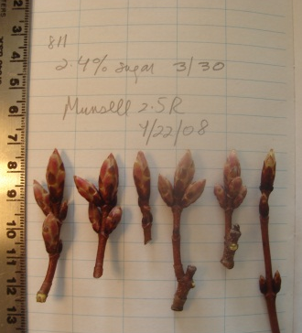
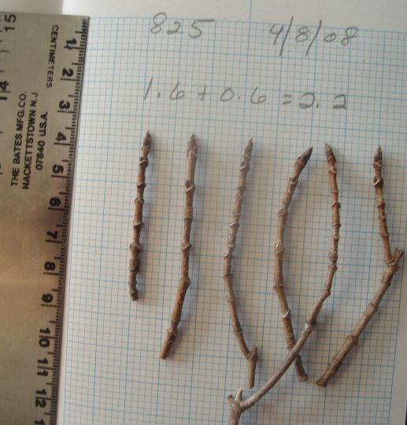
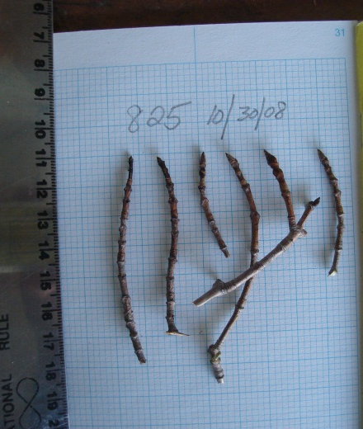
Comparison of Spring to Fall Could Guide Management
Sixteen trees showed improved bud quality.
Five other trees maintained good or excellent bud quality.
Five trees maintained Level 3, poor quality.
4 trees showed a decline in quality.
Most trees may experience stress and yet recover, investing in the next year's buds. Some of the trees which showed improvement in bud quality (Trees 817, 820, 821, 831, 833, and 837) had no lateral buds in the spring. They may have suffered stress in 2007, losing leaves which produce lateral buds, yet they produced good or even excellent buds in 2008.
Other trees may have experienced greater stress, prolonged stress or numerous stresses, reaching a tipping point at which they lack the sugar or energy to produce buds. Trees which maintain grade 3 poor buds (812, 813, 815, 825, 827) had no lateral buds in the spring of 2008, an indication they suffered stress in 2007 as well as 2008. Trees which declined from good spring condition to poor fall bud quality (814, 816, 816, 830) all had laterals with visible swelling in the spring of 2008. These trees may not have been previously stressed.

Slide 23
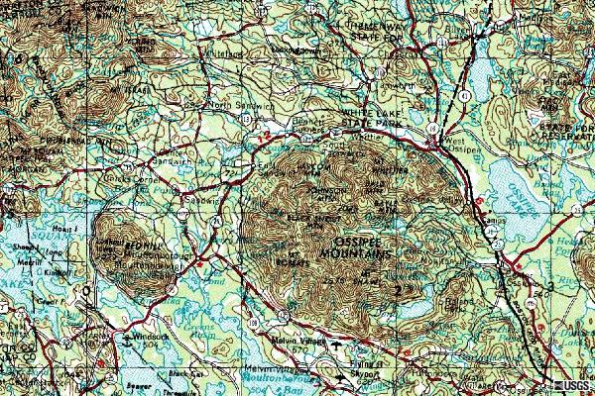
Study Plots
Plots 7 & 8
Plots 3 & 4
50% dead or deformed
Plots 1 & 2, 97% excellent
Plots 9 & 10
Plots 5 & 6
2008 Summer Weather – Driest Spring in 35 years. Then 6 weeks heavy rain.

Slide 24
Good Buds Are Top Priority
Although only 20% of the trees in the study retained leaves throughout the season, 70% of the trees produced good or excellent buds with few dead or missing buds and little shoot damage. Trees in Plots 1, 2, 5,6 and 10 produced predominantly excellent buds.

Slide 25
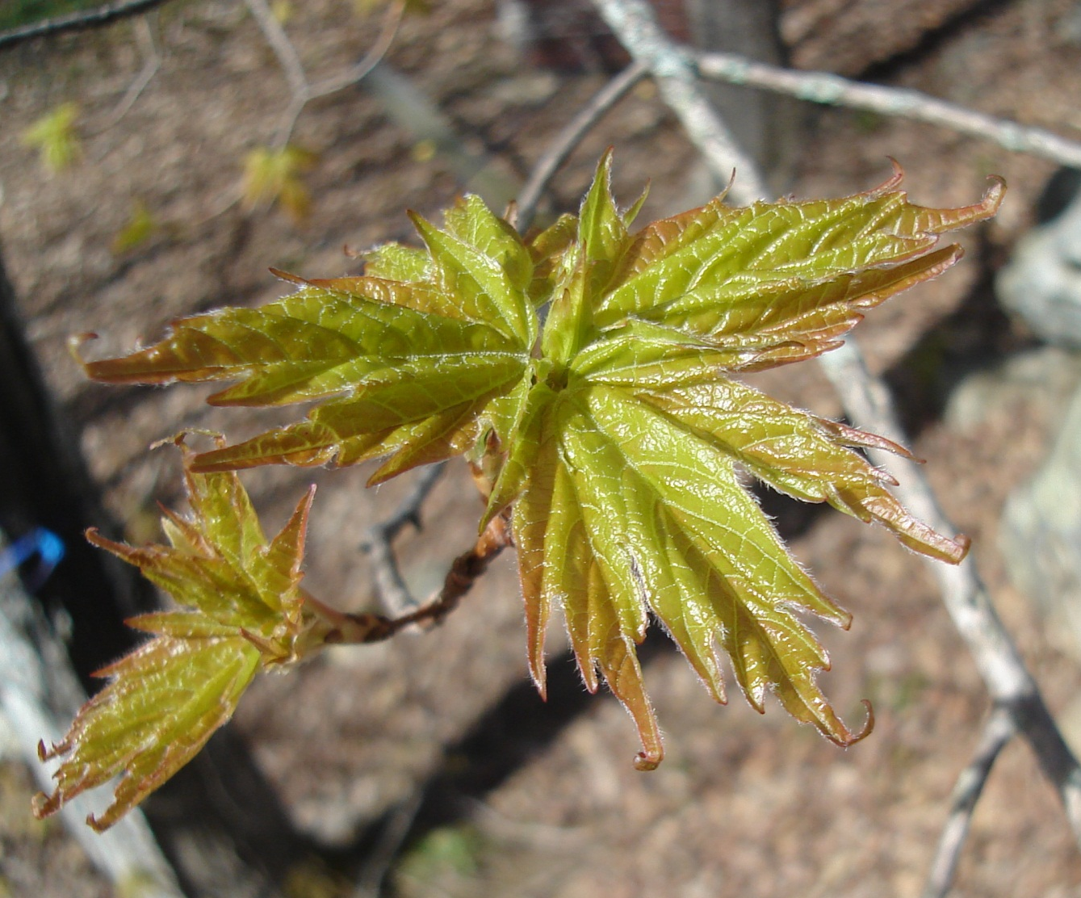
Buds Open in Late Spring
6 leaves emerge from each sugar maple bud in late April or early May.
As Kevin Smith says, “Every bud is a cosmic investment.”

Slide 26
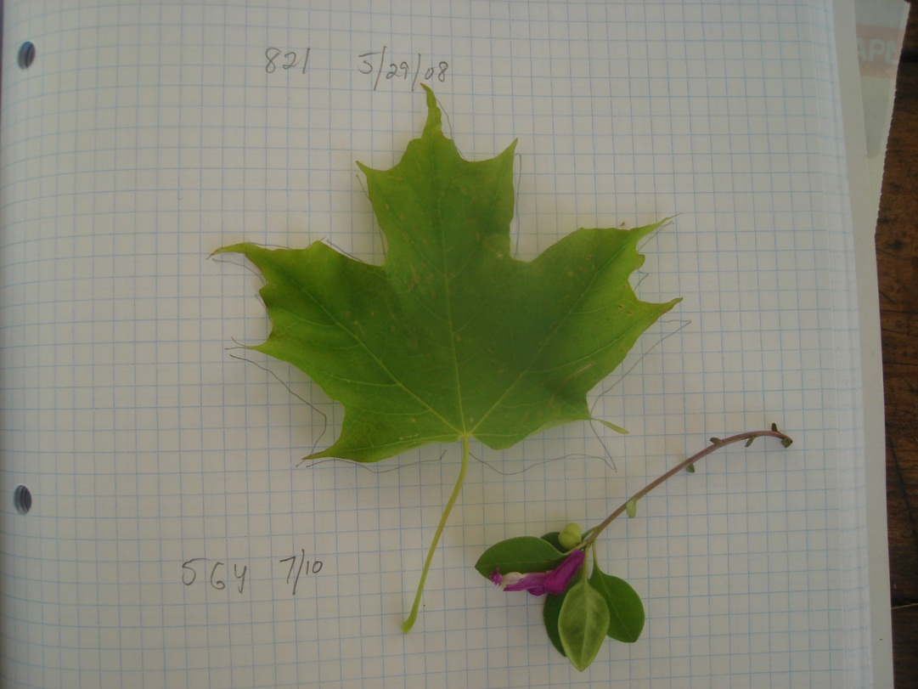
Thank You
What’s in A Bud is produced by Martha Carlson for Maple Watch, a University of New Hampshire study of climate change and its possible impact on sugar maples and the maple ecosystem. All rights reserved.
Thanks to Nancy Cherim, UNH SEM lab, and Dr. Barrett Rock, Complex Systems, UNH.
Contact us at rmcarlson@ncia.net.

