Slide 1
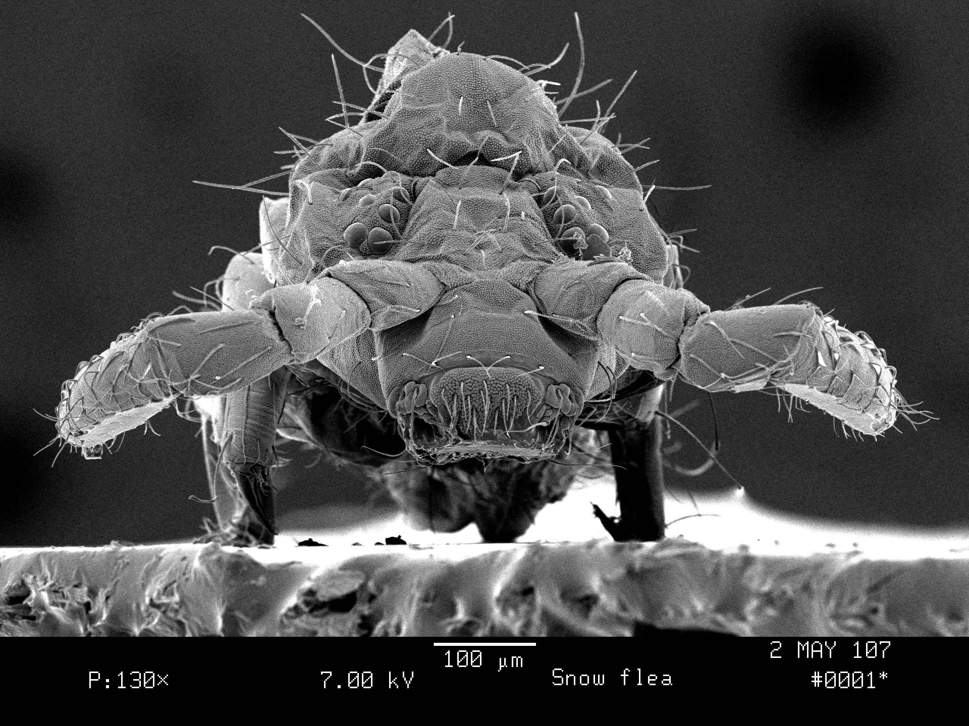
Snow Flea, 2 mm Maple Neighbor

Slide 2
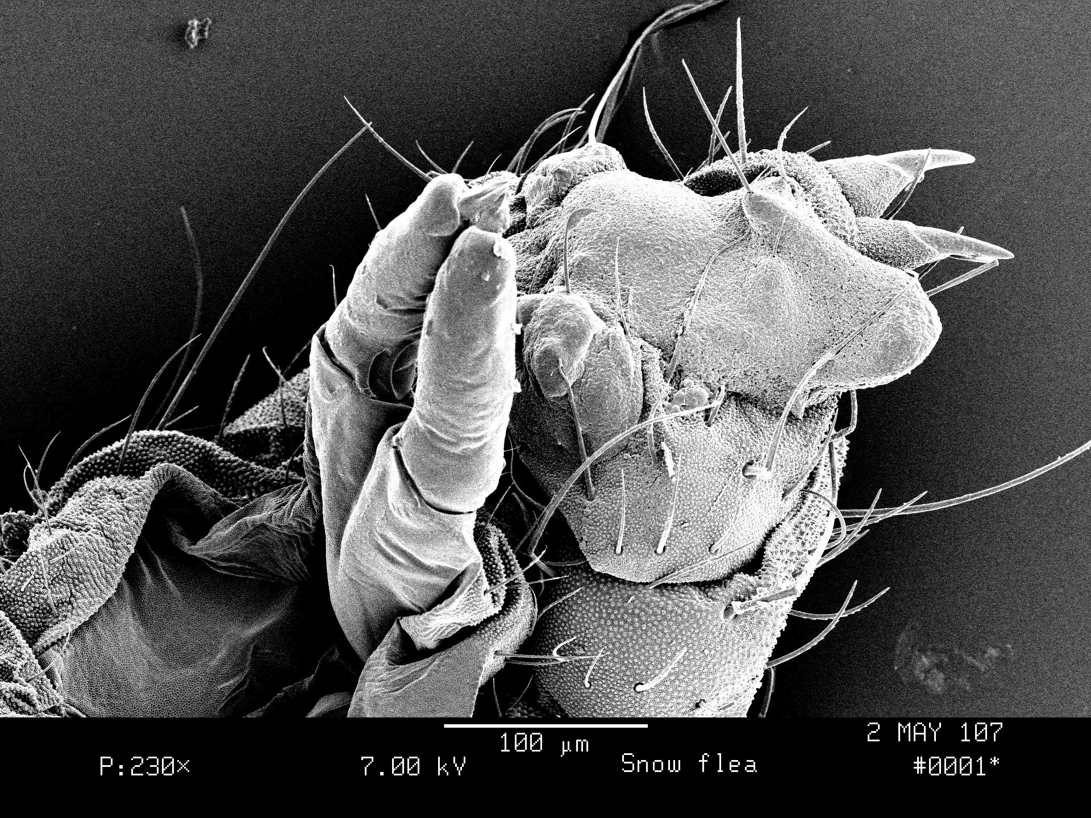
Hello Humans
My Name is Achorutes nivicola. I am a member of the Collembola order of arthropods.
What is an arthropod?
A view of the top of my head.

Slide 3
How Did I Get Here?
I was hopping around on top of the snow the other day, enjoying the bright spring sun under my sugar maple tree, playing with all my friends, when suddenly, Whoosh, something seemed to sweep me into the air. Next thing I know, I was dropped into a bottle of alcohol. Then, I was glued onto a piece of steel, coated in gold, and bombarded with electrons. Now some people are looking at me and taking photographs!

Slide 4
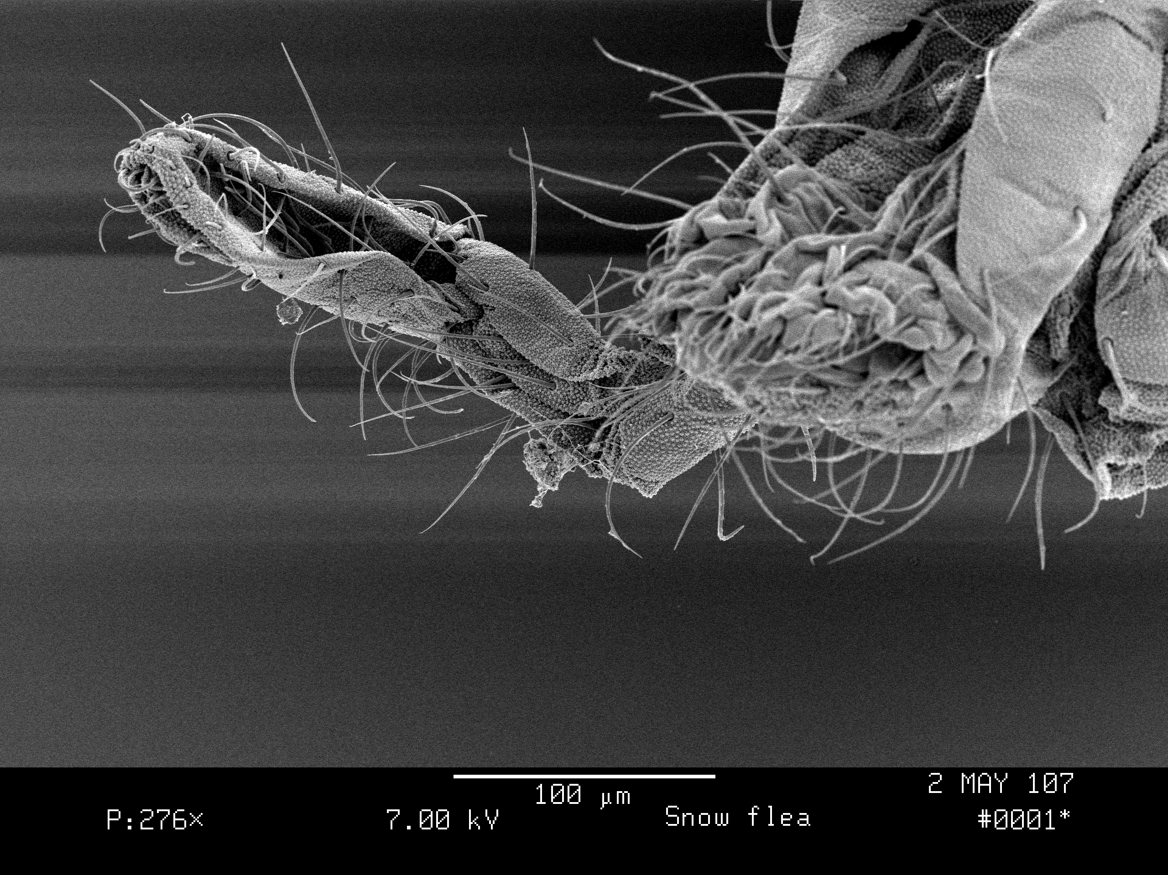
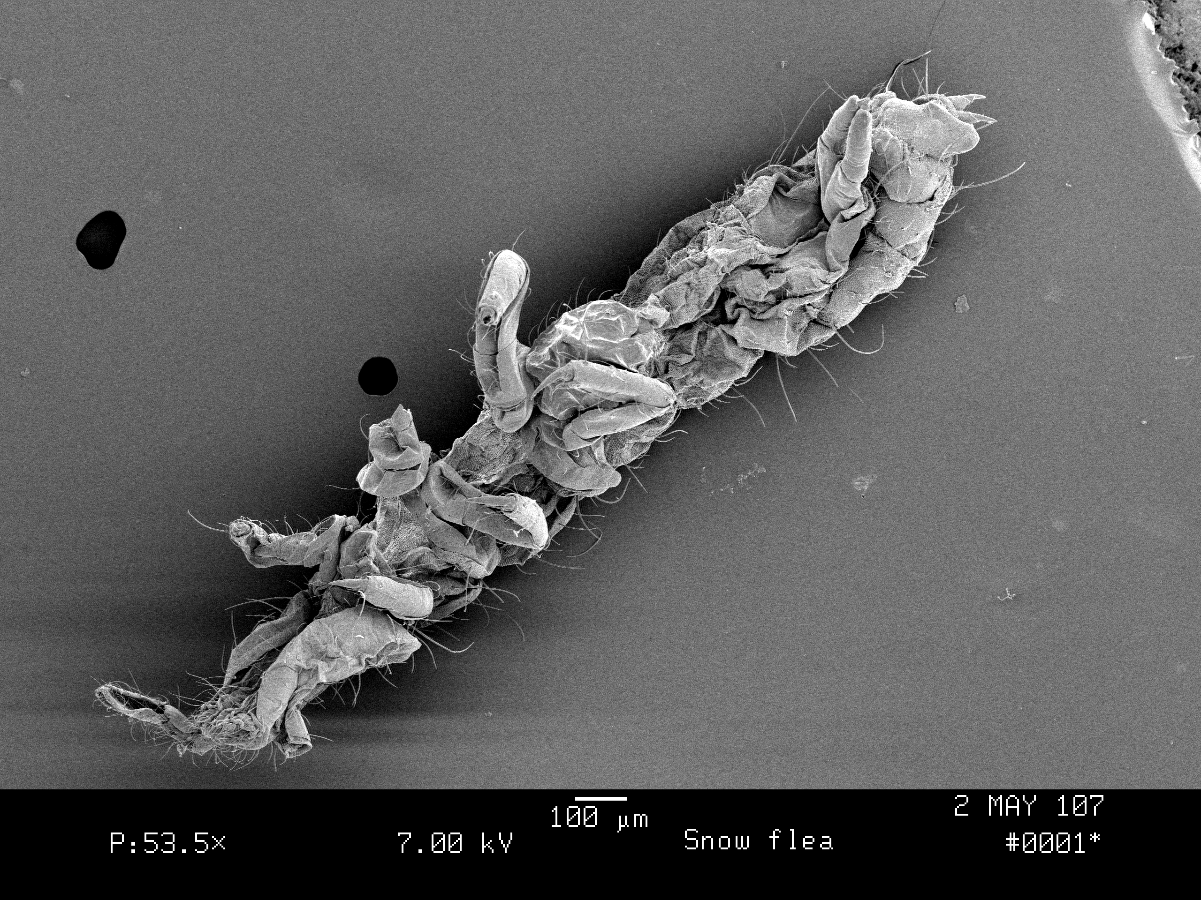
I Am A Springtail.
I have legs, much like a lobster’s. How many do I have?
I hop around on my tail, which is sort of like a shrimp’s tail.

Slide 5
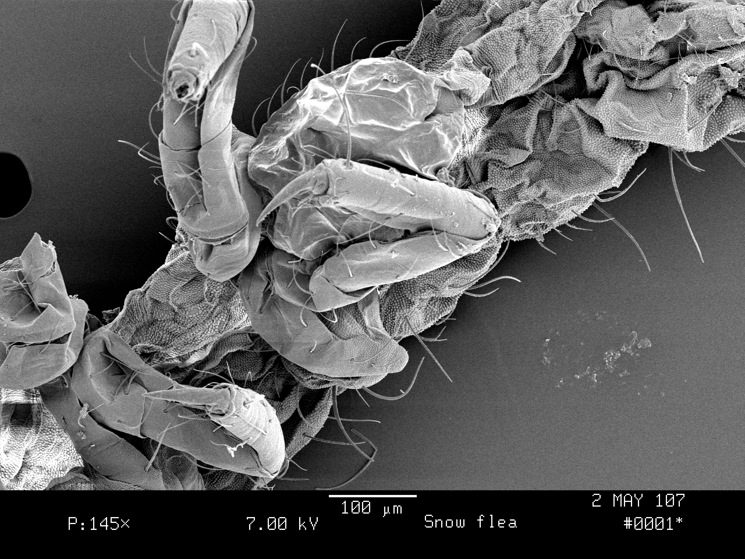
What Do You Think I’m Holding?
When the humans looked closely at me, they seemed surprised. They didn’t know I was holding something very precious!

Slide 6
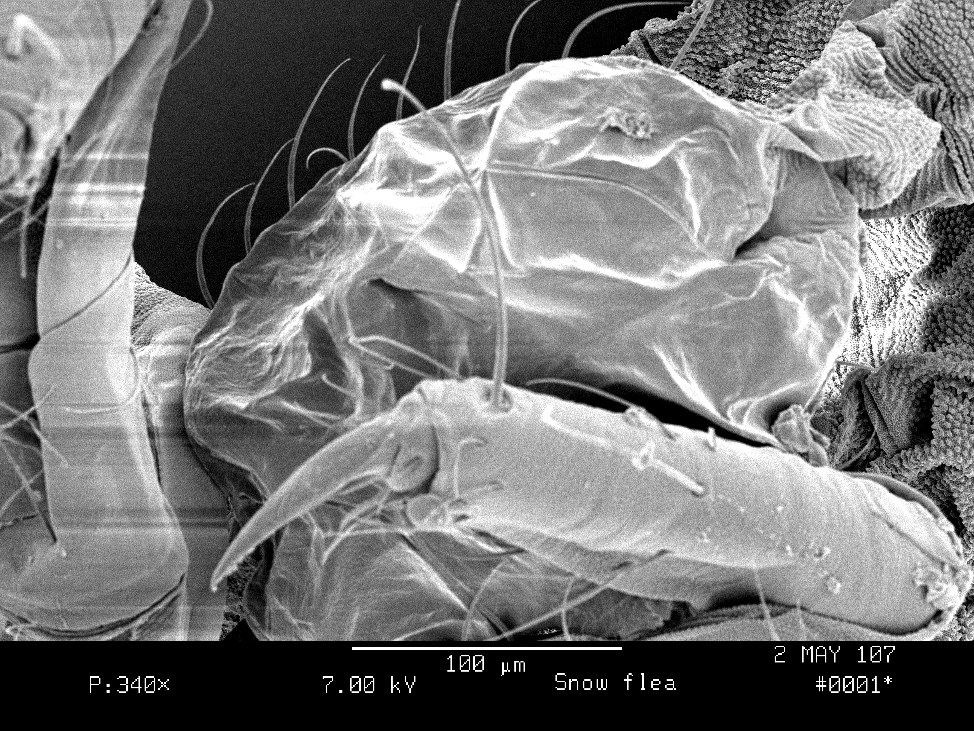
Here’s A Closeup of The Thing
Clue:
Why would I and all the other snow fleas hop around madly on a warm spring day?
Why, even as I’m dying, would I bravely clutch this thing.

Slide 7
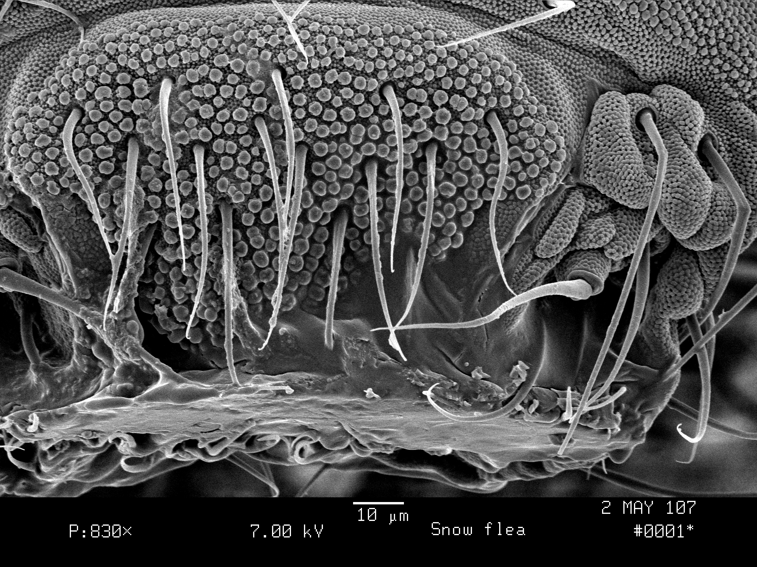
What Do I Eat?
Do I need teeth for this job?

Slide 8
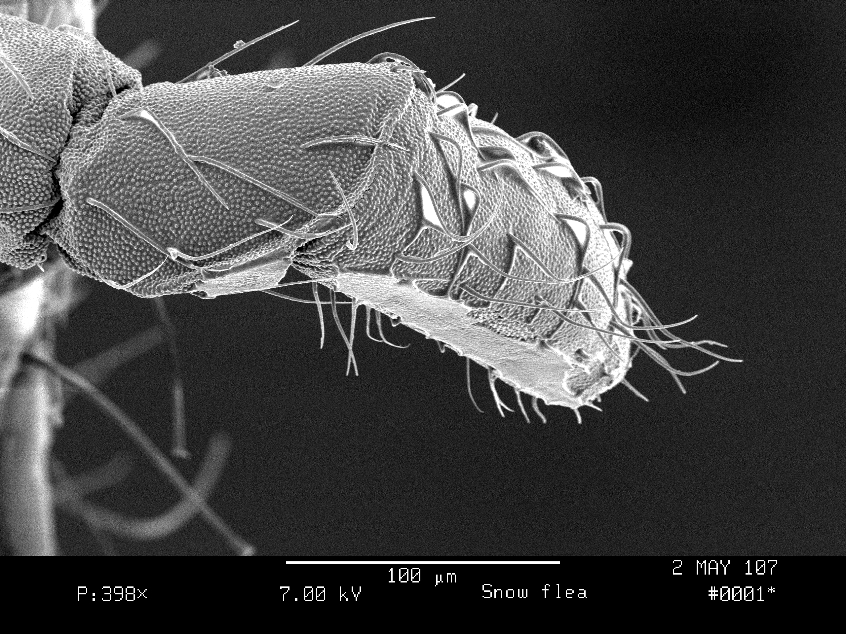
How Do I Find My Food?
What good is this thing?
How do you like my hairs?

Slide 9
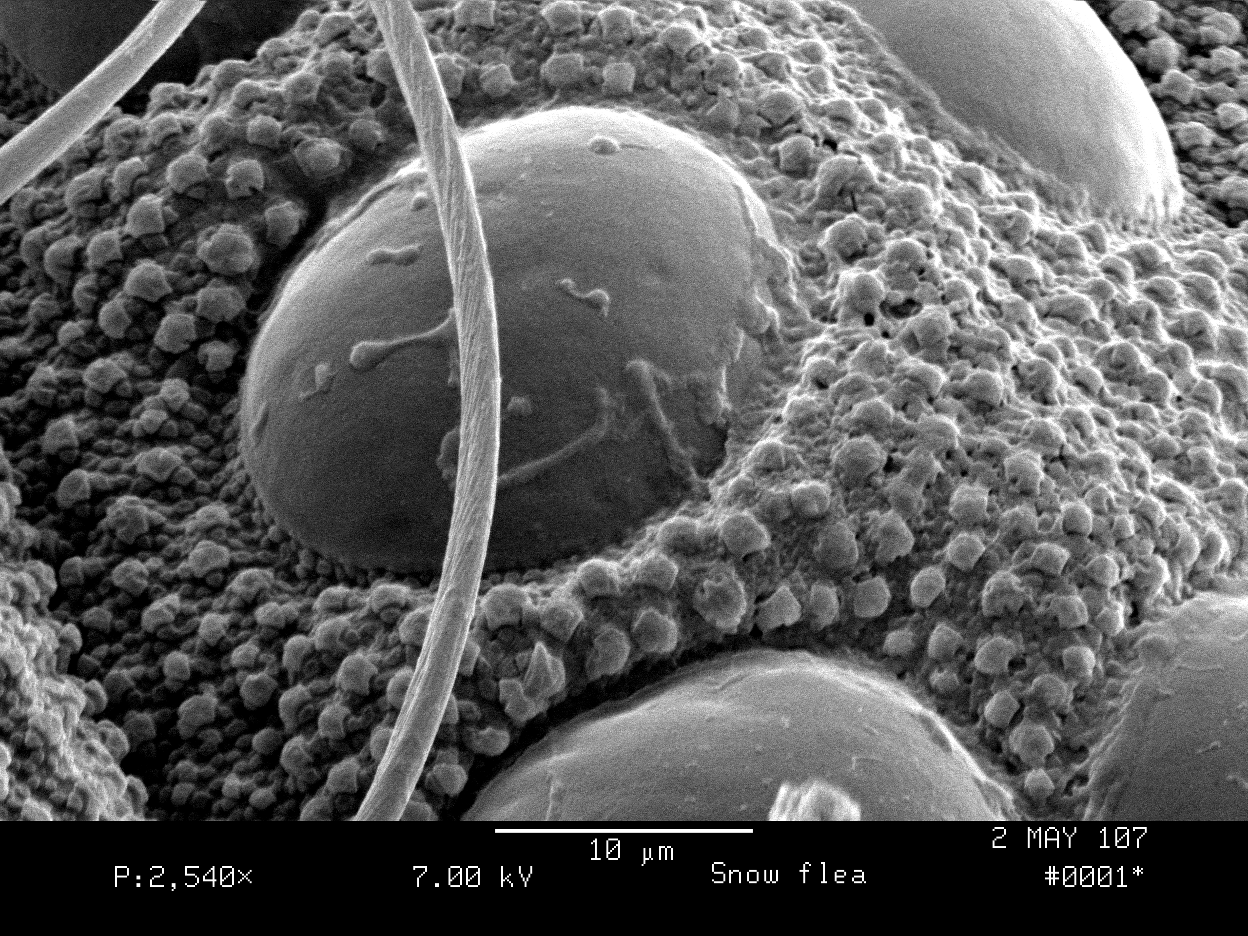
My Eyes Each have 8 Lenses
I see you!
What other animals have 8 lenses per eye?
How many do you have?

Slide 10
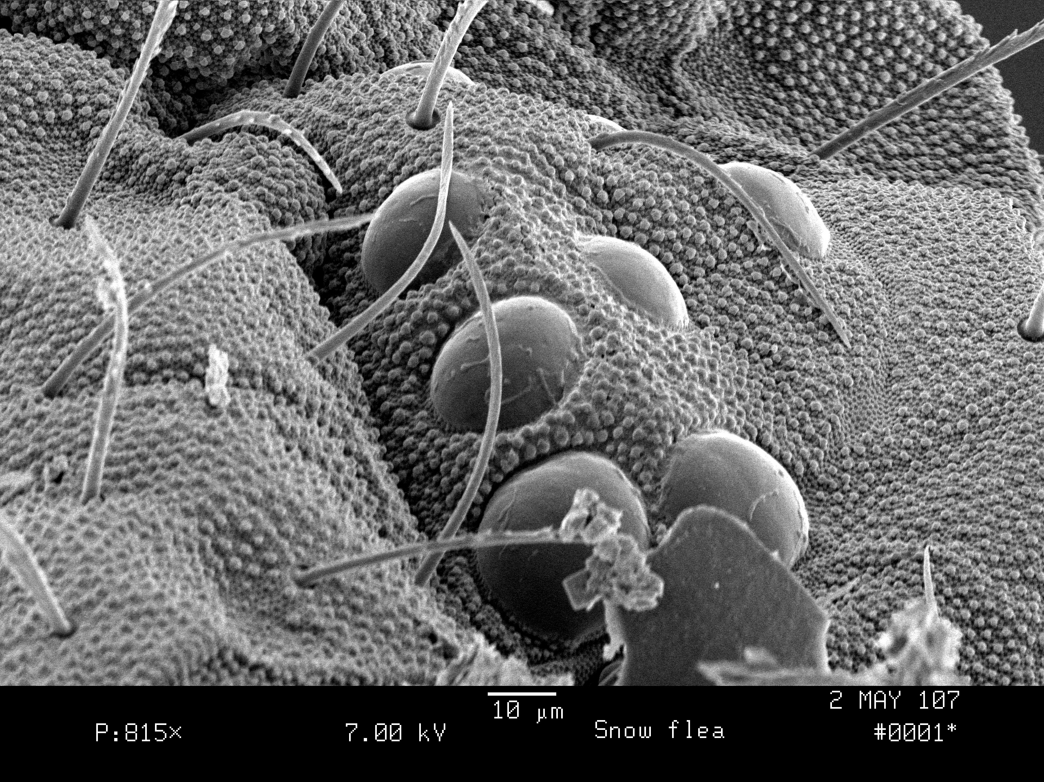
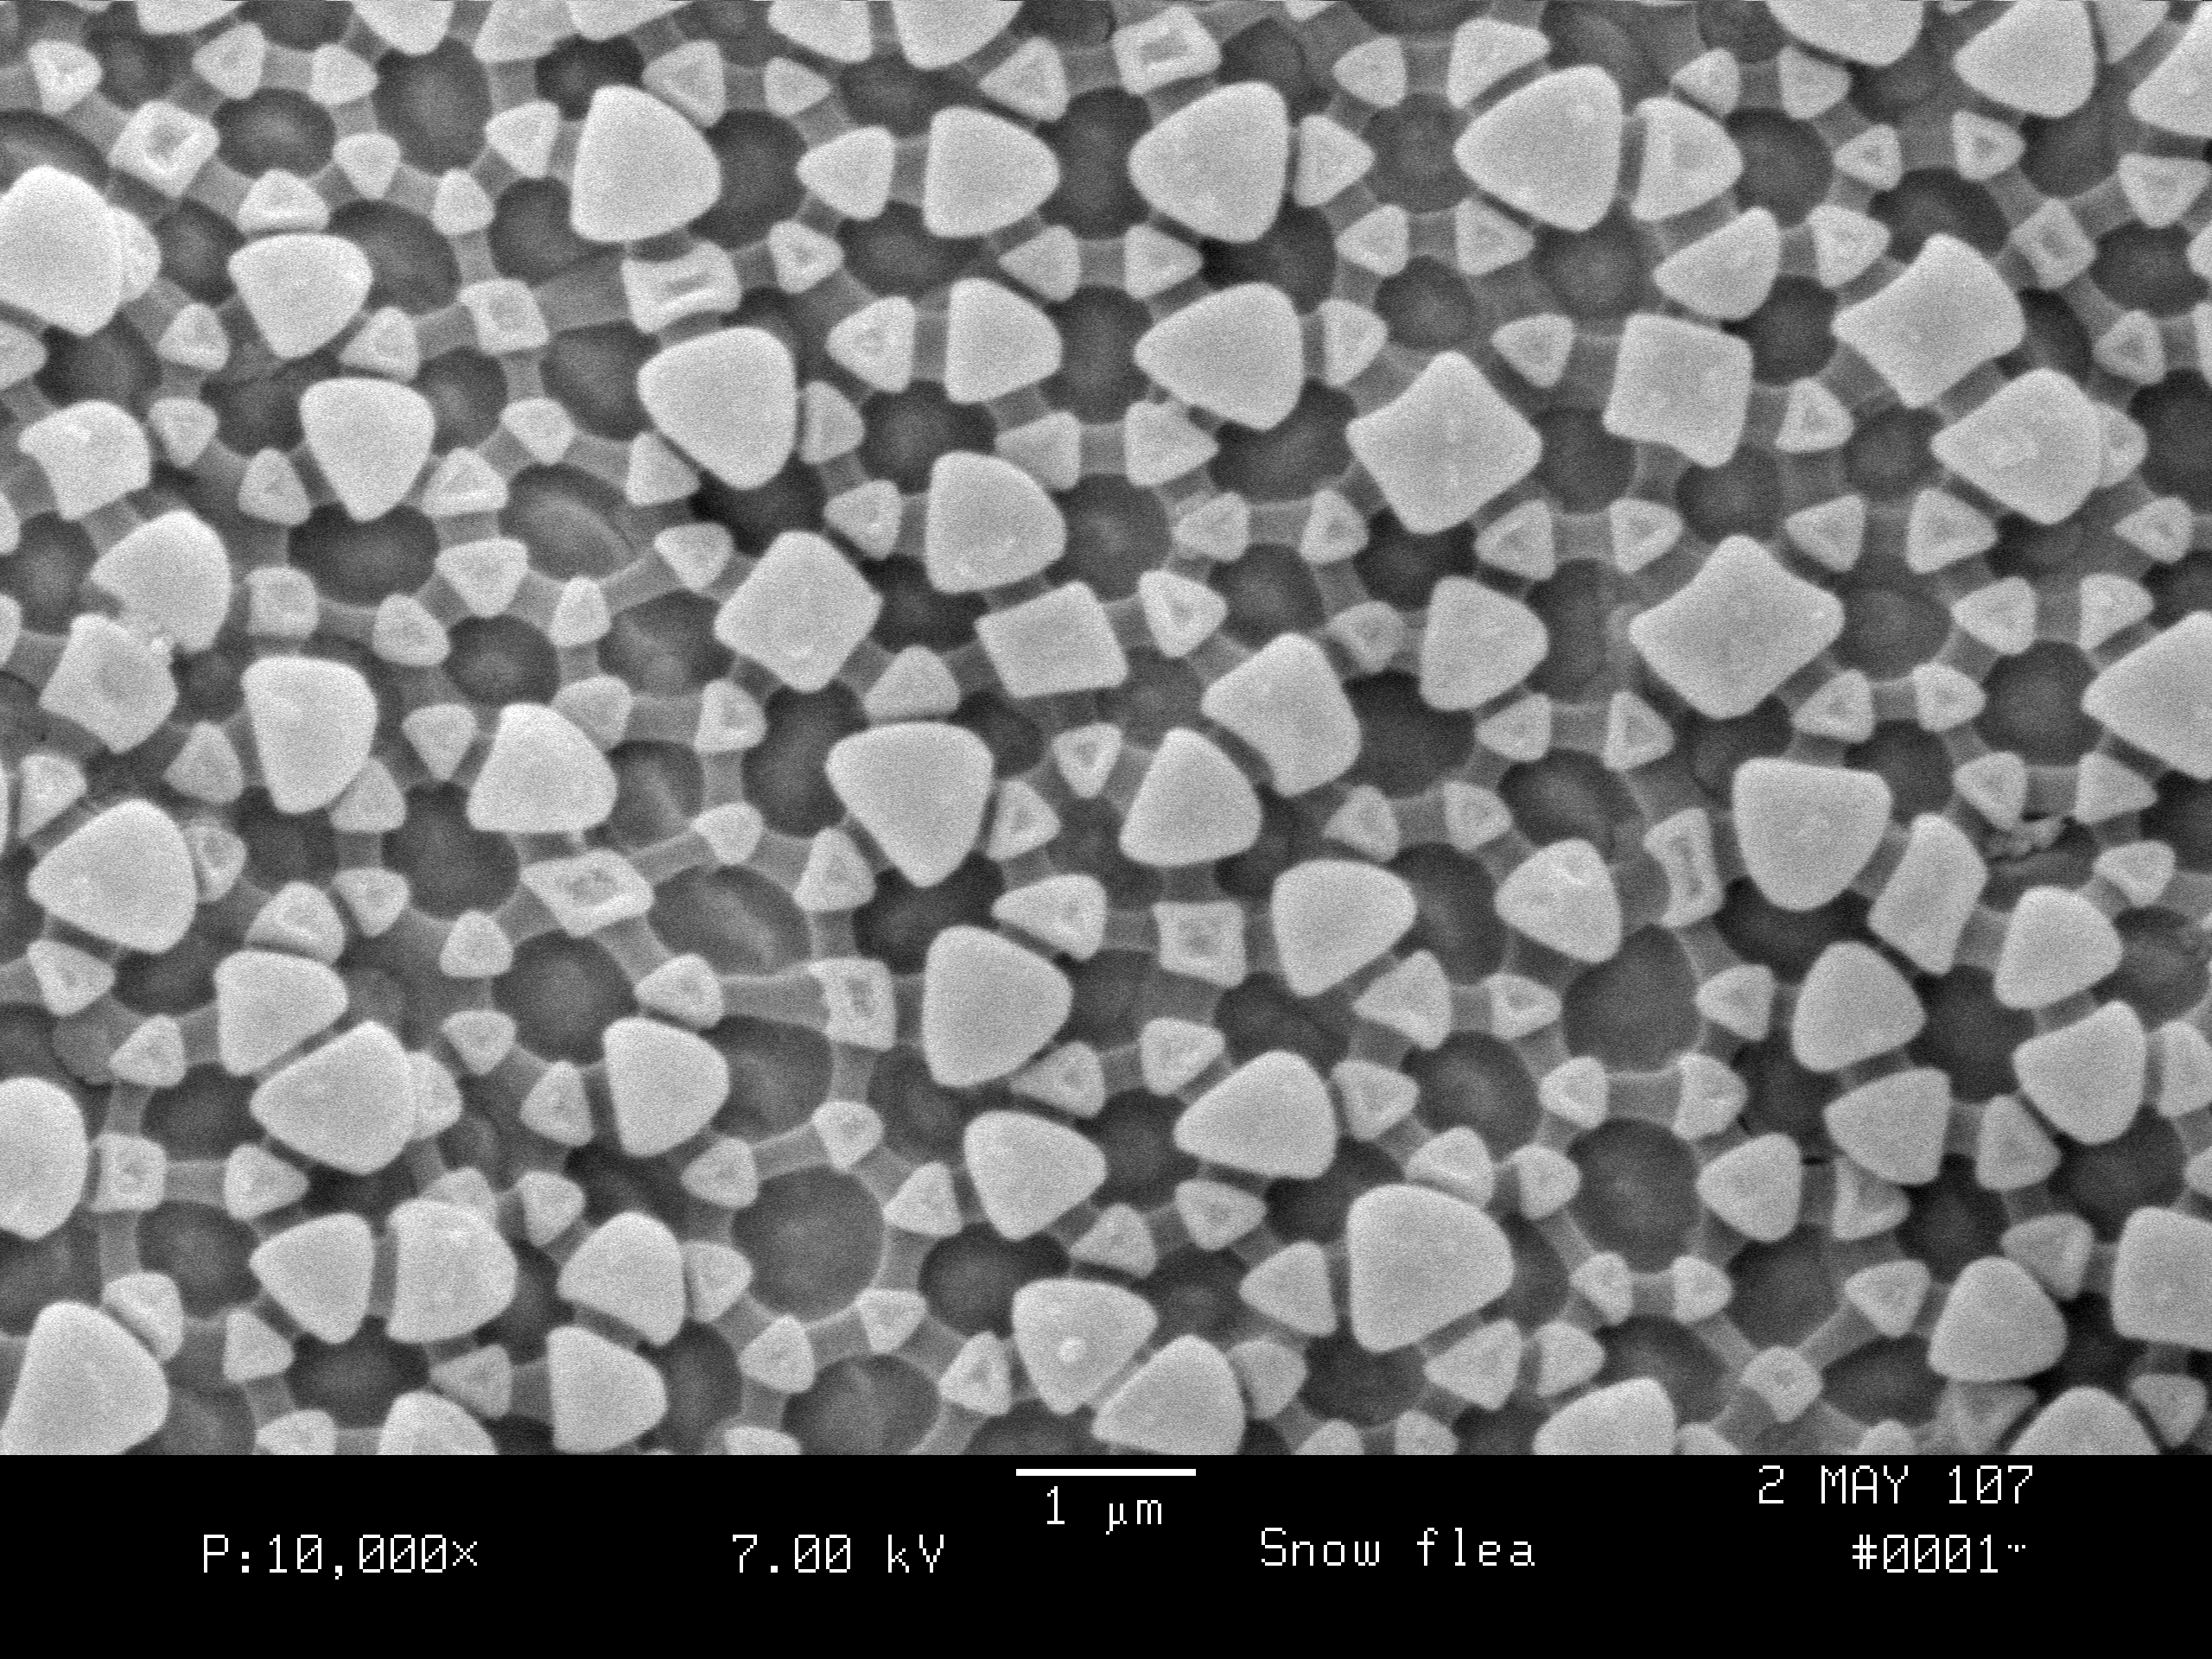
My Skin is Unique
What do you think?

Slide 11
Slater’s Question
On a sunny day, the snow is very wet. Slater wondered how I could get home to the dead leaves under the snow without drowning in a snowmelt waterfall as I slid down through the snow.
How could you answer Slater’s question?
What photo gives you a clue?

