Slide 1
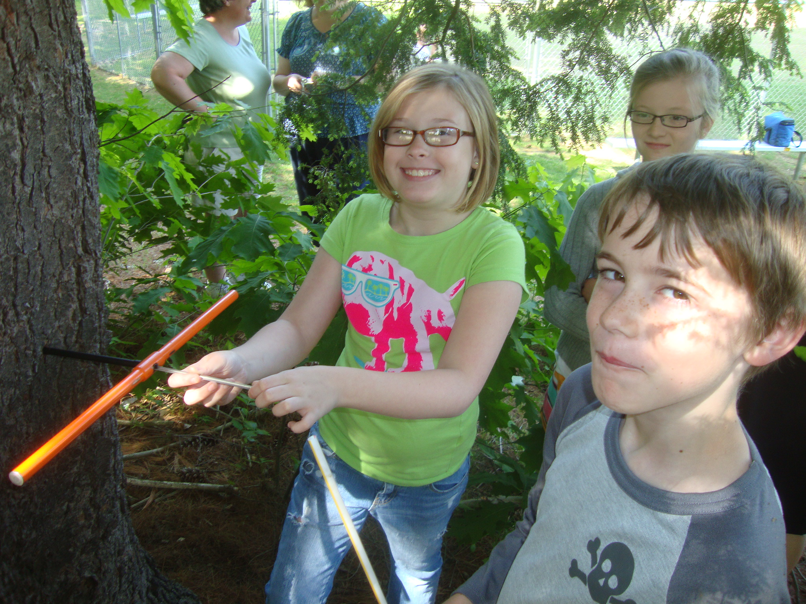
Forest Watch: 20 Years in the Public Schools
A New Hampshire Space Grant Consortium
Success Story

Slide 2

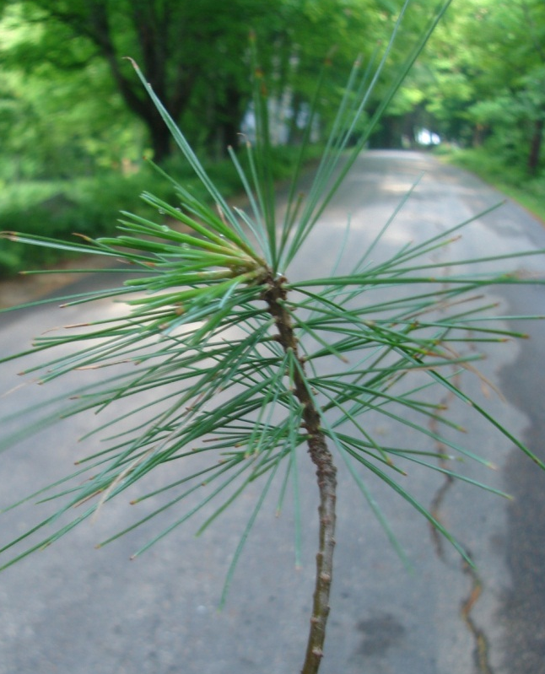
Forest Watch gives teachers and students:
Exposure to academic
challenges:
Botany
Math
Statistics
Physics
Satellite imagery
Calculus
Social studies
Comparative Forestry
Art and Literature
Forest Watch Goals:
• Hands-on/minds-on research
• Authentic science
• An interdisciplinary approach to learning
• A true student and scientist partnership
• An opportunity for students to become active contributors to an on-going research project.
“Wind combers”
White pine, Pinus strobus, an indicator species for ground-level ozone.

Slide 3
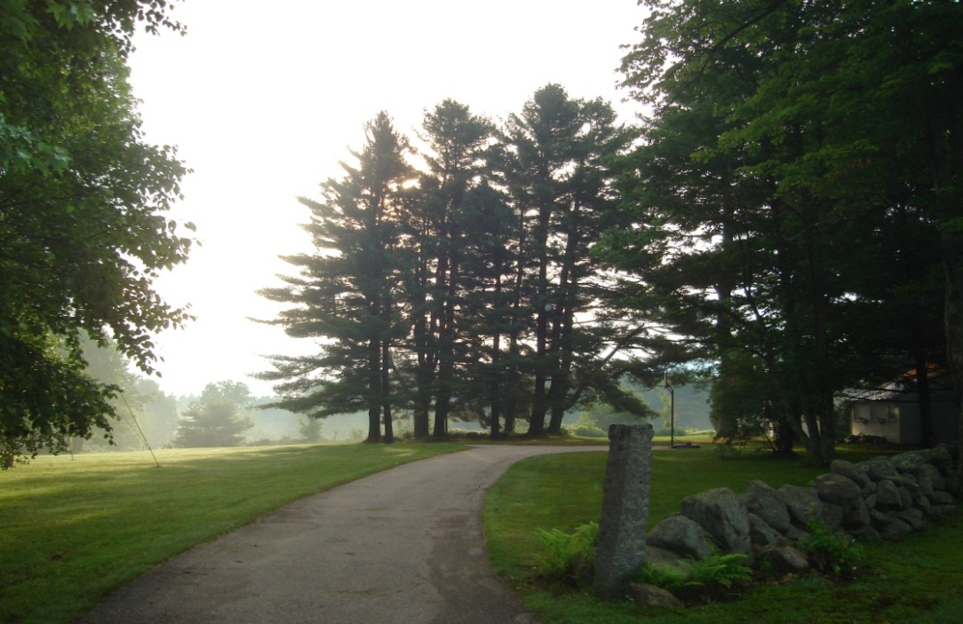
New perspectives on nature
The size of the air pollution issue
The size of the organism affected
The power of students
The power of long-term studies
The power of analysis
The limits of knowledge
Daily change in the environment
Oliver Morton says, “The tree’s form tells the truth. The tree grows into the air because it grows out of the air.”

Slide 4
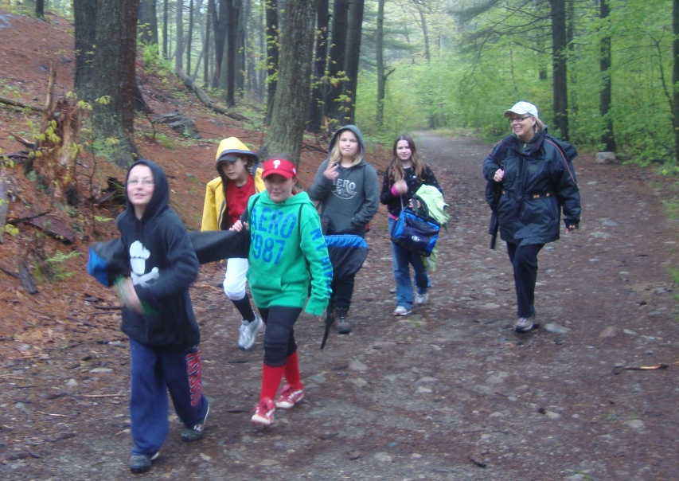
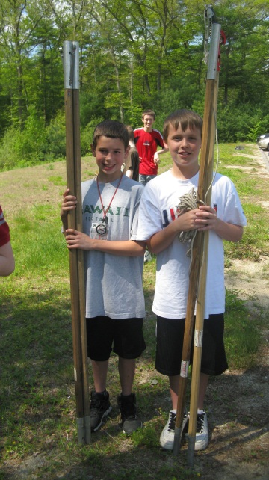
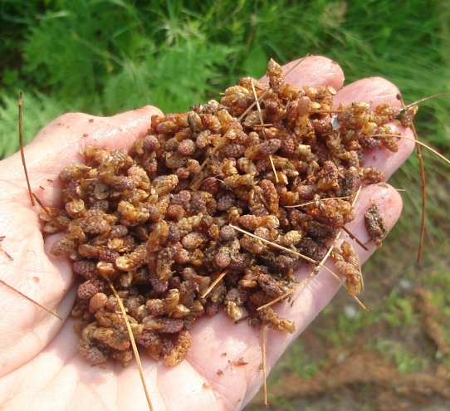
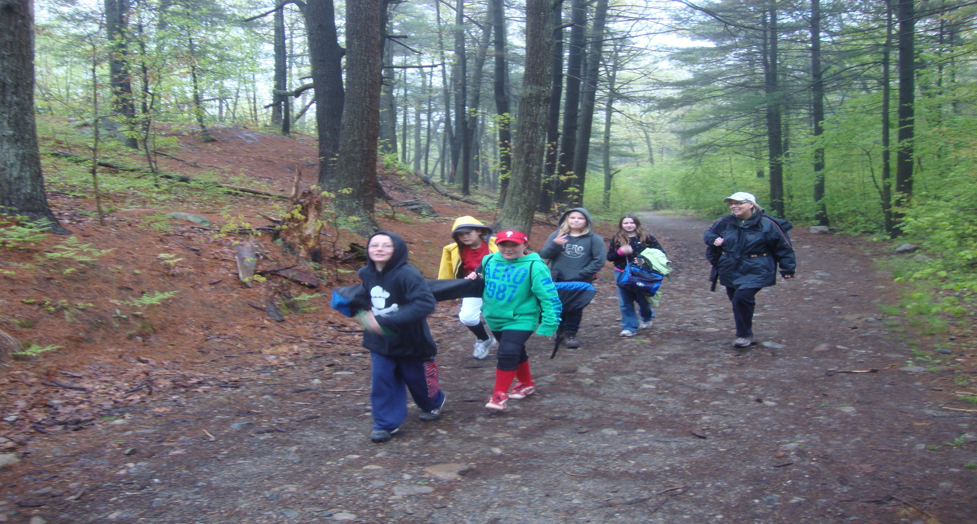
Lessons in the School Yard
Sant Bani School trees in Sanbornton, NH, increased in girth or diameter at breast height (DBH) by 18.28 cm or 1.08 cm a year. The school's five white pines grew 0.58 meter taller year by year, adding 9.9 meters in height over the 17 years.
Observation Safety
Questioning Teamwork
Journaling Sampling
Collecting Measuring
258 schools in New England and the mid-Atlantic.
367 teachers
1767 white pine trees
3,497 field samples
6,994 needle samples.

Slide 5
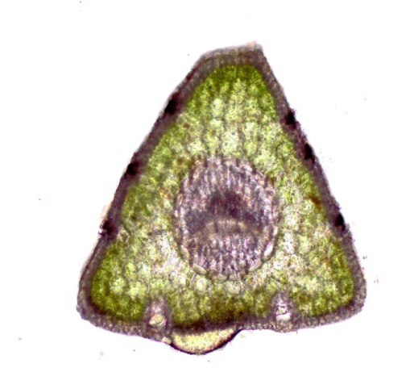
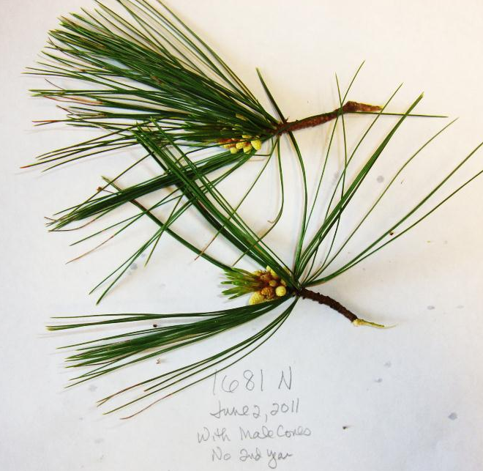
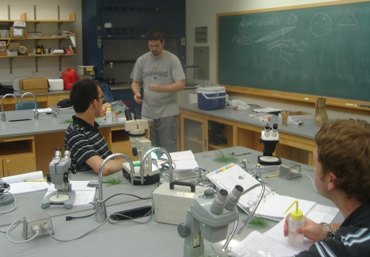
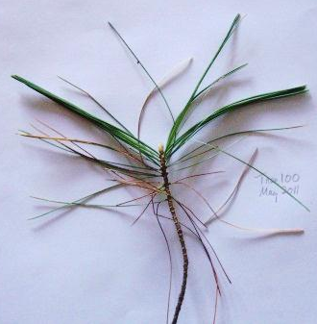
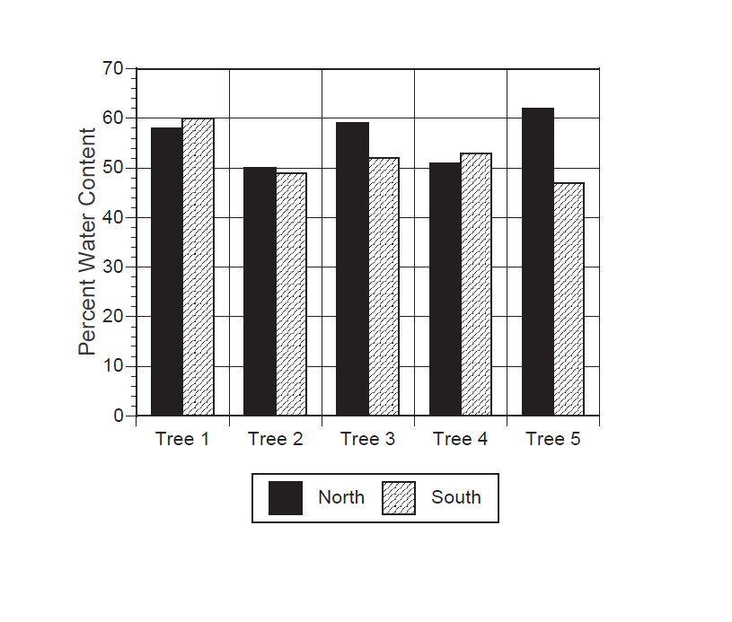
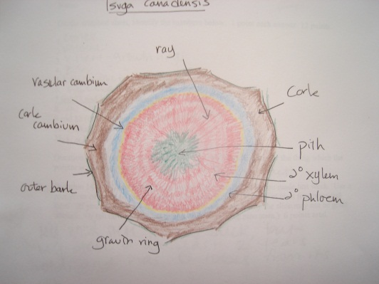
Learning in the Laboratory
196,132 bits of data from needle length to percent of tip necrosis.
Biometric measures
Microscopy
Plant anatomy
Ozone damage
Data results
Graphing
Critical Thinking

Slide 6
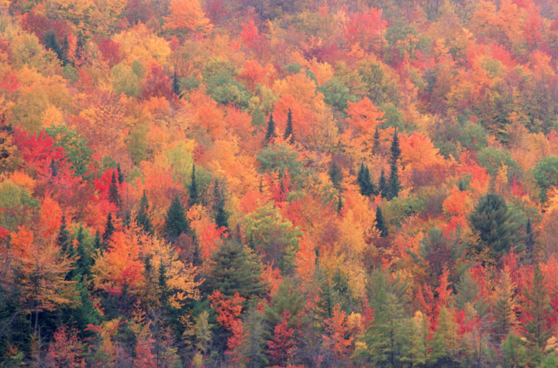
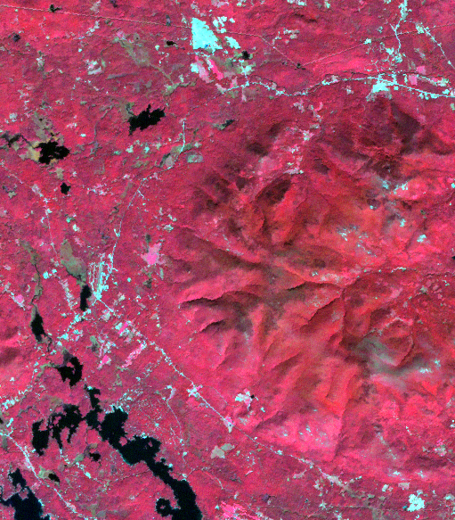
21st Century Technologies
Image sets for each school.
Multispec interpretation and classification.
Ground-truthing.

Slide 7
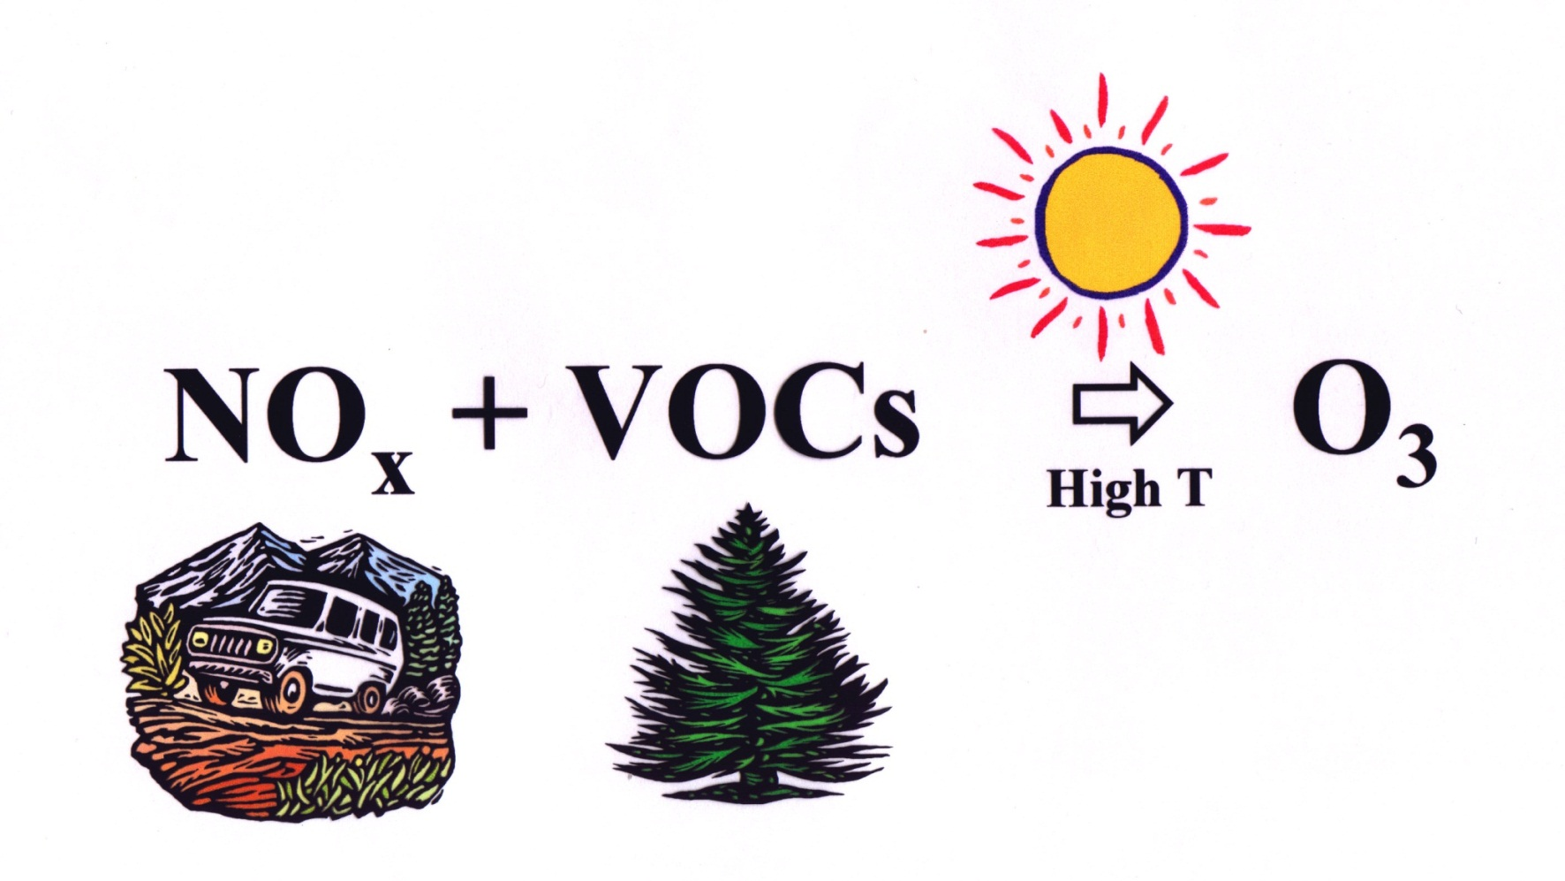
Earth Systems Science

Slide 8
Learning to Read Light
REIP
NIR 1
NIR3
NIR, TM5
NIR, TM4
Water
“Can anyone explain what the Red Edge Inflection Point is?,” Dr. Rock asked.
“A longer wavelength means this tree has more chlorophyll,” Sierra, 7th grader.

Slide 10
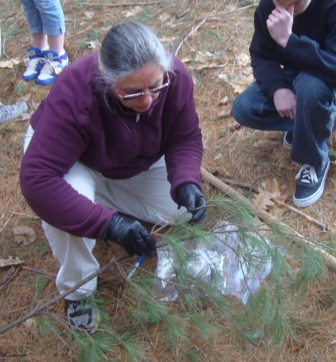
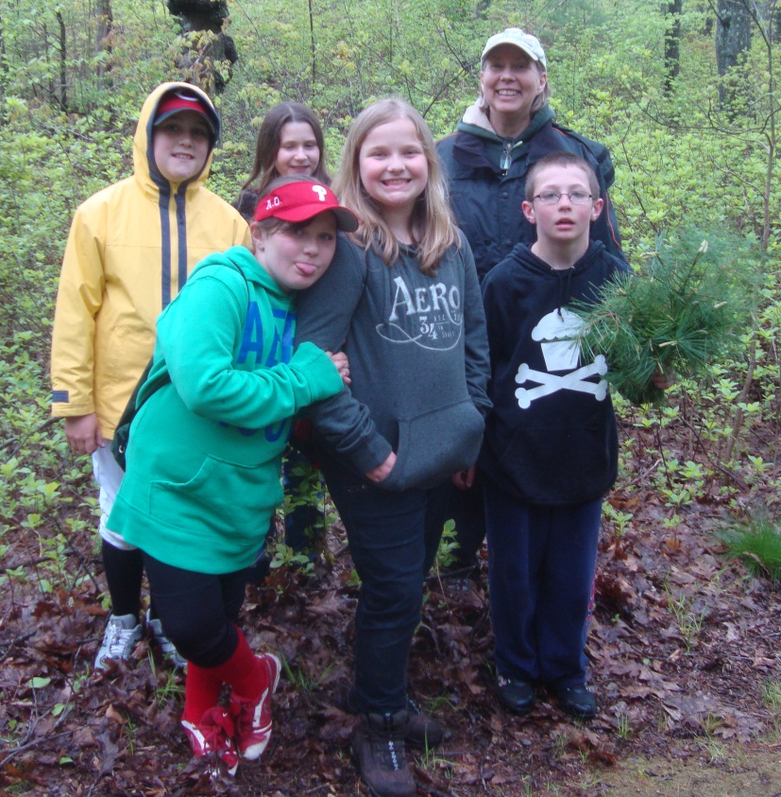
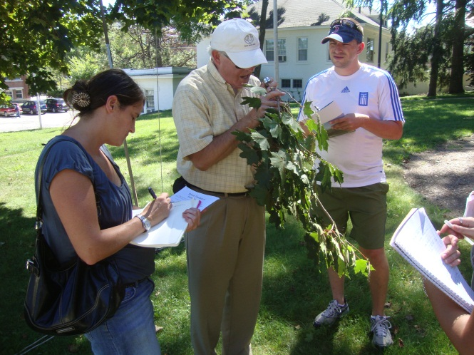
Why Forest Watch Works
28,000 students in 20 years.
Teachers can incorporate modules into required curriculum.
A teacher’s talents and skill come to bear.
Timing is flexible.
The tree is in the school yard.
Little or no costs.
Supportive training and staffing.
Web site resources.

Slide 11
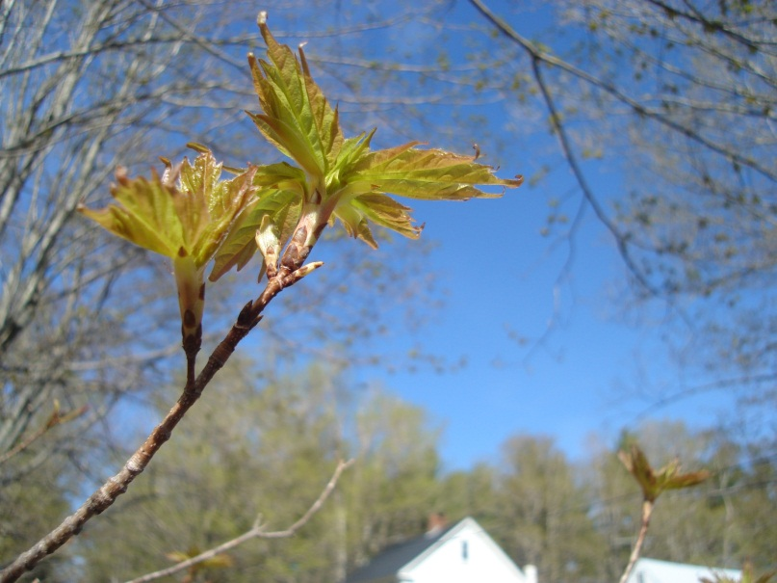
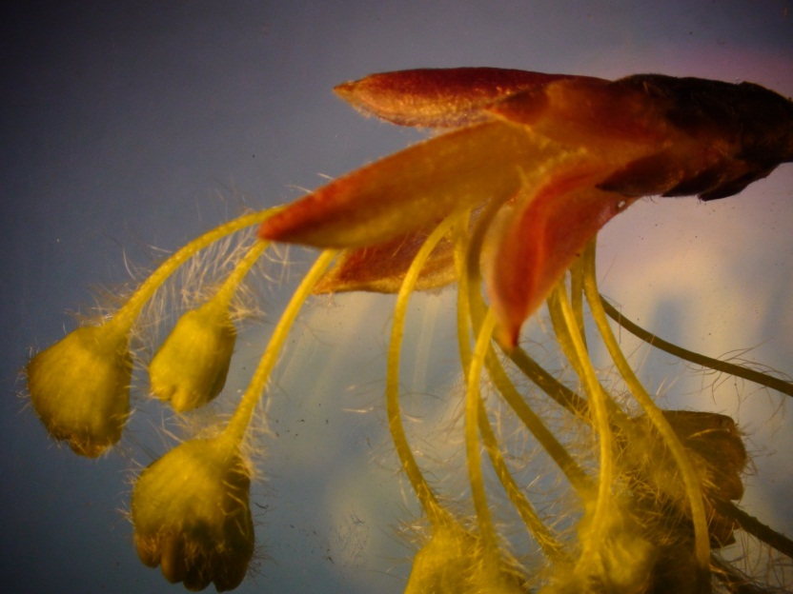
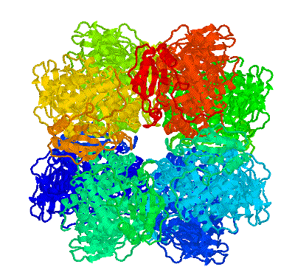
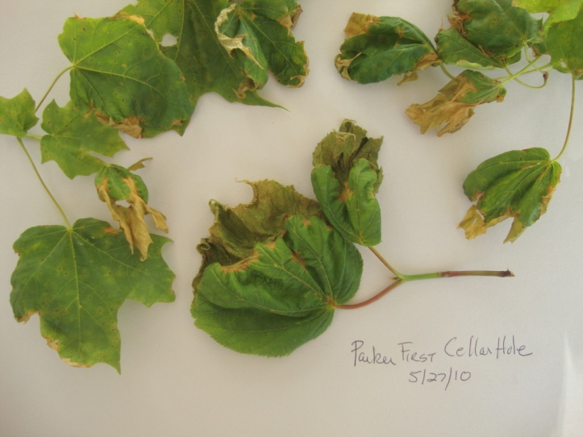
What’s Next for Forest Watch?
New technologies?
New pollutants?
Unexpected occurrences?
Phenologic change?
An imperative need for more master teachers to teach and prepare the American public.

Slide 12
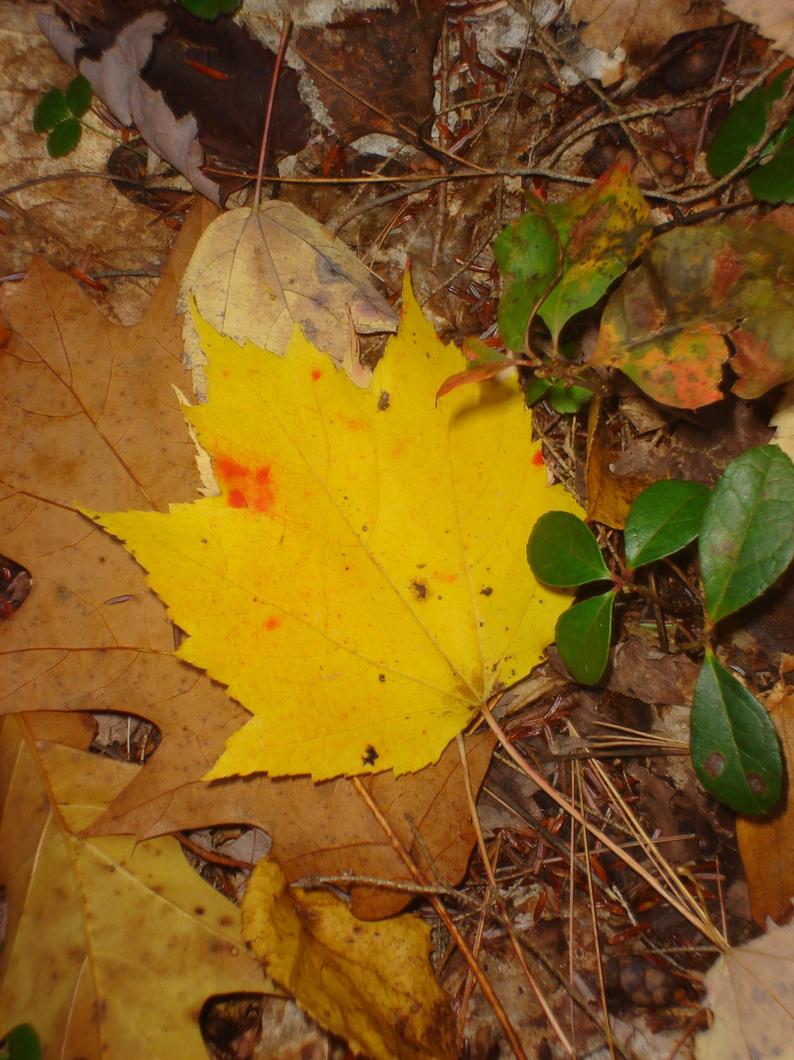
Teaching Climate Change
“Climate change is a highly interdisciplinary, pedagogically challenging subject that does not fit easily into discipline-based science curricula or assessments. However, a variety of factors—chief among them being barriers introduced by local STEM education policies and inadequate teacher preparation in this subject matter—prevent widespread exposure of learners to effective instruction on climate, or engagement of the most talented minds in climate-related education and career paths.” (NSF, 2010)

Slide 13
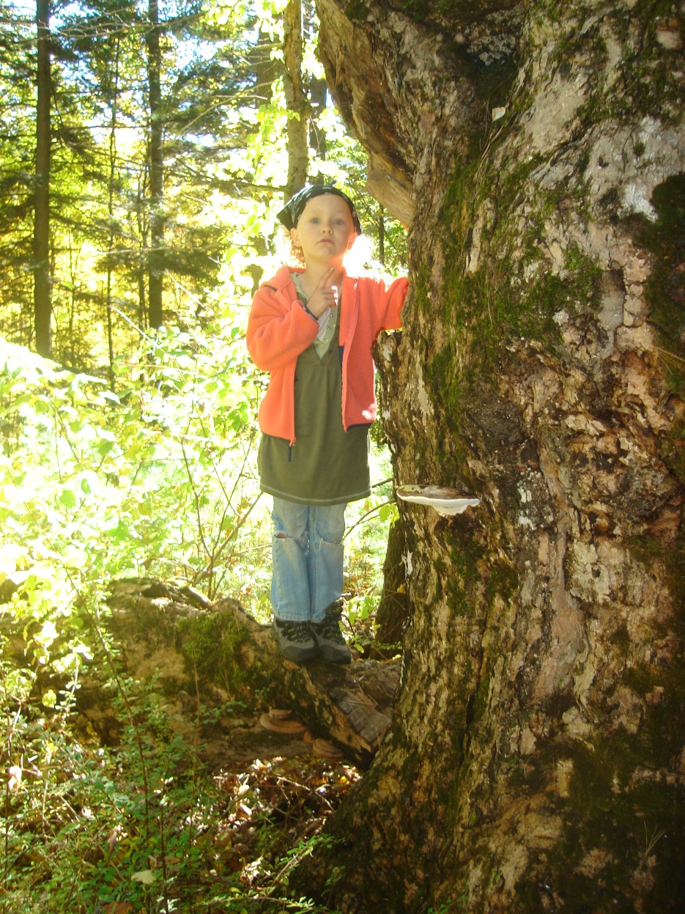
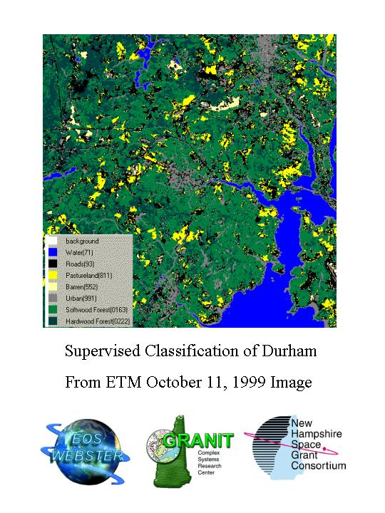
“Student experiences should model
the nature of science
to illustrate the wonder and connections that
make science real,” Louise James, 4th grade teacher, Sewall-Anderson School, Lynn, Massachusetts, laid off when science program was cut, 2008.

