Slide 1
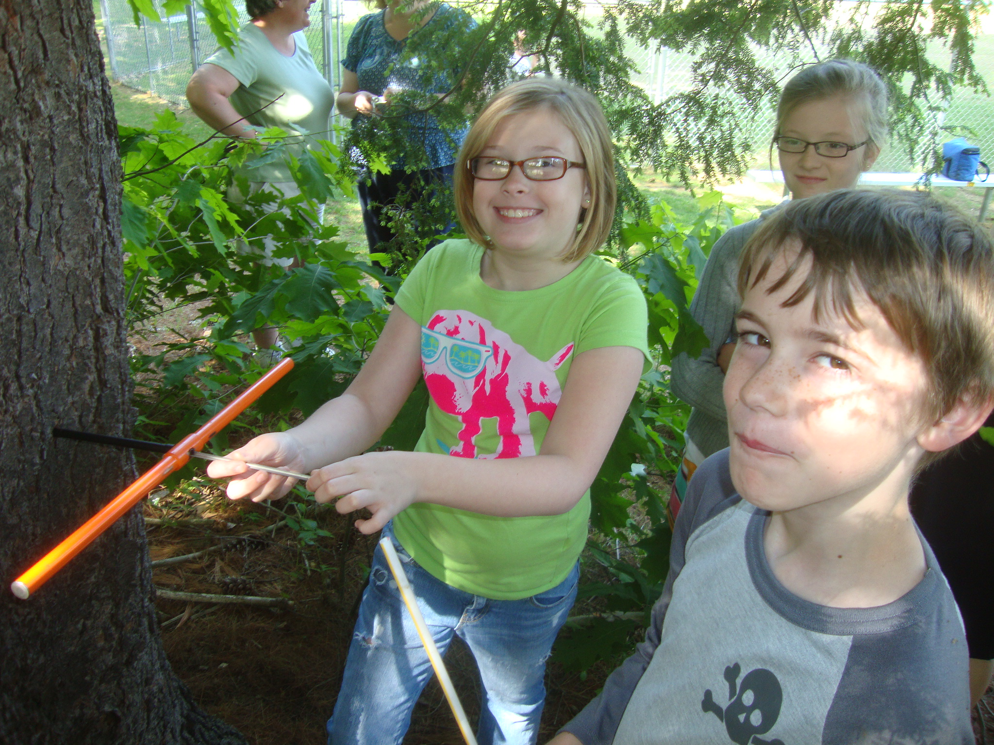

Slide 2
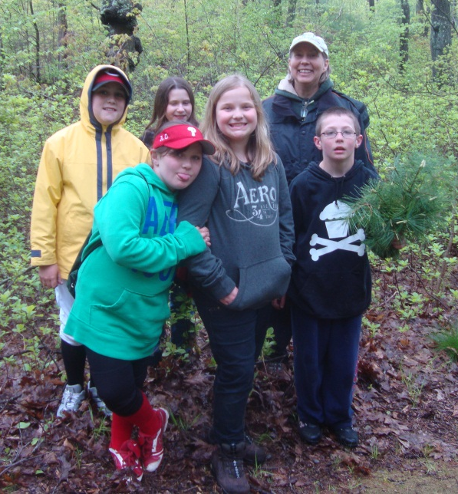

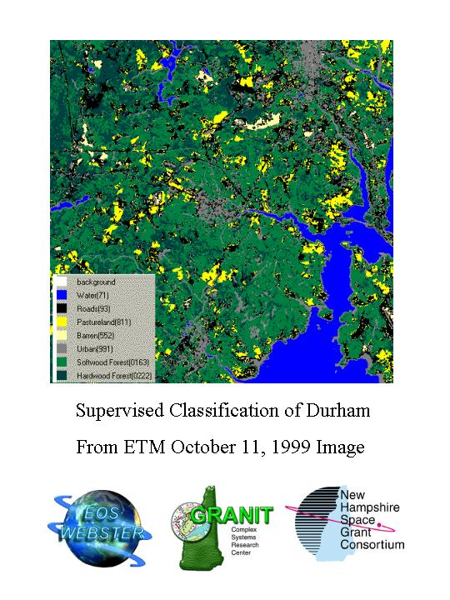
2010-2011Forest Watch
Data Book Review & Discussion
Ozone summary for 2010
Spectral & Biometric Data Analysis
Student Research
Needle Retention
New Questions
Students & Scientists Working Together
Determining the Health of New England Forests

Slide 3
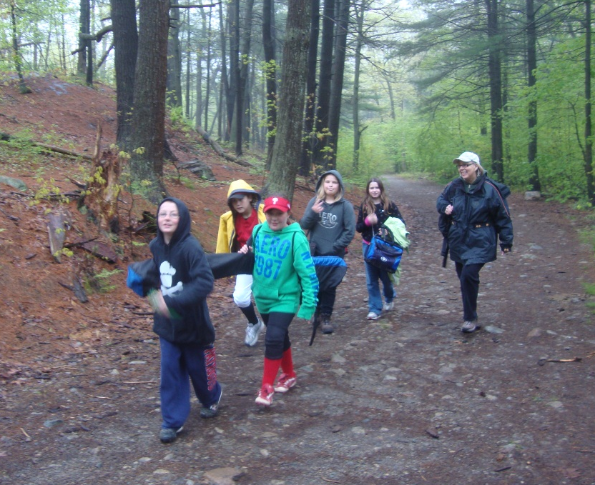
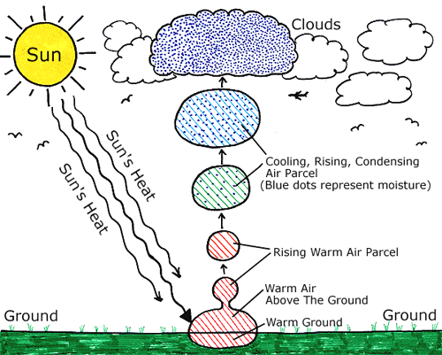
Students Engage in Real Science: How Do White Pines Respond to Tropospheric Ozone?
Measurements in white pine stands, monitoring tropospheric ozone damage and forest health.
NOx + VOCs in and high heat = O₃

Slide 4
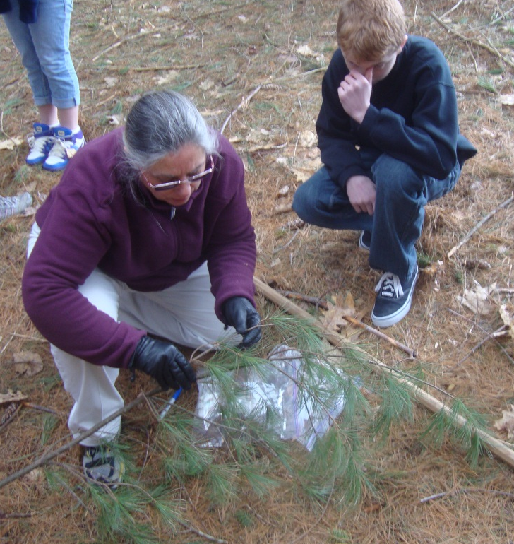
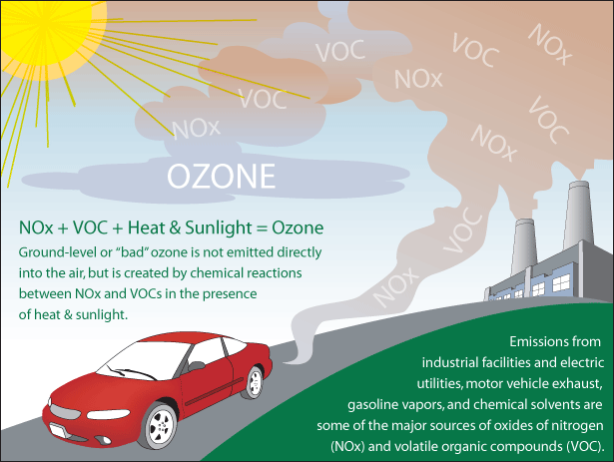
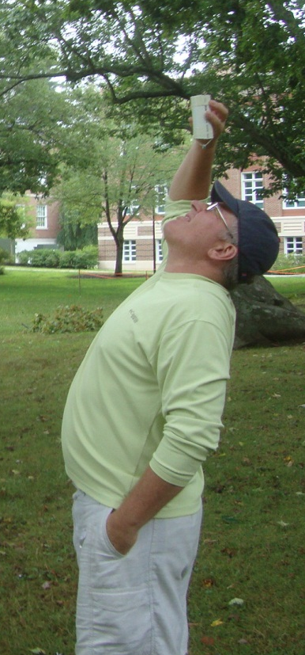
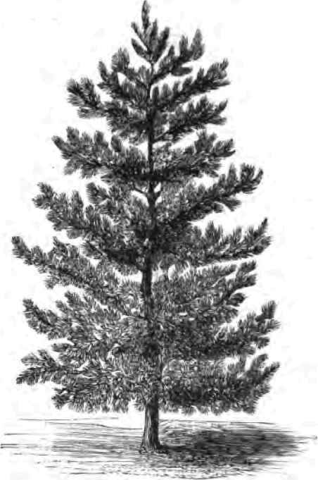
Teachers Teaching in the Forest
Complex relationships: atmospheric chemistry, trees and forest health.
The scientific method. Safety and teamwork outside the classroom.
Accuracy, labeling, tool care. Mathematics, analysis.
Presentation, comportment, language. Spectral and biometric measures.

Slide 5
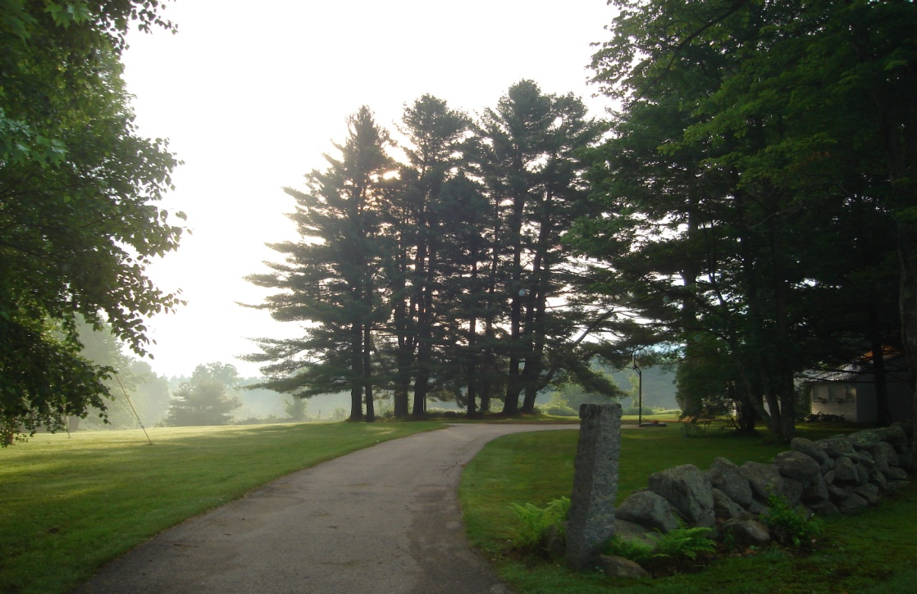
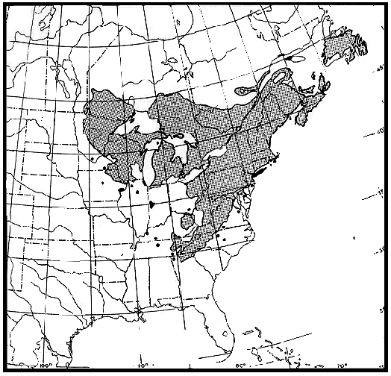
Why the Eastern White Pine,
Pinus strobus?
Selected Because:
It is a bioindicator of tropospheric
ozone (SMOG) exposure
It is a keystone species in the New England forest.
It retains foliage year-round, can be studied throughout the school year
It often occurs right outside the classroom
(a local fieldtrip)
Since the King’s forester notched the first King’s mast tree, white pine has been part of New England’s story.

Slide 6
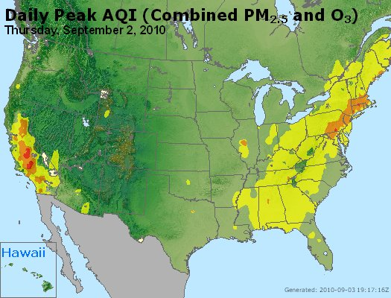
Changing Timing of Ozone Events
Figure 3.1: Ozone levels at peak concentrations on September 2, 2010, high day in 2011. Highest in 2011, January 26.
Source: www.epa.gov/airnow/2010.

Slide 7
New Research in Tropospheric Ozone
Bermuda High
Appalachian lee
Low-level Jet Stream
Stratospheric infolding
Figure 3.2: Vertical profiles of the troposphere in three New England monitoring sites show ozone levels increase with altitude. Ms. Lai measured ozone at 340 ppb near the top of the troposphere, 10 to 12 km above the Earth (Lai et al., 2011).

Slide 8
NAAQS
8-hour Average Peak Concentration
 | 0-50 ppb
 | 51-100 ppb
 | 101-150 ppb
 | 151-200 ppb
 | 201-300 ppb
More Stringent Standards Side-Stepped in 2011
1990
1-hour 120ppb (parts per billion): the average of the 4 highest values must be
< 120ppb over any 1 hour period each day.
1997
8-Hour 80ppb (parts per billion): the average of the 4 highest values must be
≤ 80 ppb over any 8 hour period each day.
2008
8-Hour 75ppb (parts per billion): the average of the 4 highest values must be
< 75 ppb over any 8 hour period each day.
The new 2010 standards were to set 60 to 70 parts per billion per volume (ppbv) as the maximum acceptable level of ozone over any 8-hour period.
“…I have requested that Administrator Jackson withdraw the draft Ozone National Ambient Air Quality Standards at this time.” President Barack Obama, Sept. 2, 2011.

Slide 9
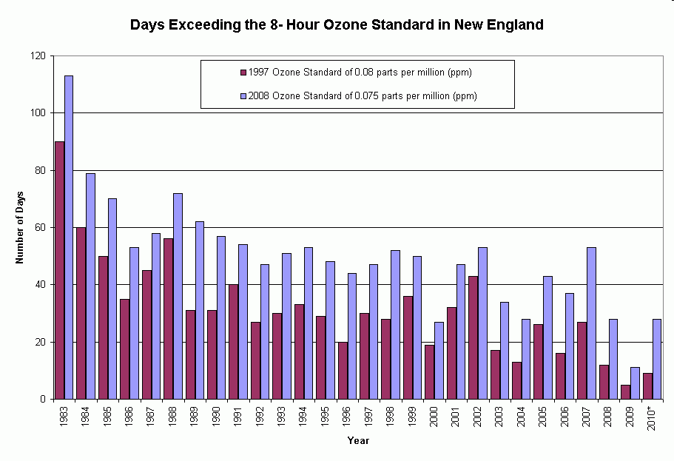
Ozone Exceedance, 1993-2010

Slide 10
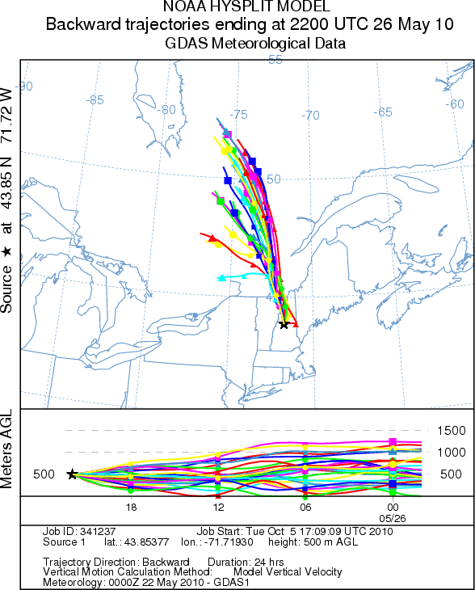
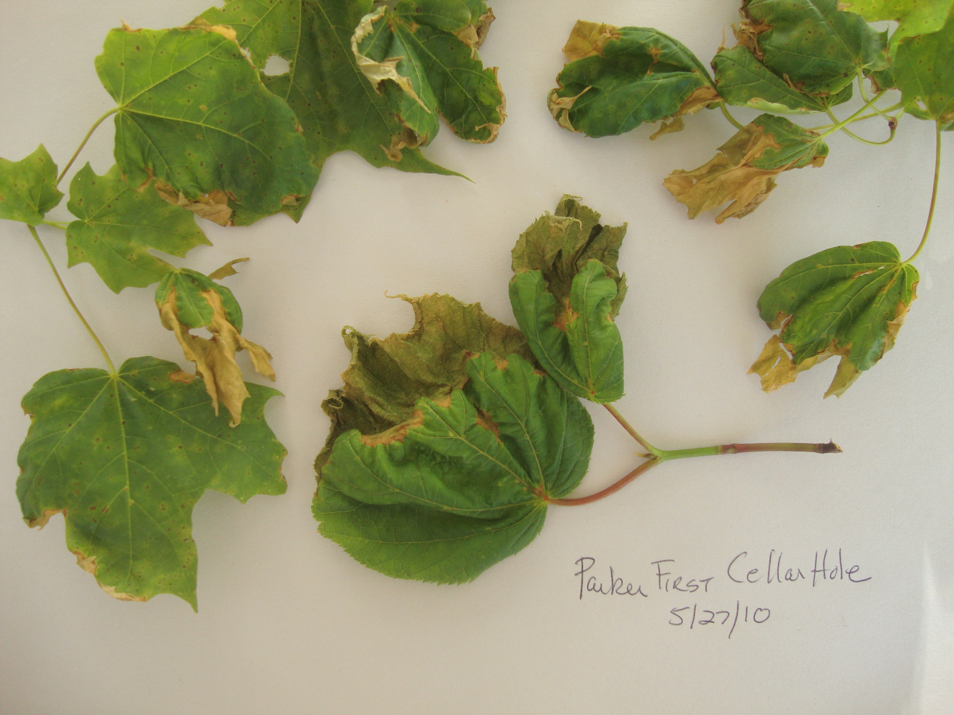
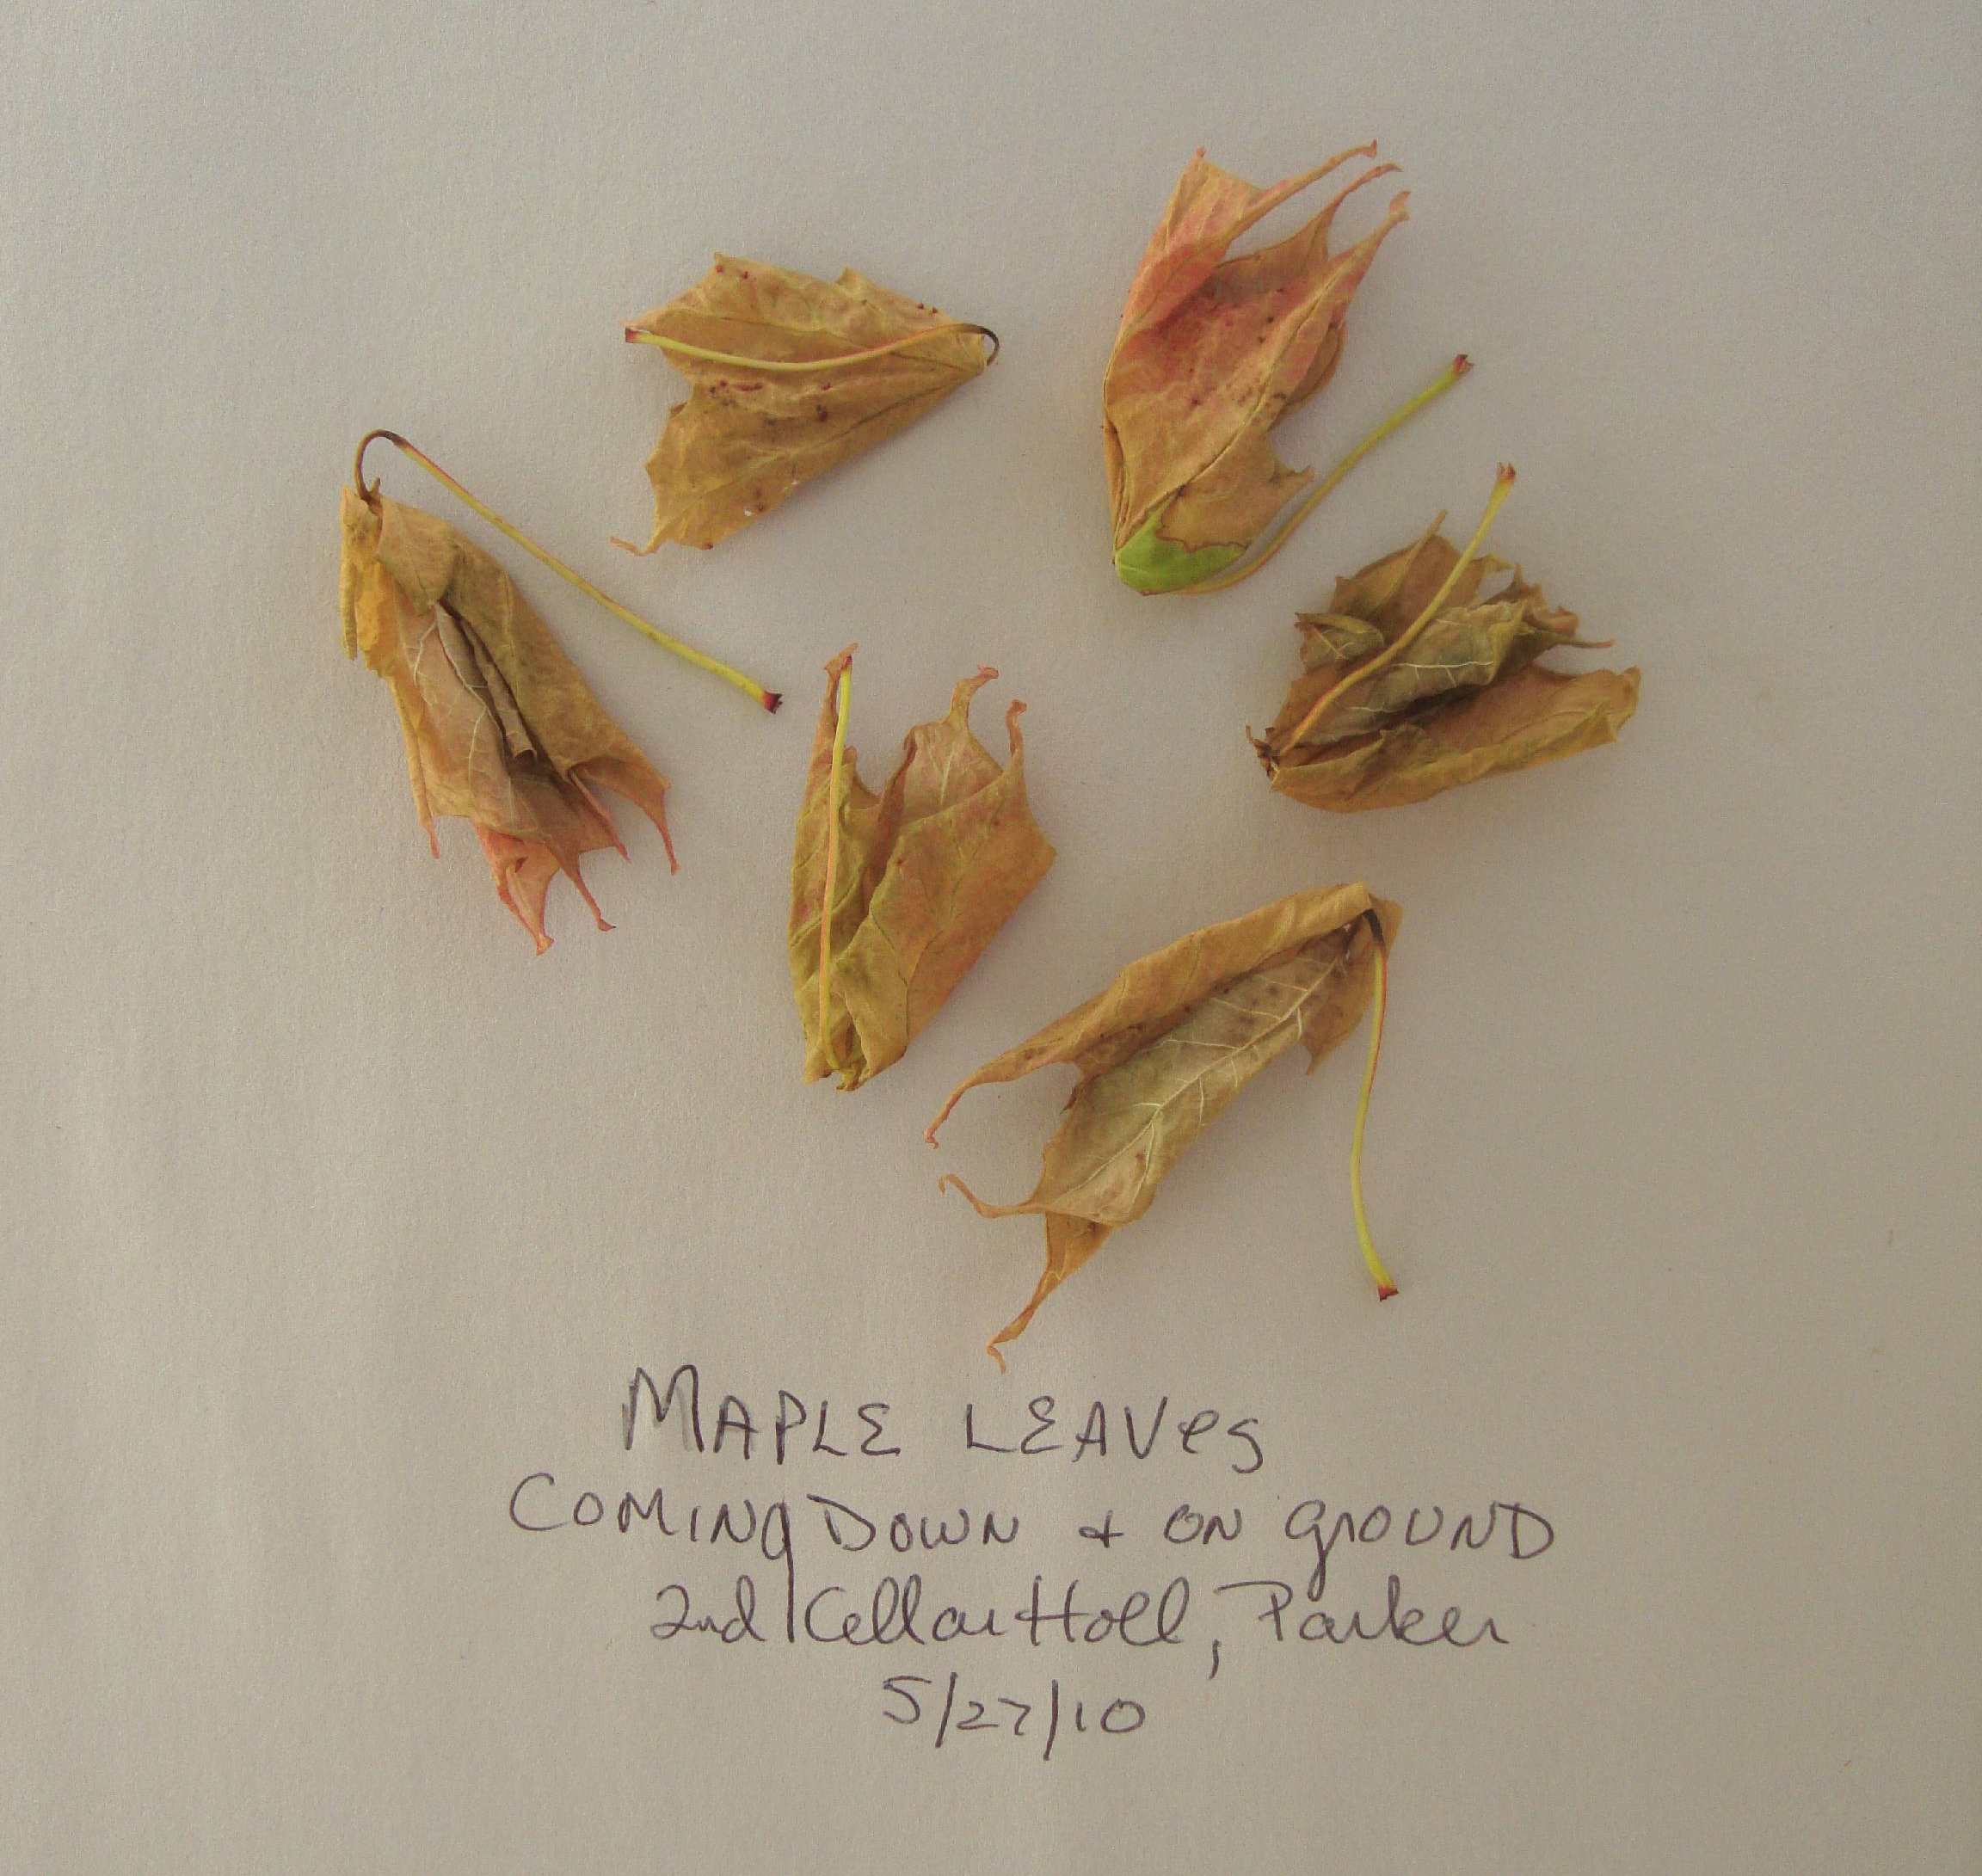
One More Atmospheric Change: PAN
Backward trajectories of air masses on May 26, 2010.
Peroxyacetyl nitrate.

Slide 11
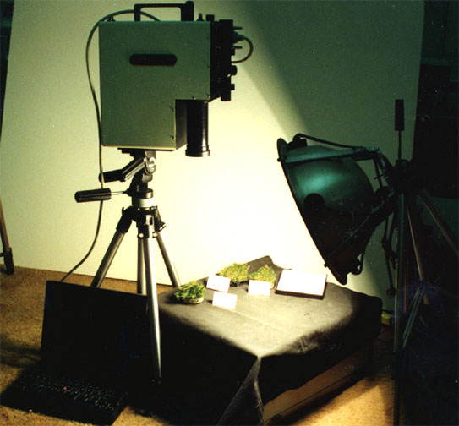
Spectral Readings of White Pine Needles
A very
healthy
spectral
report.
Reflectance Index | Number
All Needles from 74 trees, 2010
Red Edge Inflection Point (REIP) | 723.69
TM Band 5/TM Band 4 Ratio (TM54) | 0.52
Near Infrared Band 3/Band 1 Ratio (NIR31) | 0.85
Table 4.1: VIRIS indices for white pine needles, 2010.

Slide 12
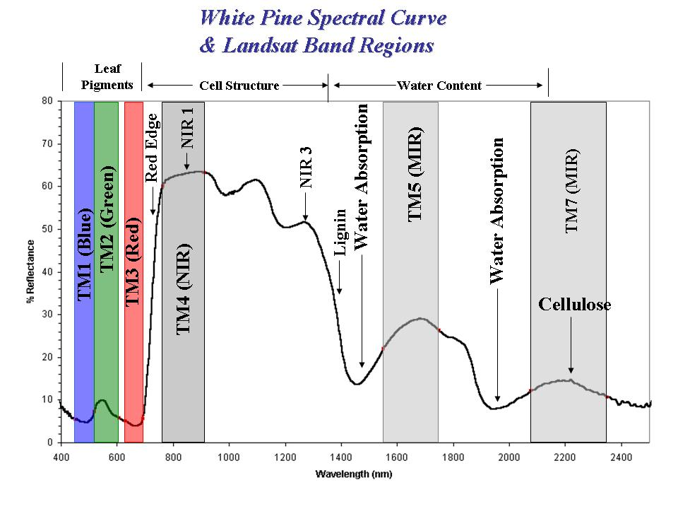
Students Are Learning to “Read Light”
[Visible Light ] [ Near Infrared Light ] [Short Wave Infrared Light --------------------------------------]

Slide 13
Interpreting the Reflectance
Red Edge Inflection Point correlates with chlorophyll concentration.
TM5/4 with water content.
Figure 4.3: A positive correlation between chlorophyll and REIP (Moss & Rock, 1991.)

Slide 14
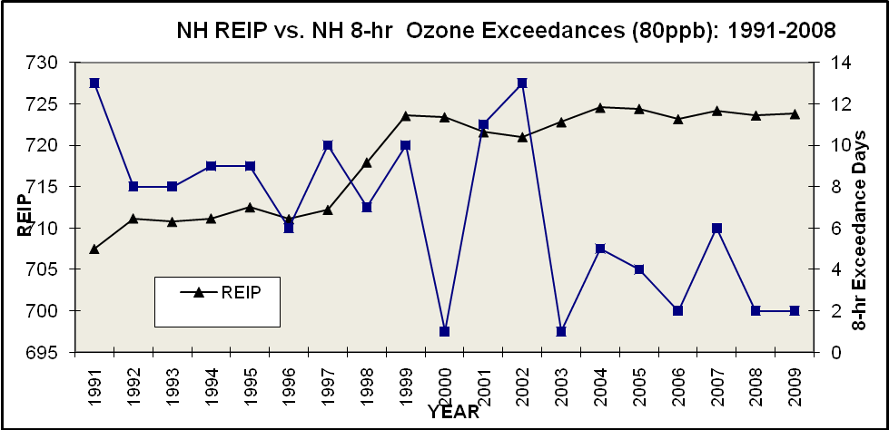
REIPs and Ozone
The inverse relationship holds: As ozone levels fall, white pine needle health climbs.

Slide 15
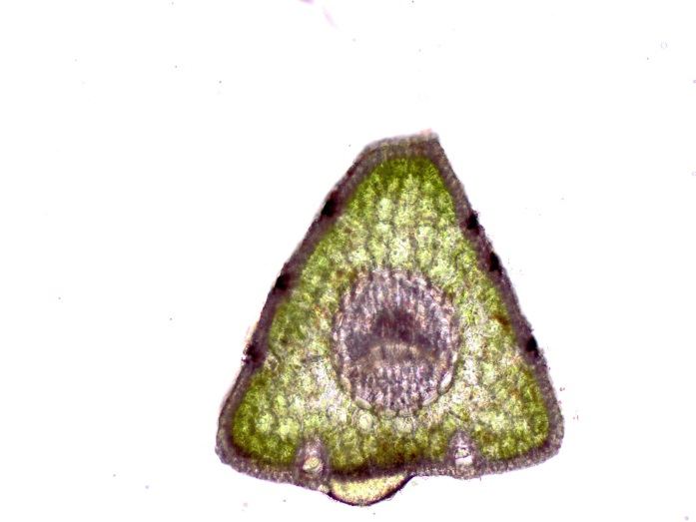
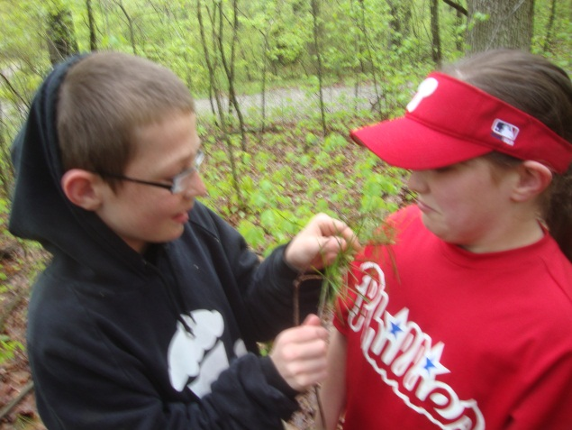
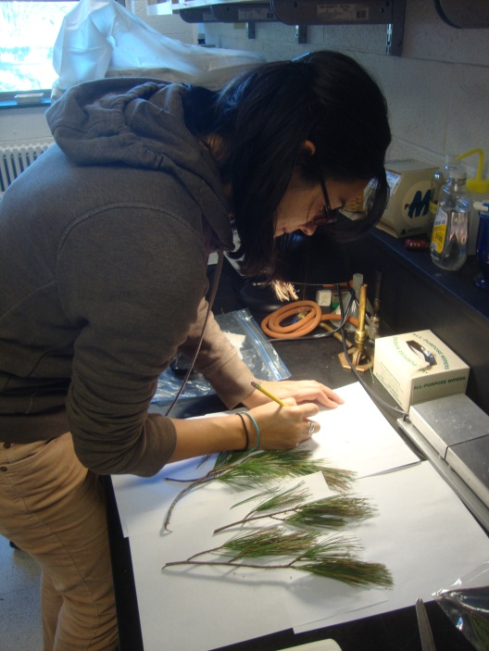
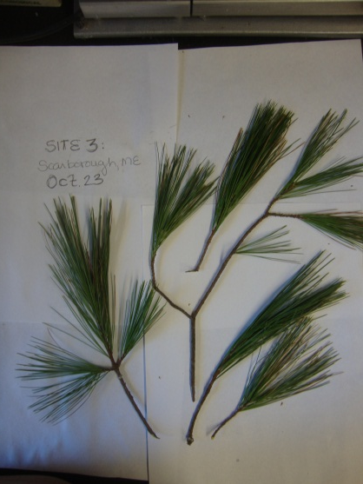
Biometric Analysis
of Forest Watch Data
Student Biometric Data: 15 Schools, 74 trees, 145 samples of fresh needles, 7,958 needles, 1,508 calculations.

Slide 16
Long Term Health Improves

Slide 17
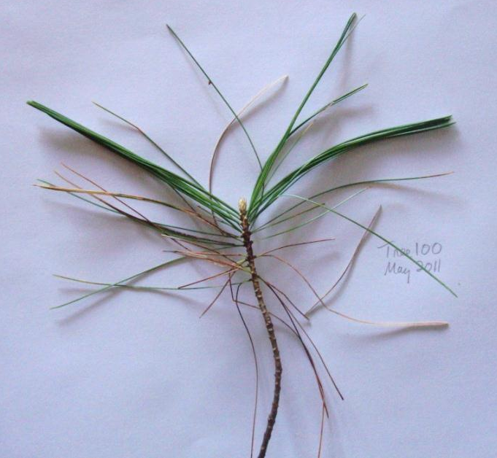
Biometric News: Needle Retention Fell
1st Time in 20 Years
Where did the 2nd-year needles go?
Was it ozone? PAN? Whatever it was, you documented it!

Slide 18
AIRMap Recorded Ozone
6 p.m., May 26, 2010
Could PAN have affected the pines?
Could repeated peaks of ozone have damaged the needles?

Slide 19
Biometric News: Our Trees Are Too Tall
No one anticipated Forest Watch would survive so long. We had no protocols for conserving an educational resource, our trees.

Slide 20
Crowded Canopies Cut Growth
Table 4.1
 |  | School #1 | School #2
Gain in Hgt. (m) |  | 9.9 | 7.3
Avg. Hgt. growth (m) |  | 0.58 | 0.41
Growth of Crown (m) |  | 9.9 | -2.1
Change in Crown (%) |  | 91.60% | -25.30%
Gain in DBH (cm) |  | 18.28 | 12.8
Avg. DBH growth (cm) |  | 1.08 | 0.85
Trees in an open site compared with trees in an unmanaged forest.

Slide 21
New Frontiers in Student Research
Concord High School AP Calculus students tackle statistics with FW data

Slide 22
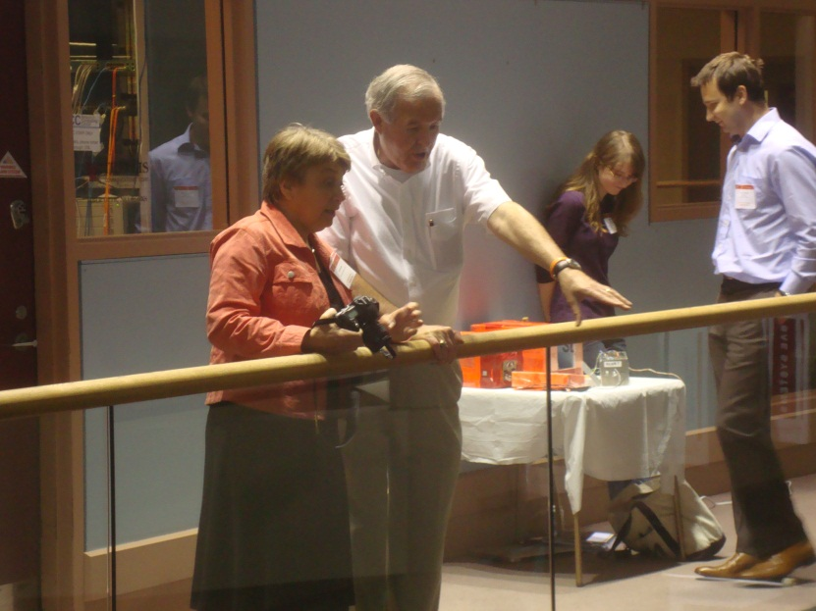
Gilmanton 7th Graders Explore Data Analyses
Four teams present research at first Forest Watch Student Convention

Slide 23
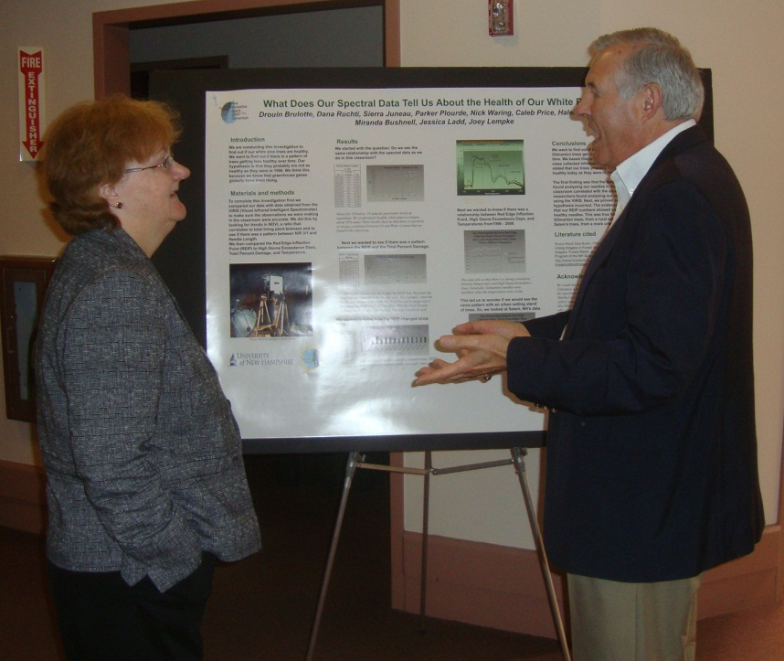
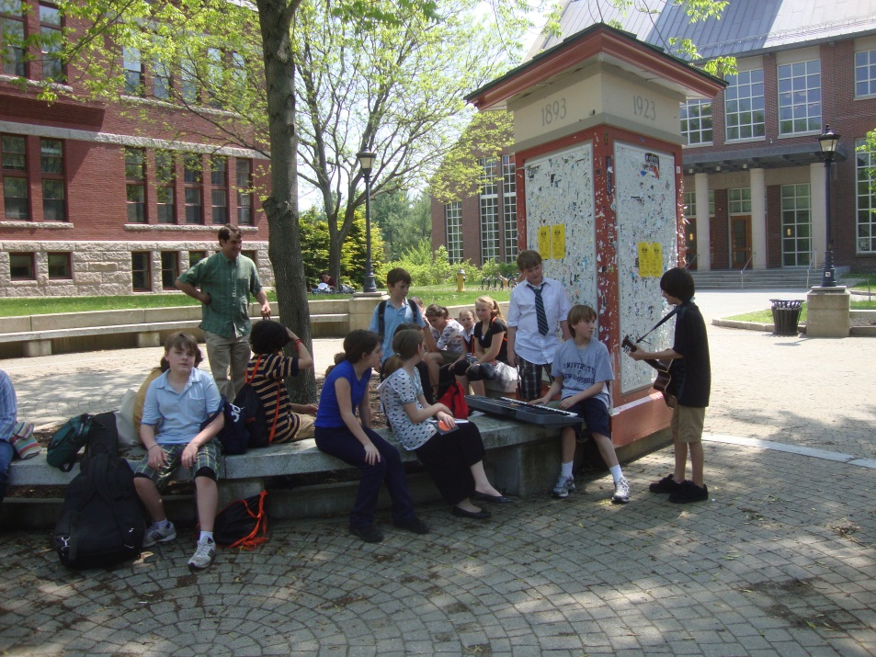
May 25, 2nd Student Convention
Posters
Research Presentations
Visits to UNH

Slide 24
Why Are We
Studying This?
Oliver Morton says, “The tree’s form tells the truth. The tree grows into the air because it grows out of the air.”

Slide 25
Students & Scientists Working Together
Determining the Health of New England Forests
Dr. Barrett Rock, & Michael Gagnon
Complex Systems Research Center
University of New Hampshire
Durham, NH 03824
Phone: 603-862- 4113
Fax: 603-862-0188
barry.rock@unh.edu
martha.carlson@unh.edu
forestwatch@unh.edu

Slide 26
Gary N. Lauten Award 2011
Louise James
Sewall Anderson School
Lynn, Massachusetts

Slide 27
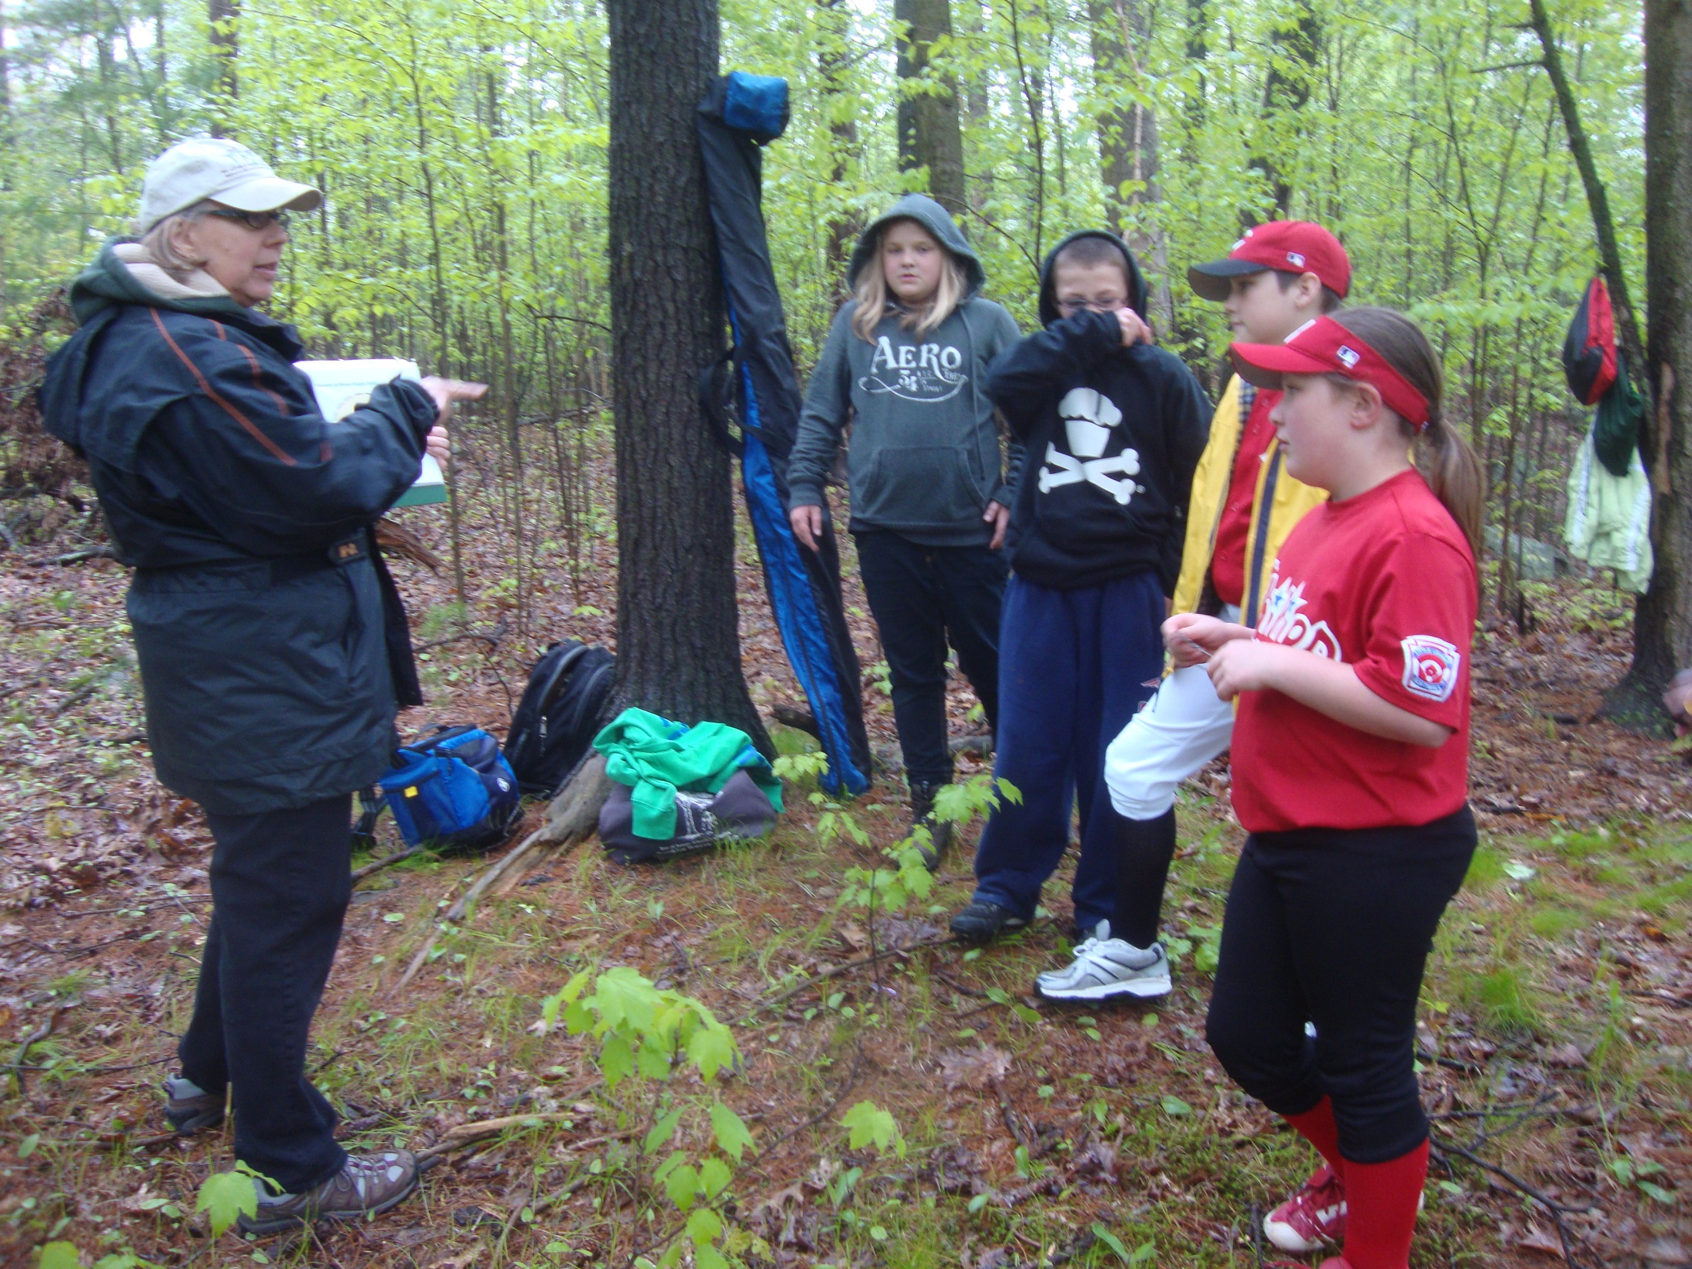

Slide 28


Slide 29
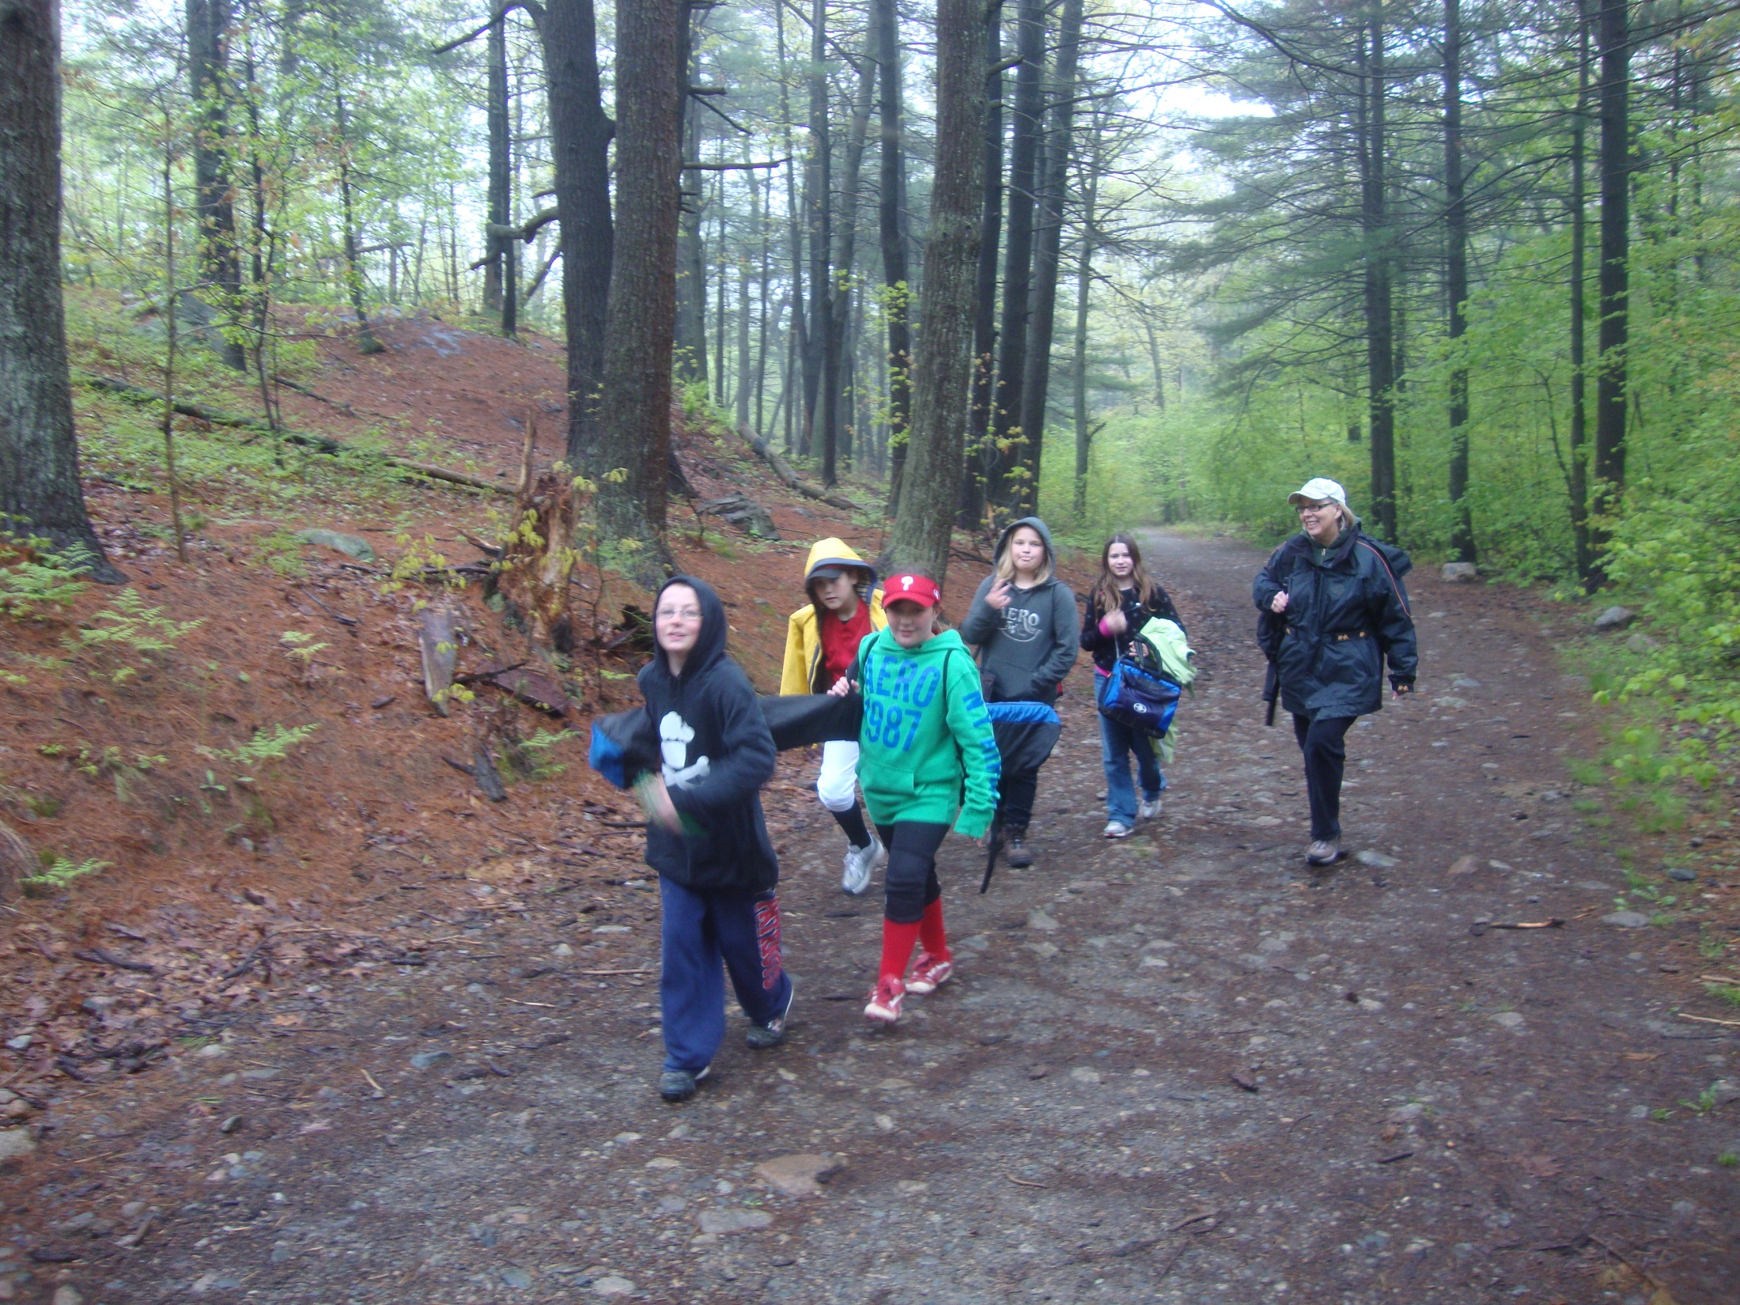

Slide 30
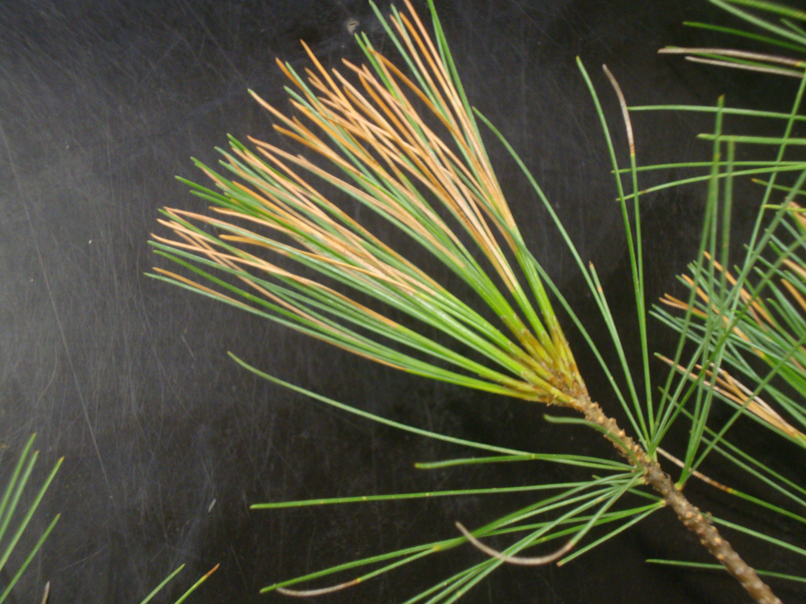
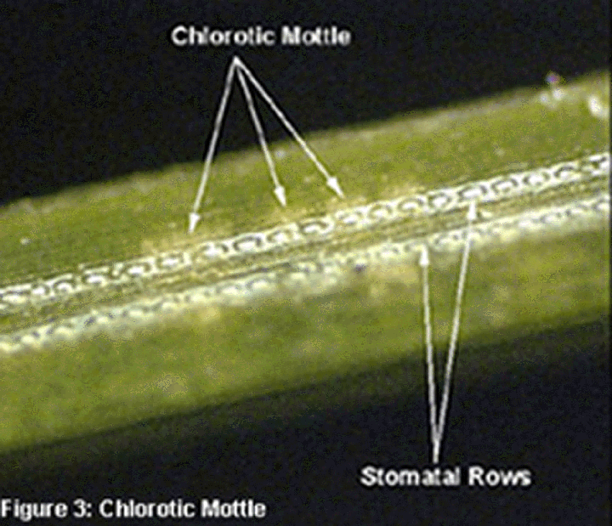
Query #1 for 2012 Studies
If ozone is happening in fall, winter, spring, could a school monitor needle damage?
Monthly?
AIRMap and EPA AirNow offer daily statistics.

Slide 31
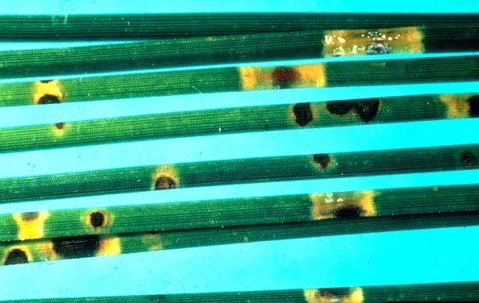
Query #2: Can We Solve the Mystery of Lost Needles?
Figure 29: Percent of white pine needles with presence of both symptoms,
(chlorotic mottle & tip necrosis) 1996-2008.
As we collect 2011 needles, can we look at damage to 2010 and 2009 needles? What evidence would we look for to confirm an atmospheric pollutant as our culprit?
How will we prove it was not a fungus?
Figure 8.2: A close-up of damage caused by Scirrhia acicola shows chlorotic mottling similar to ozone damage.

Slide 32
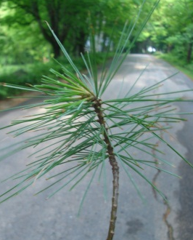
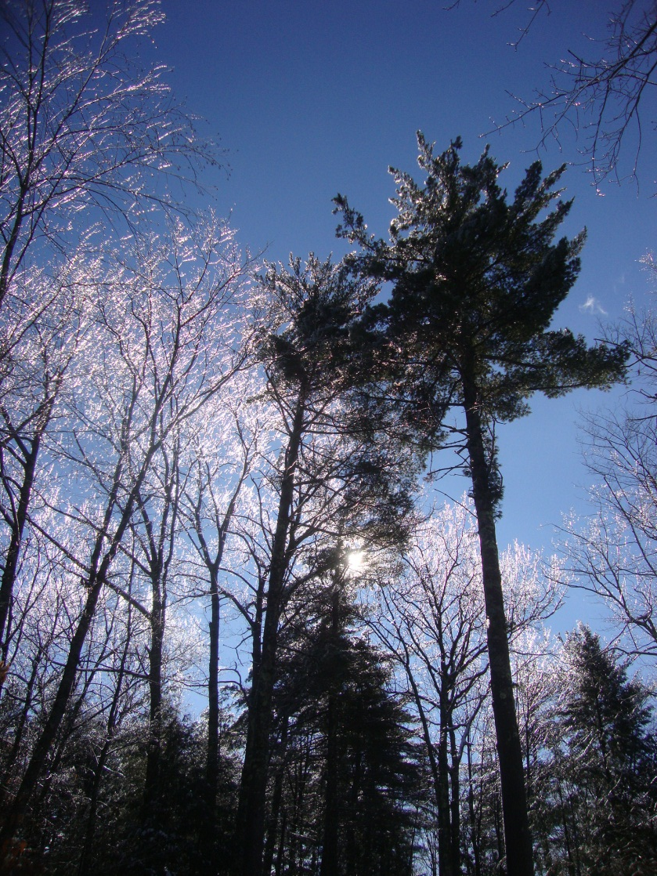
Selecting New Trees
Will young trees’ needles be the same as older trees?
Can students help select—edge trees? Lawn trees? Forest trees? How will each change with time?

Slide 33
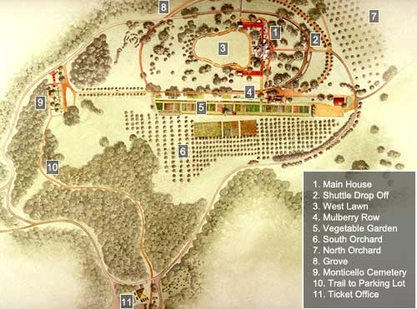
Long Term Plans for School Trees
Could students advocate for campus management of a forest educational resource, a school arboretum?

