Slide 1

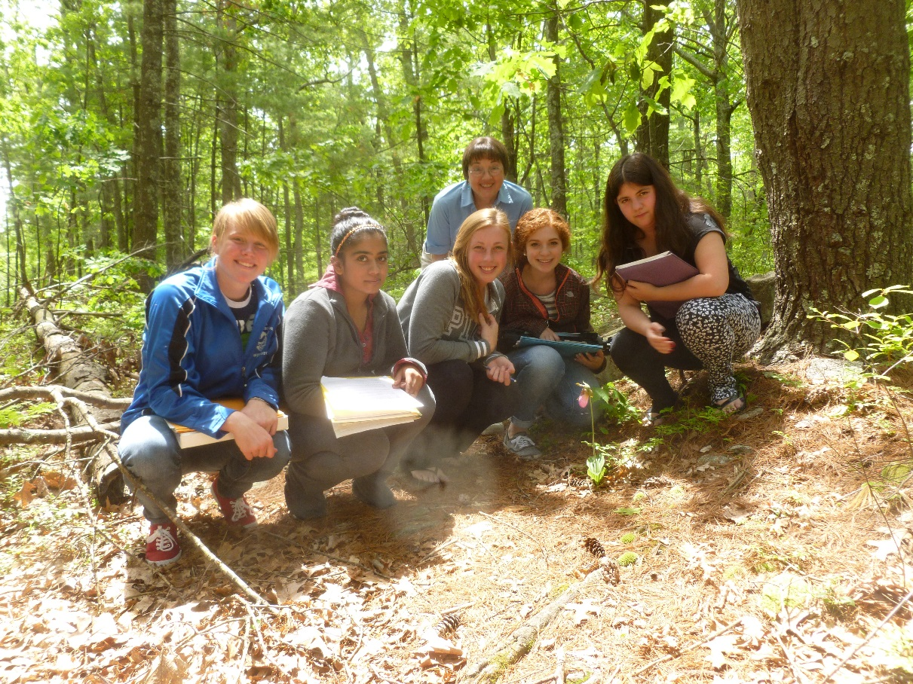
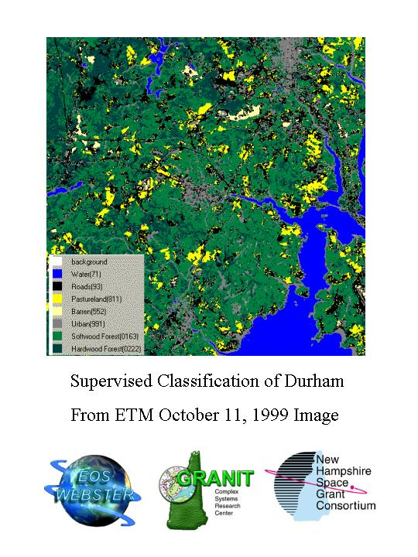
2012-2013 Forest Watch
Data Book Review & Discussion
Students & Scientists Working Together
Determining the Health of New England Forests
New Questions

Slide 2
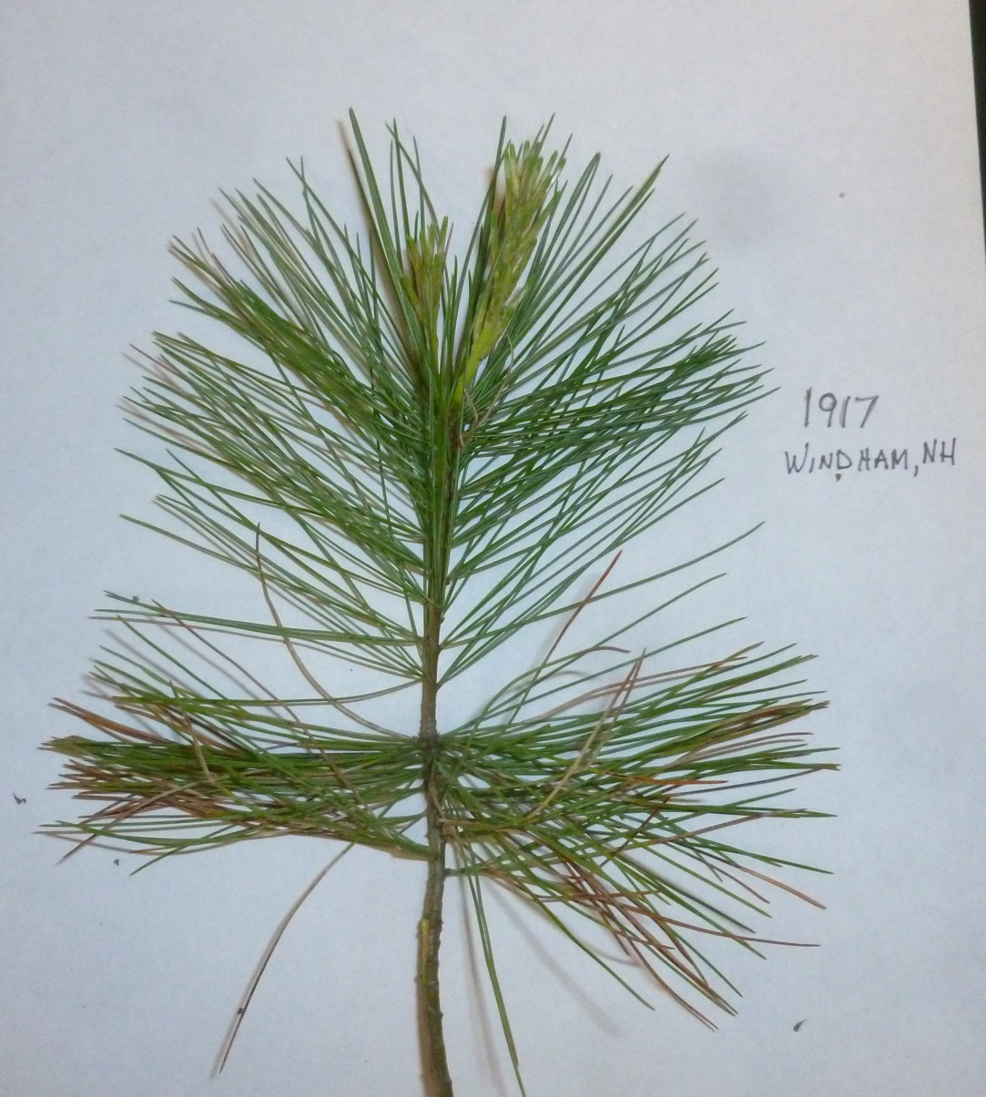
This Year’s White Pine News
Needle Retention
It’s back almost to 2.0
Ozone summary for 2012-2013
Spectral & Biometric Data Analysis
Common Core Standards
Forest Watch Activities

Slide 3
Recovery Underway
Figure 4.1. Needle retention returned to 2.08 years in 2012-2013, a strong indication that the white pines are recovering from the stress of 2010.
Needle retention averaged almost 2.1 years in 2012-2013, a big jump over 2010-2011 and an improvement on 2011-2012.

Slide 4
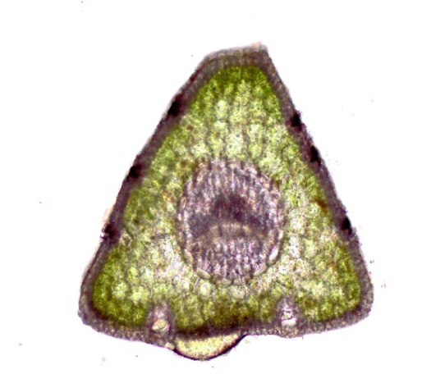
Record Needle Length
12.5% greater length than historic average = more photosynthetic equipment. Is this a response to 2010 stress?
Figure 4.4. Needles were, on average, 12.5% longer in 2012 than in any previous year, another indication trees are rebounding from the 2010 shock and perhaps compensating for lost older needles.

Slide 5
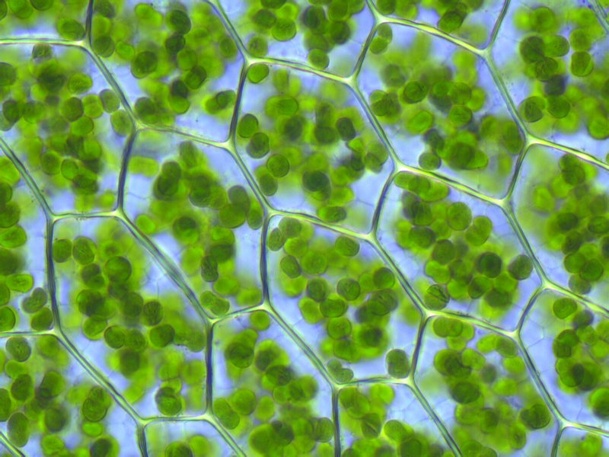
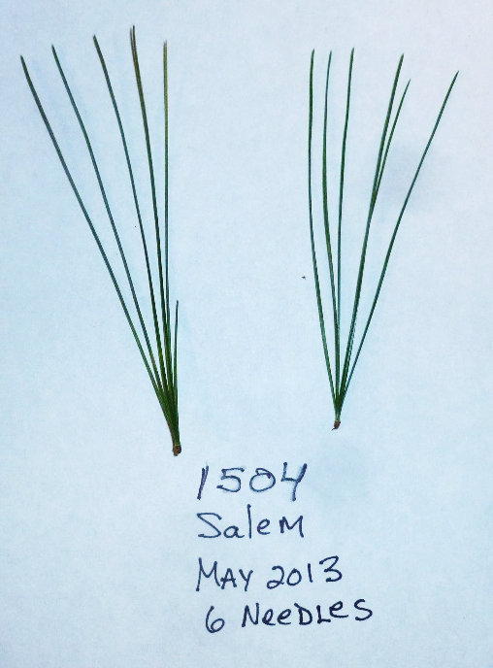
White Pine Math for Wizards
David Lawlor, a photosynthesis expert, estimates that a square meter of leaf might contain 7x10^9 mesophyll cells.
There are 1,000,000 mm^2 in 1 m^2.
So 1 mm^2 would contain 7,000 mesophyll cells.
1 mesophyll cell may contain ~50 chloroplasts
1 chloroplast may contain 6.7 x 10^8 chlorophyll molecules!
So if the white pine lengthens its needle by 12.5%, how much more chlorophyll will it have?

Slide 6
Record Low damage
Students evaluated 7,600 needles and found that 2.5 mm was the average length of needle showing either tip necrosis or chlorotic mottle.
Average total damage (damage in mm/average length in mm) was also at a record low, 2.9%.
Were the pines producing more protective phenolics?

Slide 7
Improved NIR3/1 Ratio – Less premature aging
More time to make sugar.

Slide 8
No water stress
The VIRIS index of TM 5/4, an indicator of water stress, showed a significant drop. Water content tests found a record >55%.
Student tests of water content confirm VIRIS index.
Figure 4.5. Water content returned to record high levels in 2012 needles.

Slide 10


Ozone and REIP Connections
29 exceedances in 2012 in New England up from 16 in 2011 of the 75 ppb level.
Average REIP was 723.1 in 110 trees from 19 schools.
Figure 3.3. A close-up view of visible light and the edge of the near infrared plateau help to explain the Red Edge Inflection Point. Notice that the reflectance curve for Tree 1971 is deeper in visible red, showing more chlorophyll and farther to the right on the slope. It has more chlorophyll.
Figure 2.3. Ozone is a secondary pollutant formed in the atmosphere when reactive nitrogen gases meet and react with volatile organic gases. The reaction requires high heat and bright sunlight.

Slide 11

Expand the Ozone Transport Region?
Courtesy, NH DES.
Eight New England and Mid-Atlantic governors petition EPA to add nine Mid-West States to the OTR.
90% of NH’s smog comes from out-of-state sources.

Slide 12
NOx Emission Trends in NH
Tons of NOx
Within the OTR, 11 states have worked hard to reduce NOx emissions. Regulations include a wide array of controls on engines and vehicles as well as new options in transportation: commuter car-share, light rail, natural gas taxis.
Thanks to Dr. Jeffrey Underhill, New Hampshire DES—to speak on this at May 30 Student Convention.

Slide 13
Vox Emissions Trends
A long list of volatiles are now controlled in the OTR states: gasoline fumes, paint fumes, production of cement, paint, architectural products, auto repair products, household consumer goods….and more.

Slide 14
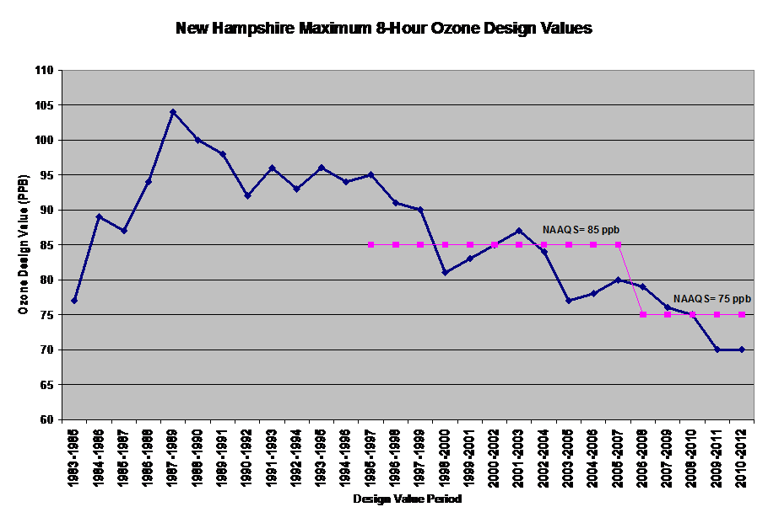
With all of this improvement, why is the Governor worried about ozone?
As ozone levels drop, emission standards have also dropped to more protective levels.
Science is learning more!
The standard may soon drop to 65 ppb. Where will New Hampshire be then?
Where will your state be?

Slide 15
School Data
Spectral Data
Biometric Data
First-Year Needles
And
Second-year Needles.

Slide 16
A Wealth of Data
How are you using this data?
Suggestions?

Slide 17
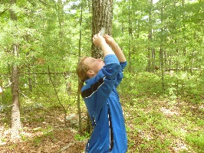
Reminders: Check Students’ math!
3% or 0.03 NOT 0.03%
How do you calculate Mean % of Damage?
Measure # of mm of damage on 30 needles –both chlorosis (usually 1 dot = 1 mm) and tip necrosis. All total mm all 30 needles.
How many mm are there in 30 needles—30 x your avg length
Divide total mm damage/total mm needles.
OR
Calculate Mean Damage in length—above # mm damage for all 30/30.
Divide this mean by mean length of all needles.
Should be same as above method.

Slide 18
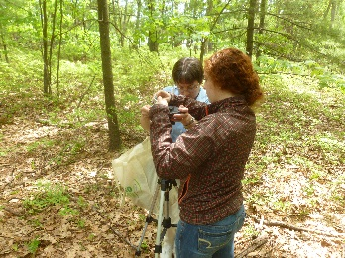
Forest Watch meets the need…
“Students need to realize how the scientific processes are used to acquire new knowledge. The best way for them to do this is to spend time using scientific inquiry, experimentation, discussing data, drawing inferences based on data, and writing conclusions based on evidence.” NH Department of Education, What is Science?, Introduction to NH K-12 Framework for Science Literacyhttp://education.nh.gov/instruction/curriculum/science/index.htm

Slide 19
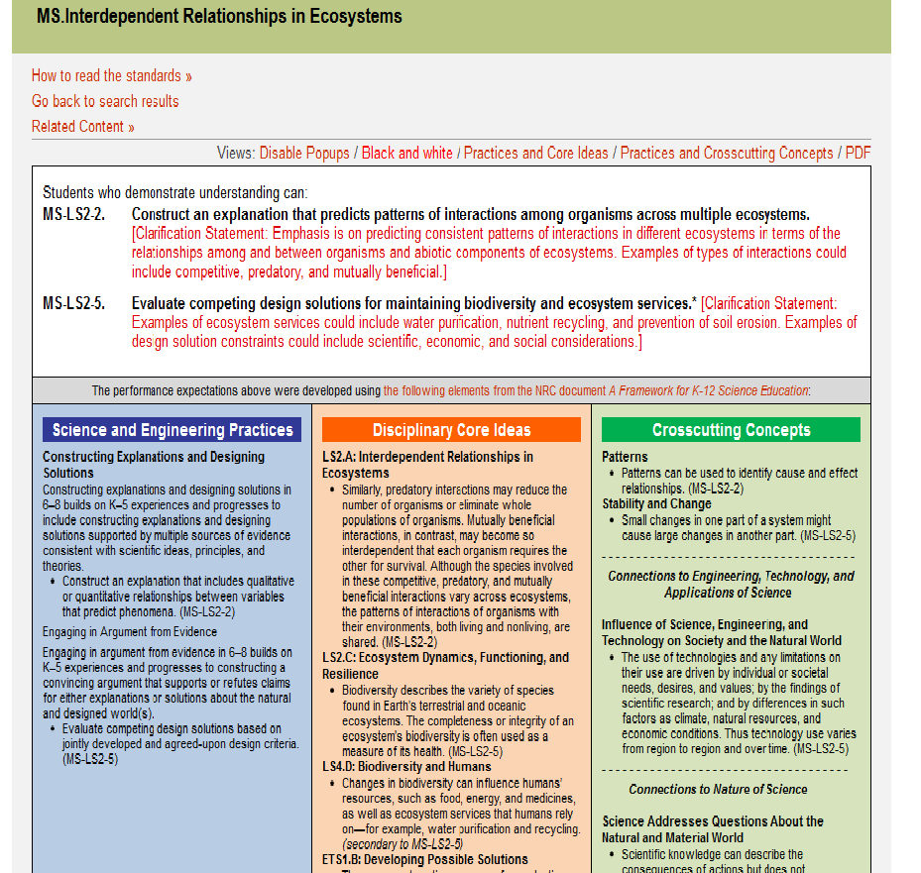
Next Generation Science Standards
Increased literacy standards
Increased mathematical standards
Science, Technology and Society
Civics and Contemporary Issues
Forest Watch could easily adapt many of our writings to grade appropriate readings for language arts readings and writing prompts.
Teachers may already be doing this—especially in middle school team teaching situations.
Could we post these readings for sharing on our web site?
Could we sell them like I-tunes so that contributors would earn something?

Slide 20
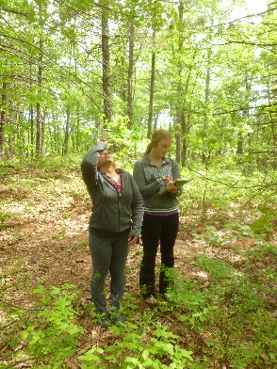
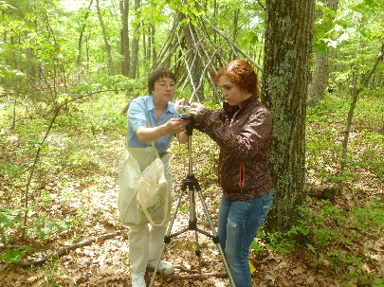
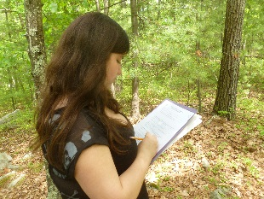
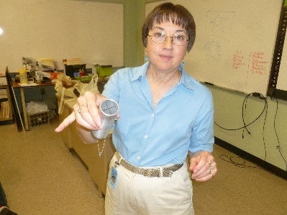
More School Visits
Norma Bursaw, veteran Forest Watch teacher, Salem High School, and a steel canopy closure tube made for her by her husband.
Notes:
In 2012-2013, we made more school visits to new schools and to visit veteran teachers like Norma Bursaw.
The visits introduce UNH to clever new ideas like Norma’s steel canopy closure tube as well as the state of high school laboratories today, teachers’ needs and ideas, new technology directions and curricular issues.
At new schools, we can help teachers and students identify good study sites, tag good trees for study and see other research potential in their school yard study areas. Sometimes, the lesson is about wearing sneakers or giving kids time to get comfortable in the out-of-doors.

Slide 21
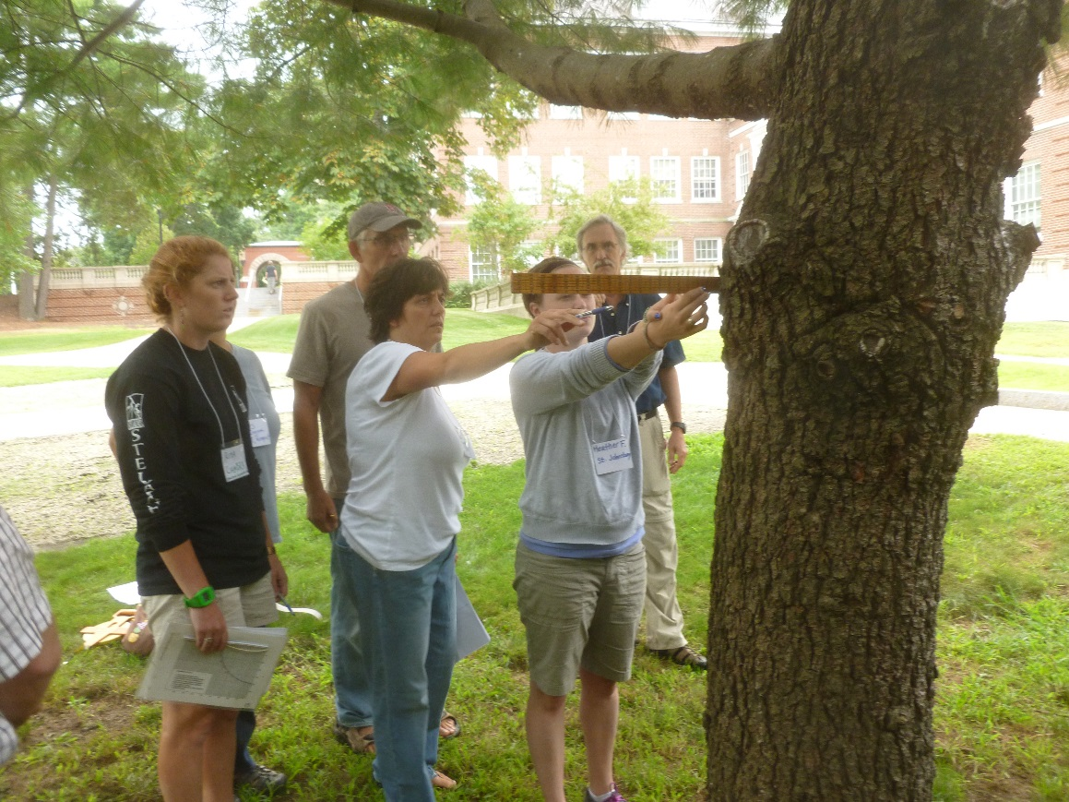
Enrichment Day 2013
Teachers just learning about Forest Watch learn how to measure the diameter at breast height of a tree (dbh) as veterans Wes Blauss and Robert Schongalla look on. Conducted on the Great Lawn at UNH, the activity gave teachers time to discuss technique, accuracy, metric versus English. Veteran teachers offer vital tips on issues such as outdoor classroom management, time management, and record keeping.
Join us for another FREE Teacher Enrichment Day on August 14, 9 a.m. to 3 p.m. Register by emailing us at www.forestwatch.sr.unh.edu.

Slide 22
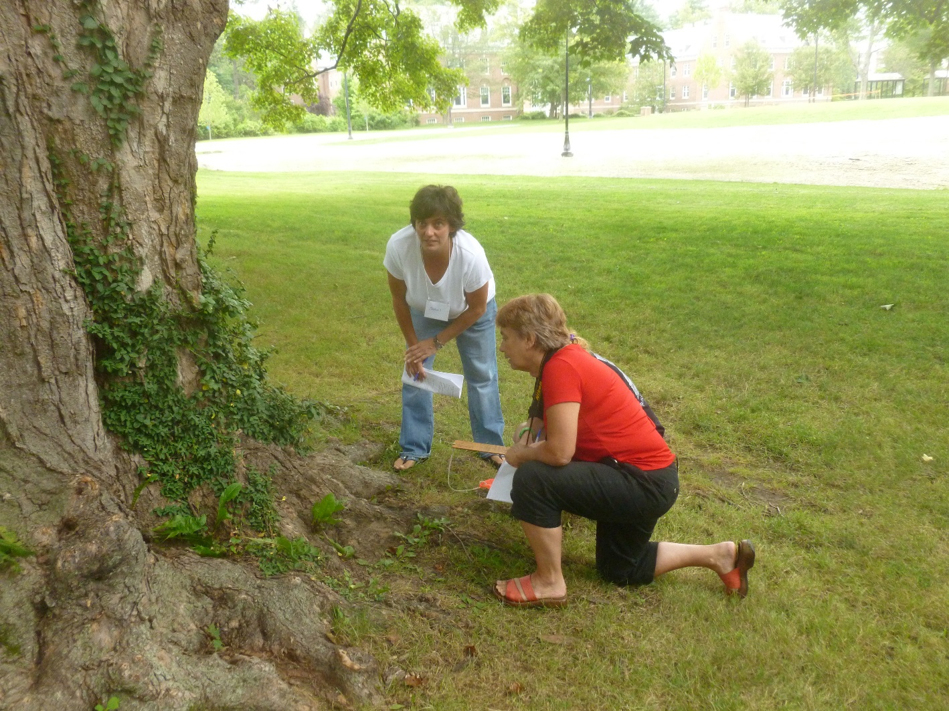
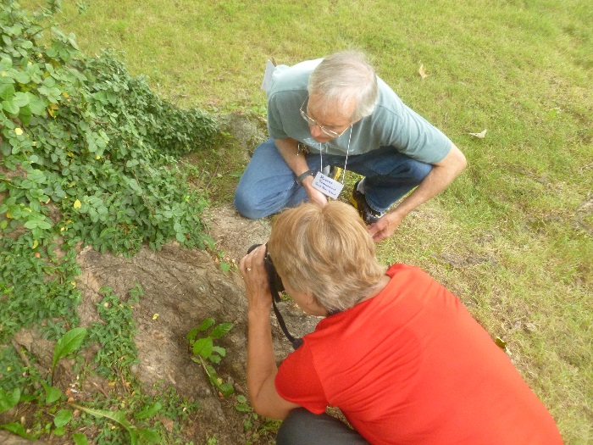
Expecting the Unexpected
Teachers Shani Scarponi and Robert Schongalla joined Kristi Donahue, EOS photographer, in examining a cicada they found crawling up a sugar maple on the Great Lawn. Every field expedition needs to take time to observe, record and consider the unexpected.
A workshop for new Forest Watch teachers will be held August 11-13 at UNH. Ask for more information at www.forestwatch.sr.unh.edu.

Slide 23
Landsat 8
New bands
Higher resolution
New views of shallow waters and your school.
Forest Watch school study plots are 30 x 30 meters square, just the size of a Landsat pixel.
This image shows the Plymouth Bay area in Massachusetts, home of Hanson Middle School, Hanson, MA.

Slide 24
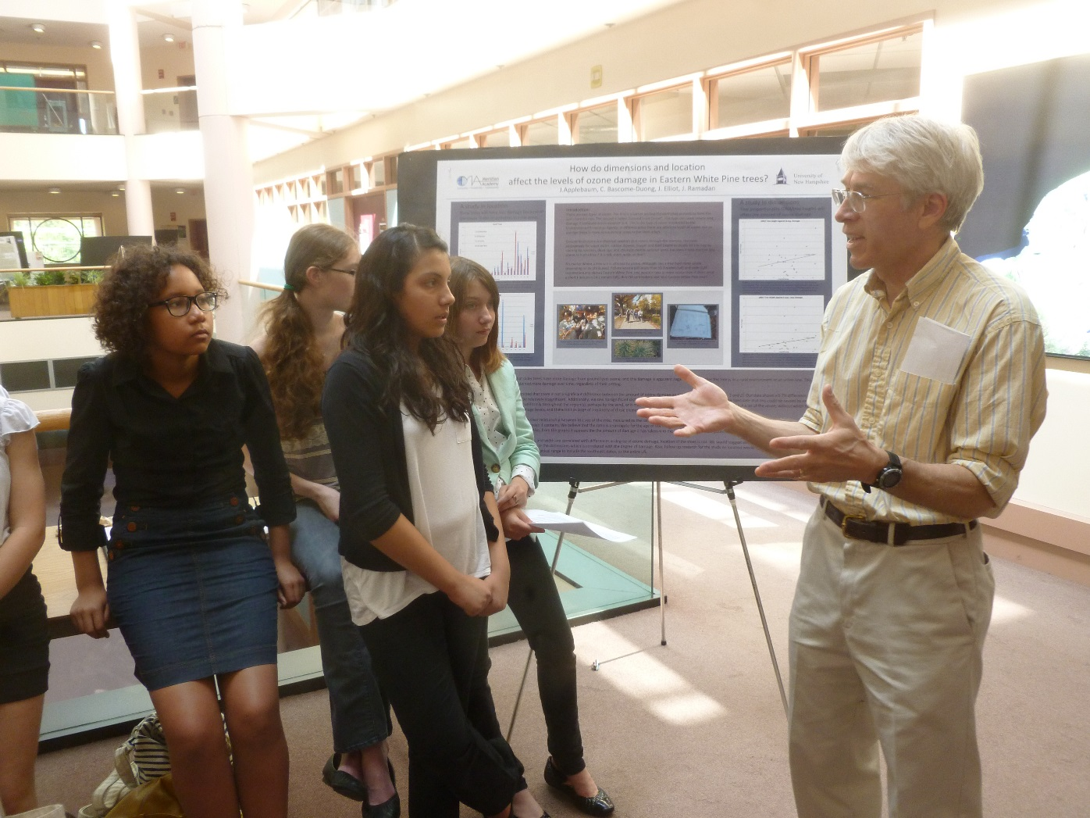
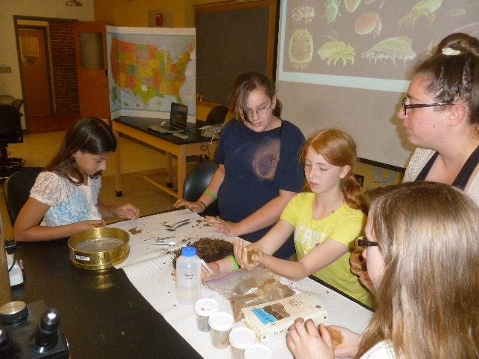
Student Convention 2013
Students from Meridian Academy talk with Dr. Mark Popecki about scientific research. Dr. P. does cosmic cloud research. Meridian students compared their data from 5 trees in Brookline, MA, with data from other schools in rural New England.
The 2014 Student Convention will be held May 30. Register now for your school trip.
Students from Bartlett, NH, visited a soils lab to find out what microganisms live with their sugar maples and pines.

Slide 25
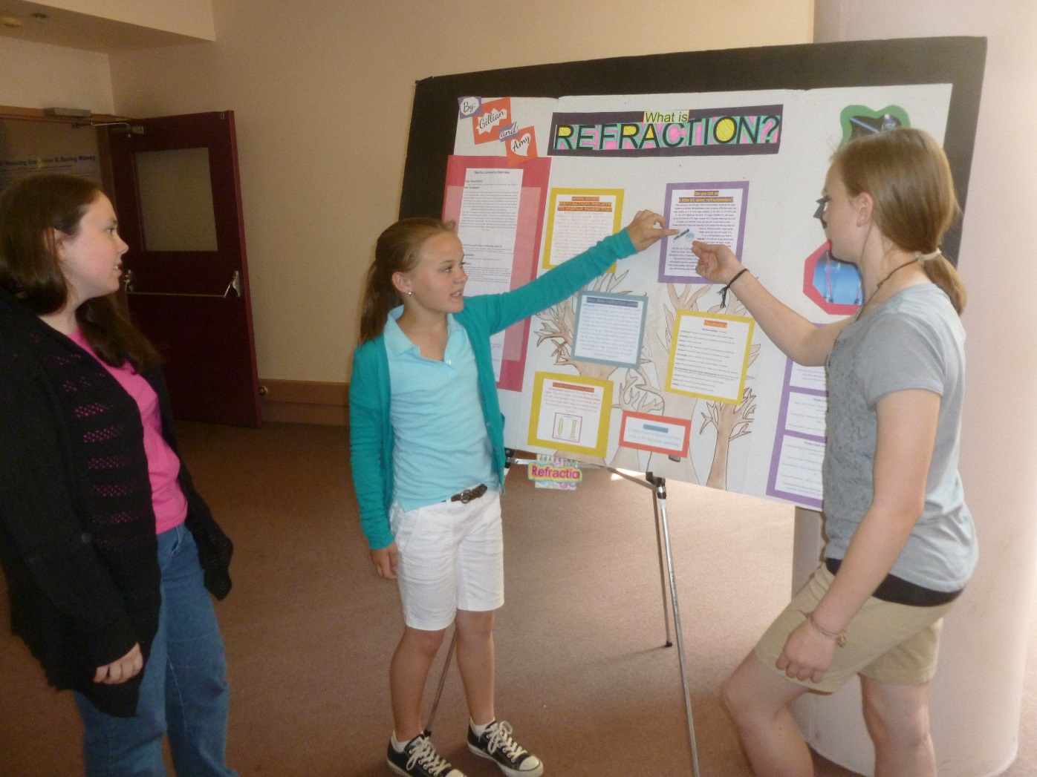
Student Convention
Students from Gilmanton School explain their analysis of white pine data to an EOS research scientist.
The Convention adds a final step to Forest Watch protocols—It gives students the opportunity to contemplate their findings, to analyze the meaning of their research, to sift and organize key findings, and to communicate those discoveries and ideas to thoughtful listeners.

Slide 26
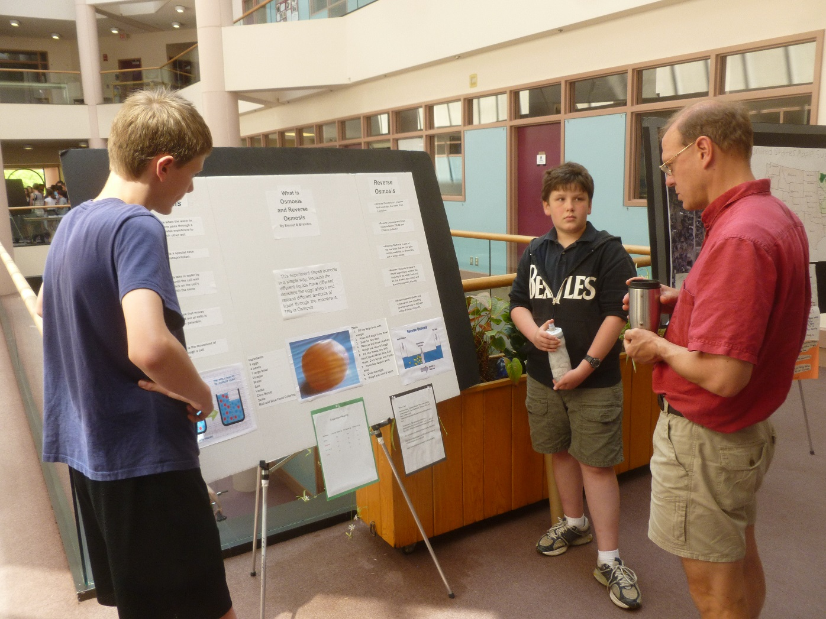
Student Convention
Students from the Josiah Bartlett School, Bartlett, NH, chat about their classic experiment: dissolve the egg shell but not the egg. Such experiments take on a whole new depth of meaning when students can discuss their method and findings with a real scientist like Dr. Erik Hobbie.

Slide 27
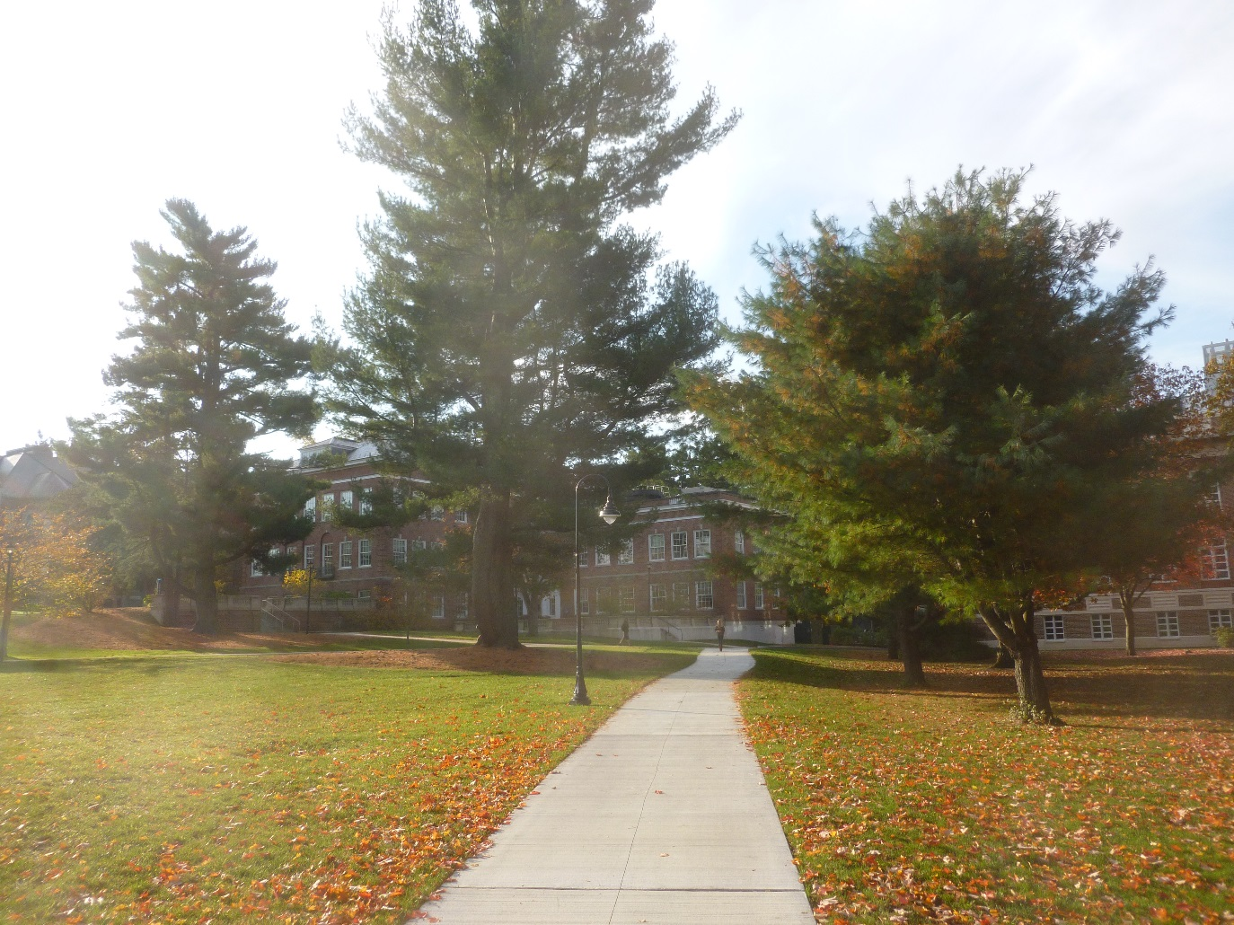
What’s Next?
Student Convention May 30
More School Visits
Summer Workshops for New teachers
Enrichment for All Teachers

Slide 28
Gary N. Lauten Memorial Award
2014 Gary N. Lauten Memorial Award – Frank Schmidt, RHAM High School, Hebron, CT, and Otto Wurzburg, St. Johnsbury School, St. Johnsbury, VT.
2013 Gary N. Lauten Memorial Award – Wes Blauss, Hanson Middle
2012 Gary N. lauten Memorial Award walking stick – Dr. Barry Rock
2011 Gary N. Lauten Memorial Award – Louise James
2010 Gary N. Lauten Memorial Award – Mike Gagnon
2009 Gary N. Lauten Memorial Award – Norma Bursaw
2008 Gary N. Lauten Memorial Award – Brian Doyle
2007 Gary N. Lauten Memorial Award – Robert Schongala
2006 Gary N. Lauten Memorial Award – Nancy Chesley
2005 Gary N. Lauten Memorial Award – Mary Fougere
2004 Gary N. Lauten Memorial Award – Phil Browne
2003 Gary N. Lauten Memorial Award – Bob Dyer
2002 Gary N. Lauten Memorial Award – Anne LaCroix

Slide 29
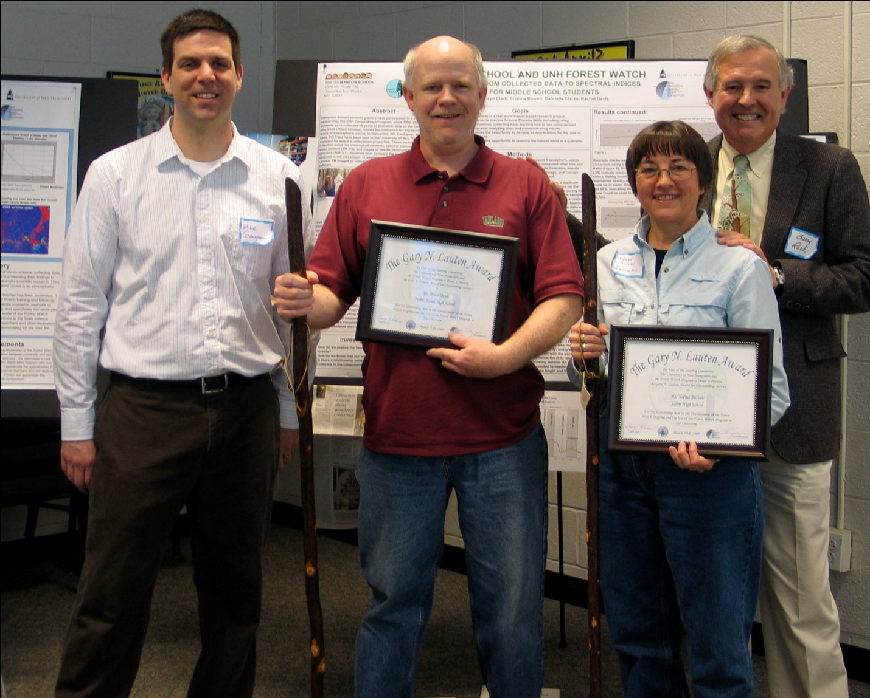
Brian Doyle and Norma Bursaw with Mike Gagnon and Barry Rock

Slide 30
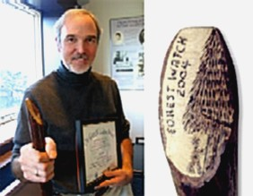
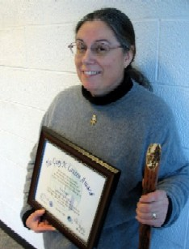
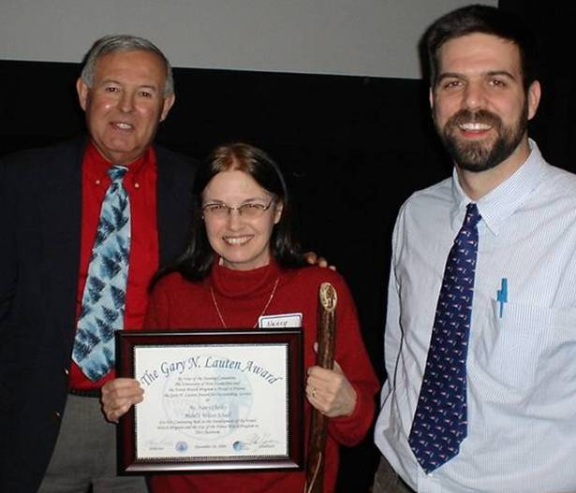
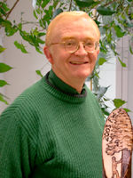
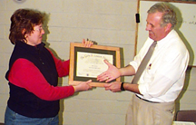
Clockwise from top left, Phil Browne, Nancy Chesley with Barry Rock and Mike Gagnon, Mary Fougere, Anna Croix with Dr. Rock, and Bob Dyer.

Slide 31
2014 Gary N. Lauten Award Winners
Frank Schmidt
RHAM High School
Since 1997
Ten trees!
Otto Wurzburg
St. Johnsbury School
Since 1997
Ten trees!

